Slide 1
Stakeholder perceptions of outstanding leadership in schools and colleges in England
Professor Jaswinder K Dhillon, Dr Colin Howard, Mrs Vivian Cooke, Mr Tom Whittingham, (University of Worcester) Ms Jayne Holt (Walsall College) and Mr Russell Goffe-Wood (Mortar Board Digital)
Contact : j.dhillon@worc.ac.uk

Slide 2
Project aims
Presentation reports on findings from a BELMAS funded research and development project, Sept 2016-Sept 2017
Aims :
to investigate the characteristics of outstanding leadership in different educational contexts:
schools (primary and secondary)
colleges (post-16 education providers)
rural and urban locations
to involve collaboration between school and college leaders, governing bodies and academics

Slide 3
Theory, research and literature
Democratic and distributed leadership
Alliances, collaborations and partnerships
Day et al (2010) eight dimensions of successful leadership
Barber et al (2010) list of practices derived from a review of education systems across eight countries
Features of leadership (Bush 2008, NCSL 2007)
Tamkin et al 2010 three principles of outstanding leadership from research with high performing business and commercial organisations

Slide 4
Methodology
Research position – how and why questions not just what works in leadership practice in different contexts
Development of research and phases of investigation (Dhillon 2016)
BELMAS funded phase:
Q-methodology applied to study of enacted leadership practice in different educational contexts
PQ software for data analysis
emerging findings from on-going analysis.

Slide 5
Sampling
Stakeholder perceptions sampled in the project:
School and college leaders
Governors of schools and colleges
Middle leaders
Teachers and lecturers
Teacher educators
Academic researchers and scholars in educational leadership and management research and practice

Slide 6
The Statements
Clear strategic vision communicated effectively to others
Passion for providing world class education
Balancing financial constraints with aspirational educational ambitions
Strategic vision based on shared values
Inspirational leader who leads by example
Engaging local community in a shared vision for education in the area
High levels of trust between leaders and their stakeholders
Ability to bring out the best in people and inspire others
Maximising talent and deploying it effectively in the organisation
Power and accountability shared and distributed
Ability to foster discussion and debate
Develop entrepreneurial innovative approaches to improve education
High expectations of all members of staff and pupils
An open culture of learning where excellence achievement celebrated
Developing an aspirational culture in the school and local community
Foster collaboration, partnerships and shared decision-making
Values and vision developed and owned by all staff and governors
Setting ambitious targets and focus on financial educational goals
Empowering others to achieve ambitious targets
Meticulous monitoring of outcomes for pupils/learners
Reconciling opposing points of view and summarising agreed points
Taking decisive action to address poor performance of staff
Taking difficult decisions and communicating them honestly

Slide 7
Data Collected
67 participants broken down as follows:

Slide 8
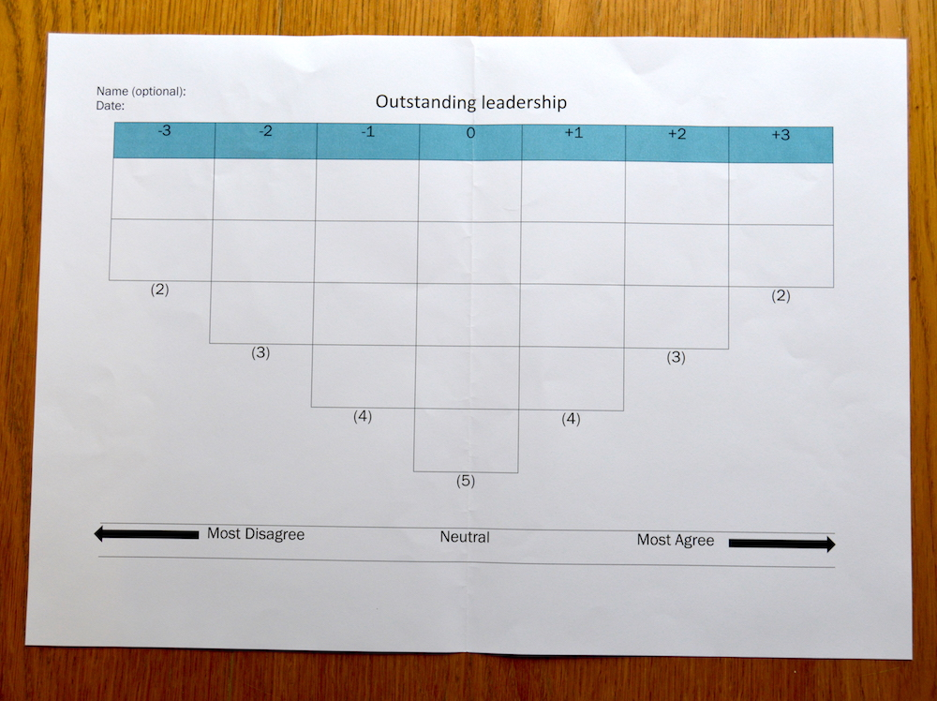
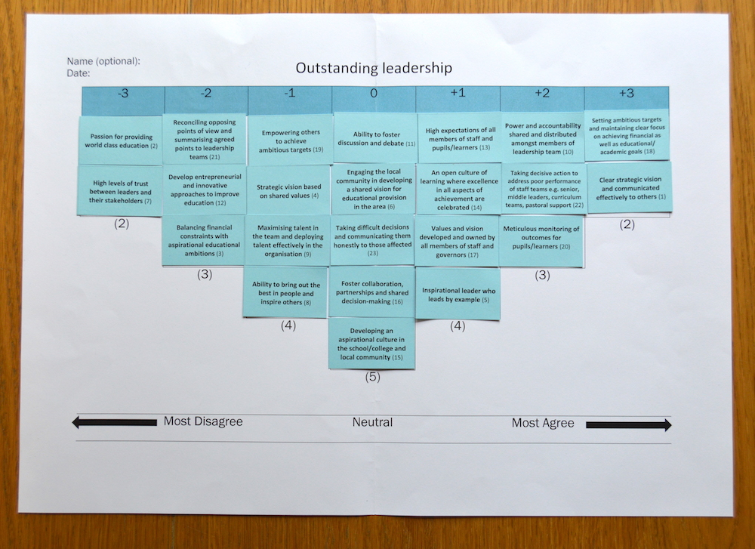
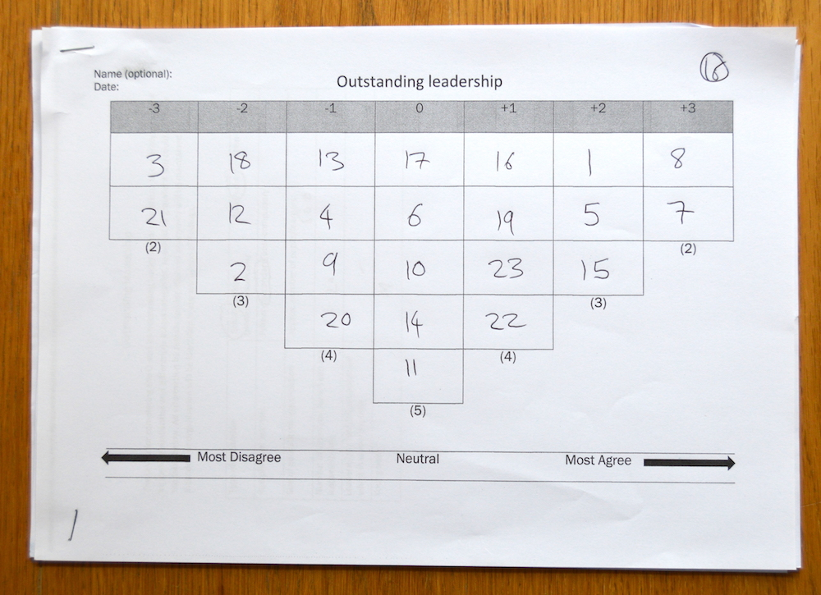
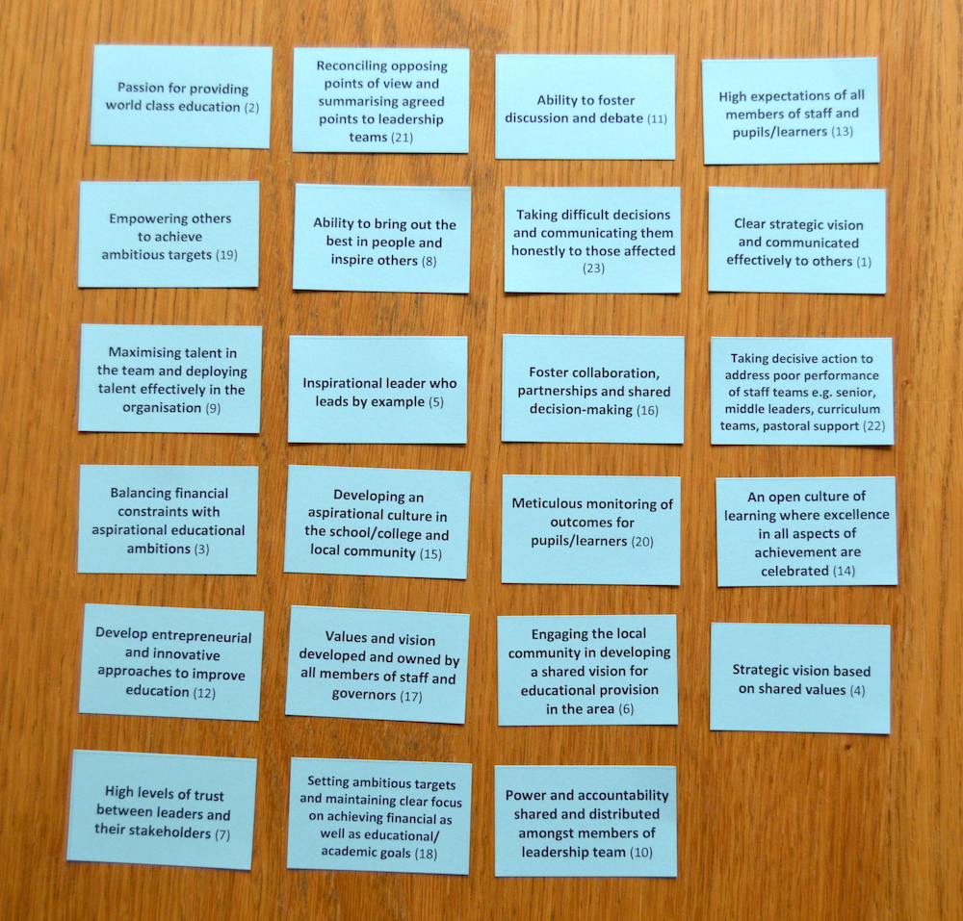
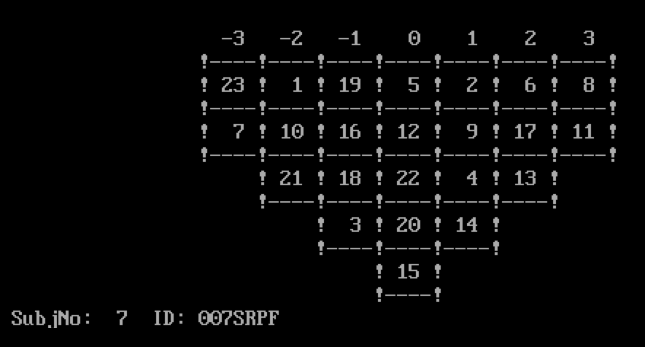
Q Sort Evolution

Slide 9
Coding the Sorts
001 S U S M
Sort ID
School/
College
Urban/
Rural
Primary/
Secondary/
Post-Compulsory (C)
Male/
Female

Slide 10
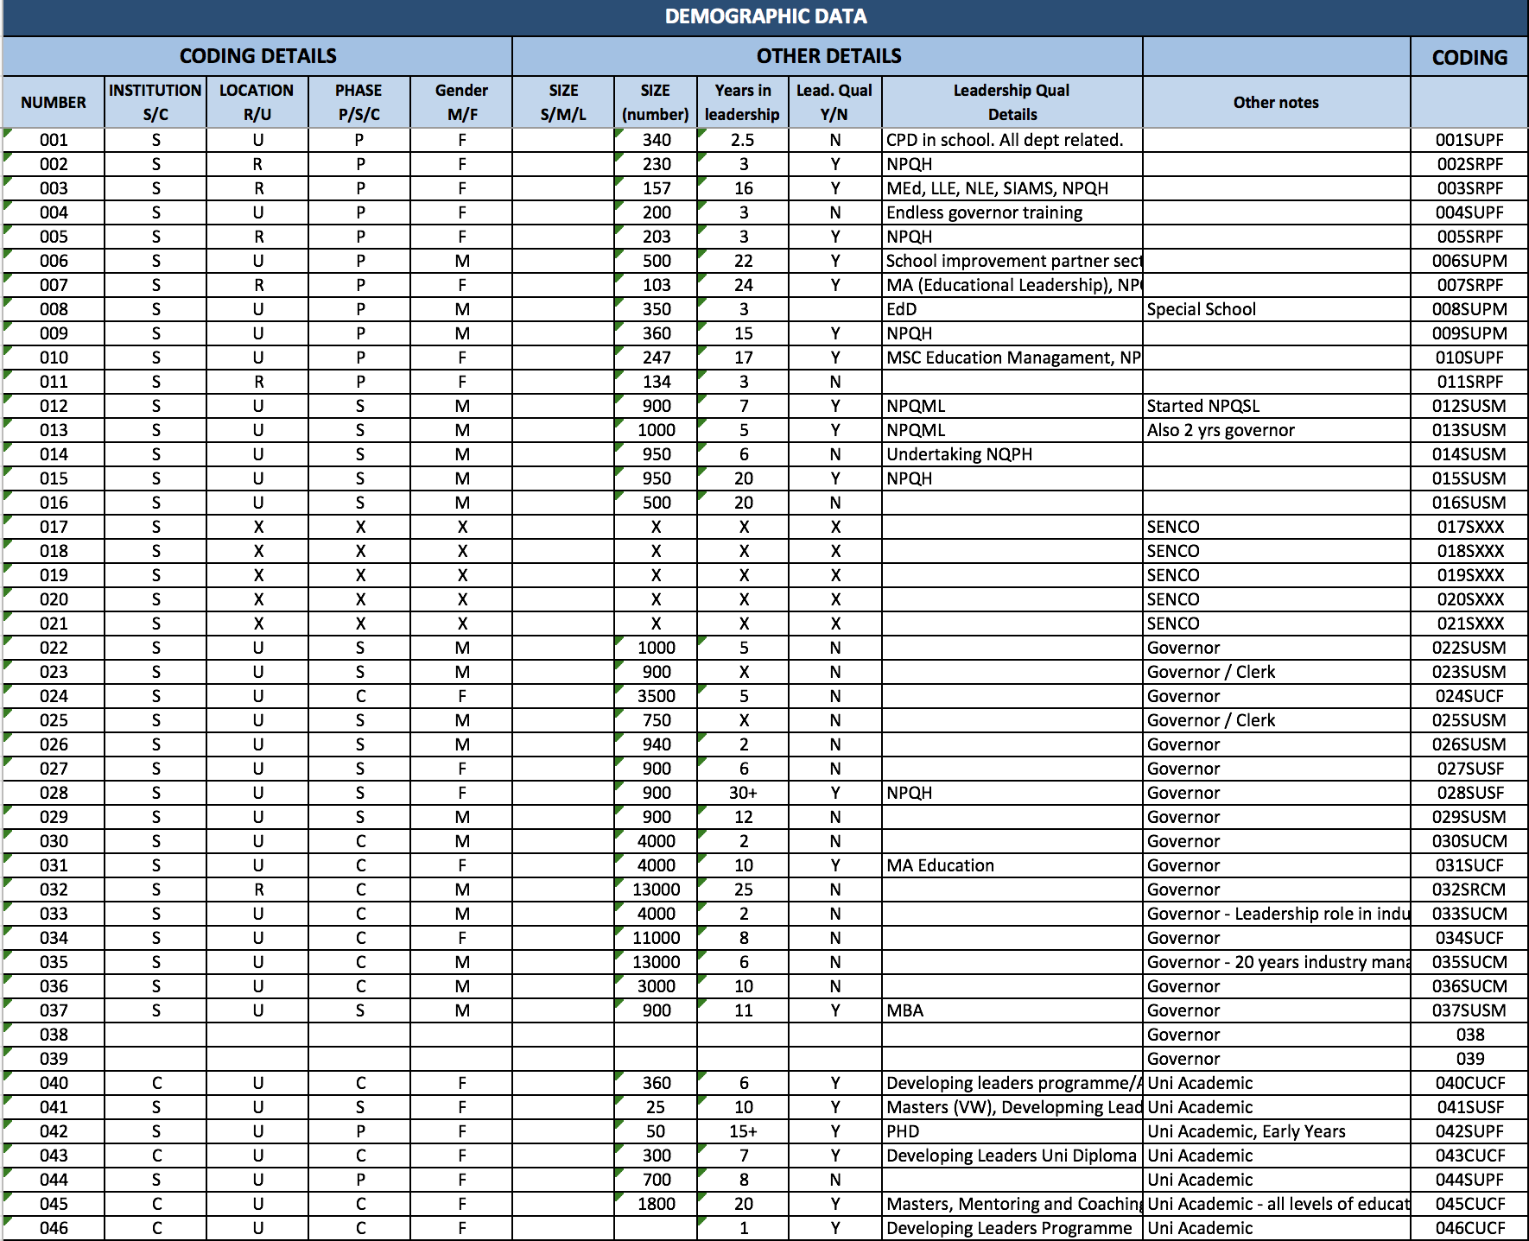
Sorting/storing the data

Slide 11
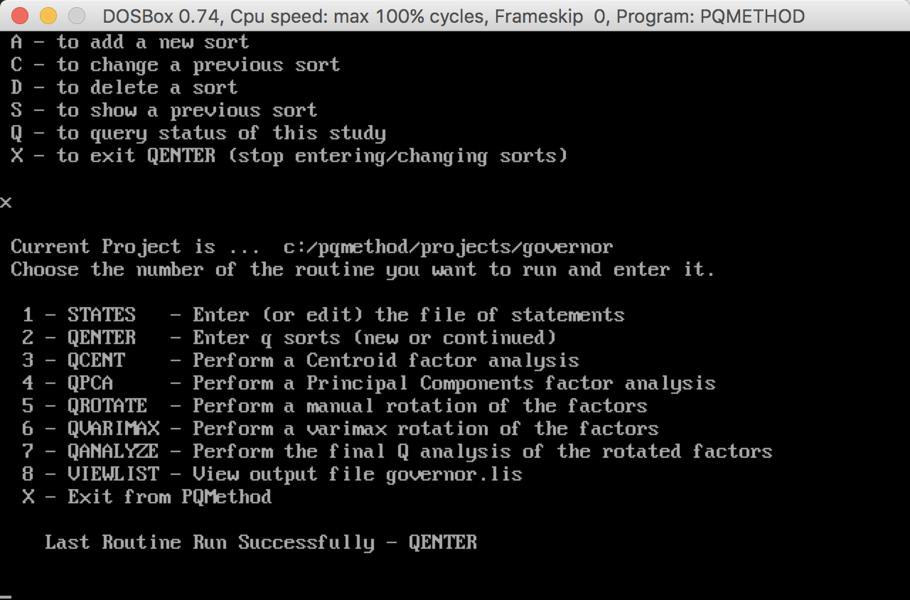
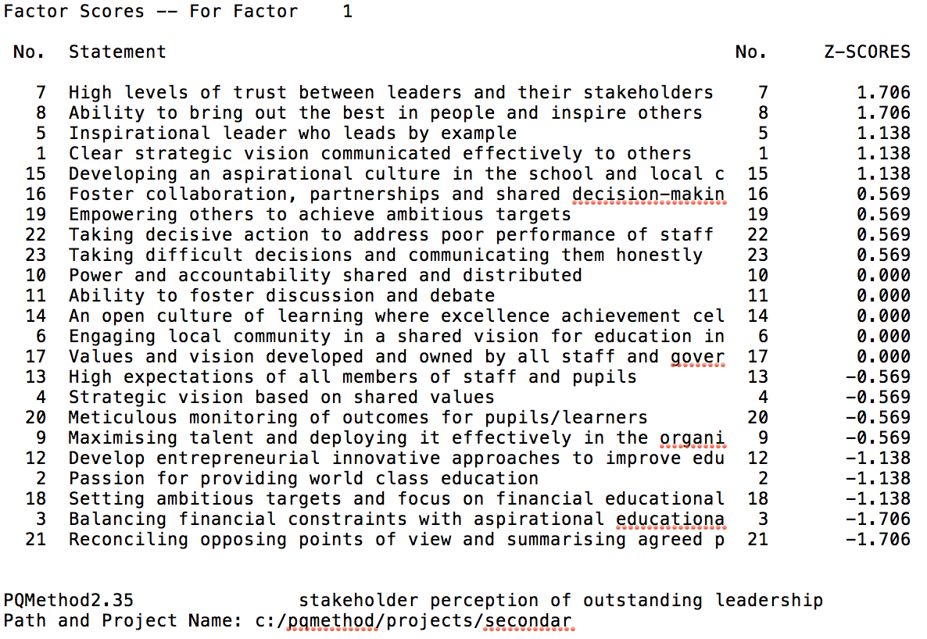
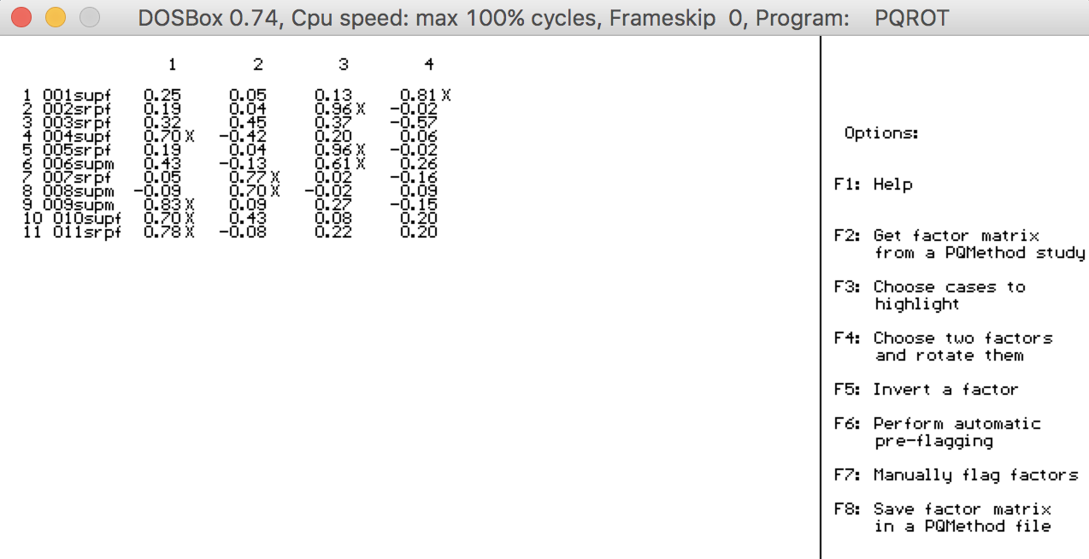
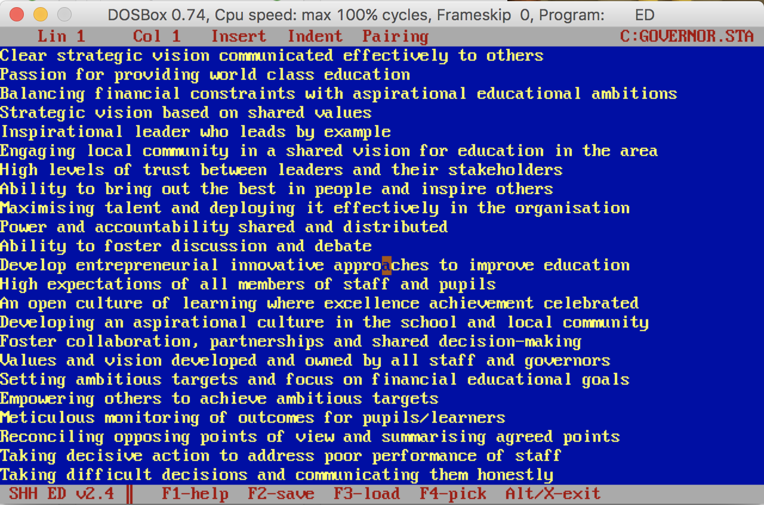
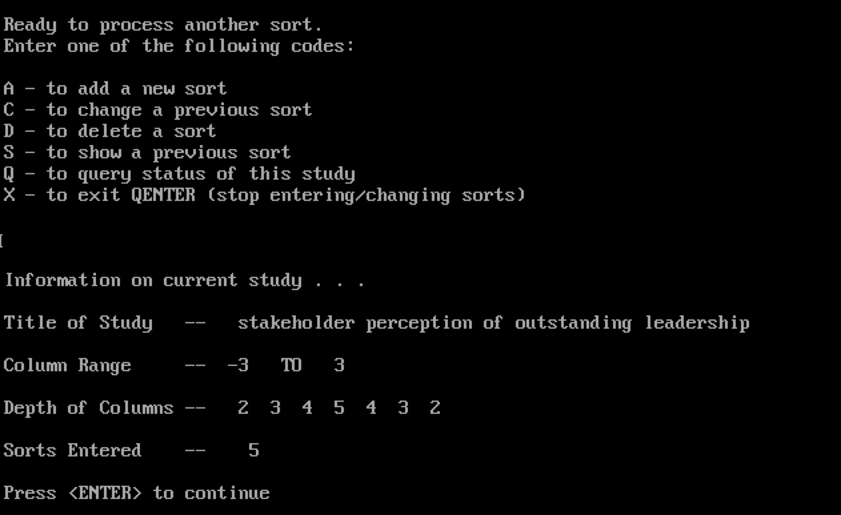
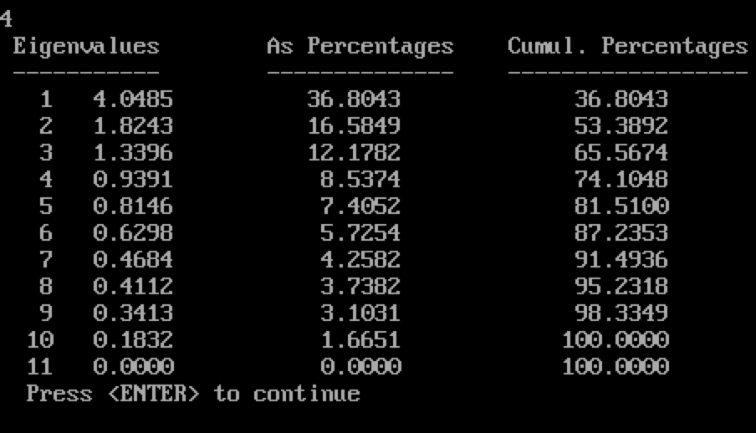
PQMethod Software Process
QENTER Enter sort structure and upload the sorts data
QANALYZE Perform the final Q analysis of the rotated factors
QPCA Perform a Principal Components factor analysis
QVARIMAX Perform a varimax rotation of the factors
STATES Enter the statements
Notes:
Using factor analysis reduces and simplifies the data.
A factor is an latent (unmeasured/unobserved) variable that expresses itself through its relationship with other measured variables.
The program looks first for the strongest correlations between variables and the latent factor, and makes that Factor 1.
The factor analysis program then looks for the second set of correlations and calls it Factor 2.
QPCA - Principal Components analysis is the default method of factor extraction in statistical packages like SPSS. The absolute and relative sizes of the Eigenvalues are of some importance when deciding on how many factors to keep for rotation. Eigenvalues are the variances of the factors.
PCA converts a set of observations of possibly correlated variables into a set of values of linearly uncorrelated variables.
QVARIMAX - Varimax rotation tries to maximize the variance of each of the factors, so the total amount of variance accounted for is redistributed over the three extracted factors.
ROTATION: In order to make the location of the axes fit the actual data points better, the program can rotate the axes. Ideally, the rotation will make the factors more easily interpretable.
Limitation: Factor analysis is a technique that requires a large sample size. Factor analysis is based on the correlation matrix of the variables involved, and correlations usually need a large sample size before they stabilize. Over 300 recommended.
Factor in Factor Analysis (from http://www.theanalysisfactor.com/confusing-statistical-term-6-factor/)
In factor analysis, a factor is an latent (unmeasured) variable that expresses itself through its relationship with other measured variables.
Take for example a variable like leadership. We may want to measure a person’s or an organization’s leadership style, but this is the kind of construct that would be impossible to measure using a single variable. It’s just too abstract and multifaceted, although it does represent a single concept.
So instead, you may have to develop the scale with many items, each of which measures some more measurable part of leadership. The idea would be that there is an underlying unmeasurable factor, leadership, that causes people to respond in certain patterns on the many items on the scale.
The purpose of factor analysis is to analyze these patterns of response as a way of getting at this underlying factor. Factor analysis also allows you to use the weighted item responses to create what are called factor scores. These represent a single score for each person on the factor.
Factor scores are nice because they allow you to use a single variable as a measure of the factor in the other analyses, rather than a set of items.

Slide 12
Emerging Findings: Primary
MOST AGREE
High expectations of all members of staff and pupils
Taking decisive action to address poor performance of staff
Inspirational leader who leads by example
MOST DISAGREE
Ability to foster discussion and debate
Develop entrepreneurial innovative approaches to improve education
Engaging local community in a shared vision for education in the area

Slide 13
Emerging Findings: Secondary
MOST AGREE
High levels of trust between leaders and their stakeholders
Ability to bring out the best in people and inspire others
Inspirational leader who leads by example
MOST DISAGREE
Meticulous monitoring of outcomes for pupils/learners
Balancing financial constraints with aspirational educational ambitions
Setting ambitious targets and focus on financial educational goals

Slide 14
Emerging Findings: Post-Compulsory
MOST AGREE
Empowering others to achieve ambitious targets
Ability to bring out the best in people and inspire others
Maximising talent and deploying it effectively in the organisation
MOST DISAGREE
Develop entrepreneurial innovative approaches to improve education
Meticulous monitoring of outcomes for pupils/learners
Engaging local community in a shared vision for education in the area

Slide 15
Emerging Findings: SENCO
MOST AGREE
Strategic vision based on shared values
An open culture of learning where excellence achievement celebrated
Inspirational leader who leads by example
MOST DISAGREE
Reconciling opposing points of view and summarising agreed points
Balancing financial constraints with aspirational educational ambitions
Ability to foster discussion and debate

Slide 16
Emerging Findings: Governors
MOST AGREE
Clear strategic vision communicated effectively to others
Inspirational leader who leads by example
Taking decisive action to address poor performance of staff
MOST DISAGREE
Engaging local community in a shared vision for education in the area
Ability to foster discussion and debate
Develop entrepreneurial innovative approaches to improve education
Reconciling opposing points of view and summarising agreed

Slide 17
References
Barber, M. Whelan, F. and Clark, M. (2010) Capturing the leadership premium. Nottingham: NCSLCS.
Bolden, R. (2011) Distributed Leadership in organizations: a review of theory and research. International Journal of Management Reviews 13(3) p. 251-269.
Bush, T. (2008) Leadership and management development in education. London: Sage.
Day, C. Sammons, P. Hopkins, D. Harris, A. Leithwood, K. Qing, G. and Brown, E. (2010) 10 strong claims about successful school leadership. Nottingham: NCSLCS
Dhillon, J. K.(2016) Leadership as shared practice in outstanding schools and colleges in England. Paper presented at American Educational Research Association (AERA) Annual Conference, 8th -12th April 2016, Washington DC, USA.
NCSL (National College for School Leadership) (2007) What we know about school leadership. Nottingham: NCSLCS
Tamkin, P. Pearson, G. Hirsh, W. and Constable, S. (2010) Exceeding expectation: the principles of outstanding leadership. London: The Work Foundation Alliance.

Slide 18
Questions ?
Thank you for listening. We would like to thank BELMAS and the University of Worcester for funding the research reported in this presentation.
For further information please contact:
Professor Jaswinder K Dhillon
Institute of Education
University of Worcester
j.dhillon@worc.ac.uk

