Slide 1
Categorising asynchronous discussion threads: improving the quality of student learning
Dr Anthony Barnett
a.barnett@worc.ac.uk

Slide 2
Previous approach: Worcester Journal of Teaching and Learning Issue 6, July 2011
Bloom’s digital taxonomy rubric:
Reply construction
Understanding
Evaluation
Reference, clarity, argument, critique, questioning

Slide 3
Current approach:
A qualitative adaptation of concepts from Social network analysis utilised by Jimoyiannis & Angelina (2012) e.g.
Cohesion analysis
Equivalence (role analysis)
Power analysis (centrality)

Slide 4
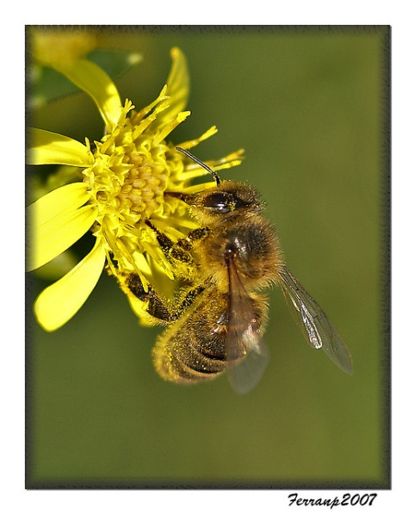
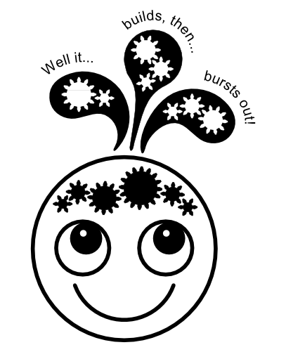
Forestier, M et al (2012) Roles in social networks: methodologies and research issues
pollinator
bursty contributor
debater
balanced conversationalist

Slide 5
Categorising discussion threads
The following categories were created to describe the data:
The passive facilitator
The dominant facilitator
The self referencing facilitator
The multiple facilitators discussion
The balanced discussion
The cliqued discussion
The formulaic discussion
The uninvolved discussion
The multiple sub-threads discussion
Complex models
Time factor models

Slide 6
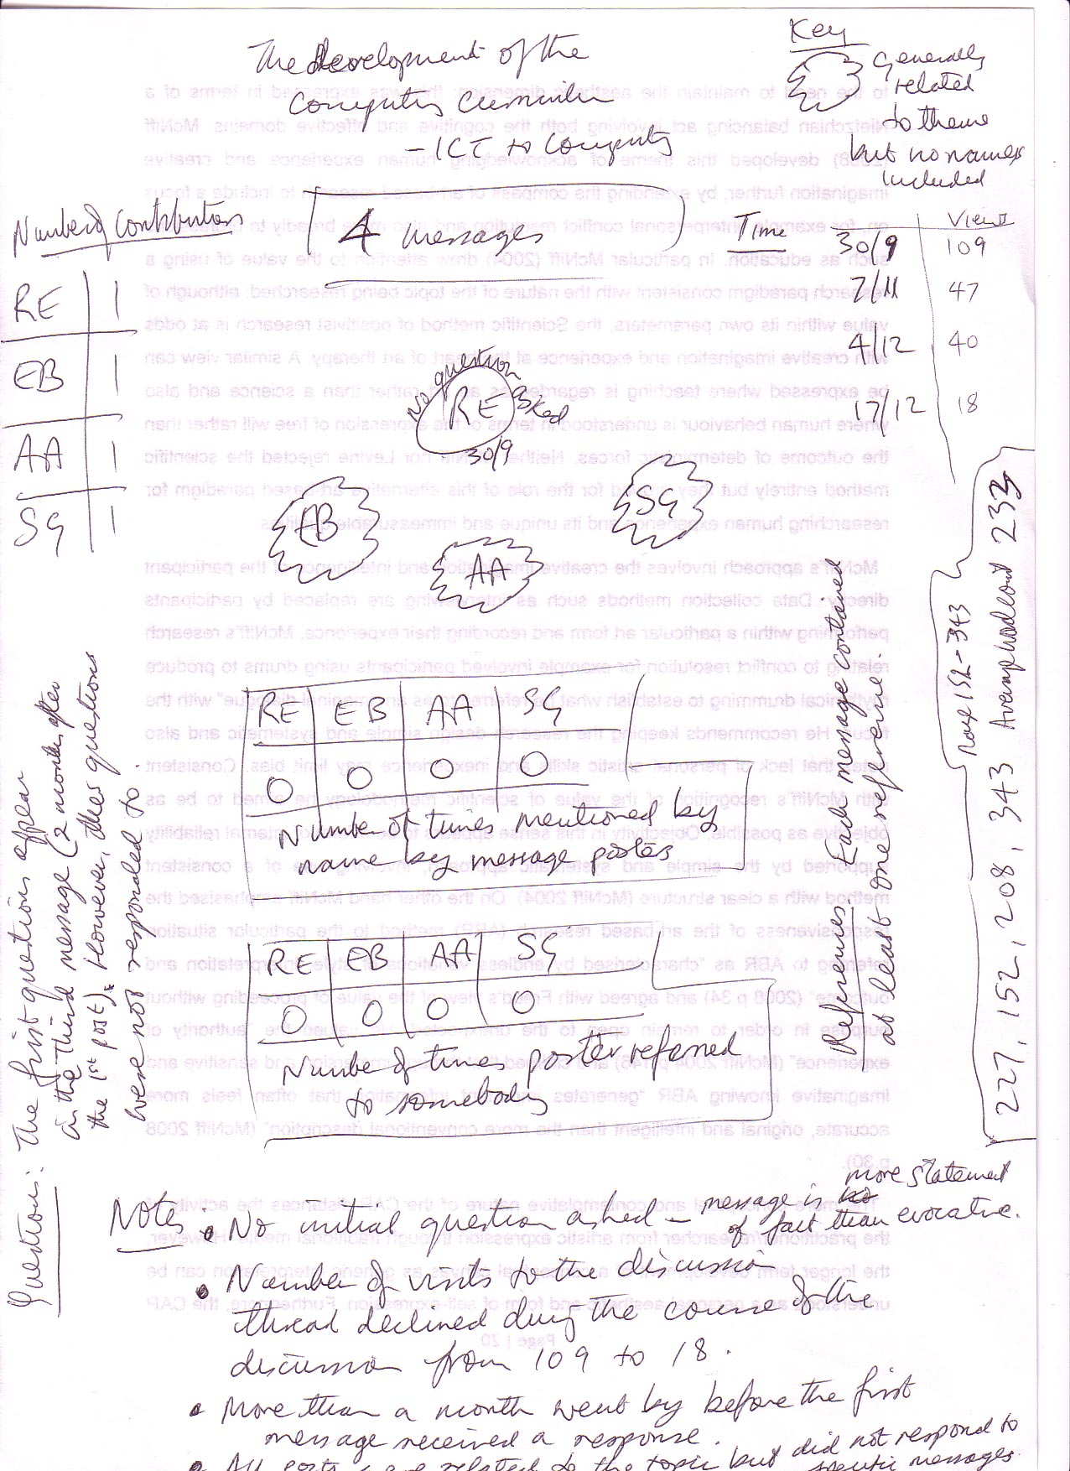
An uninvolved discussion

Slide 7
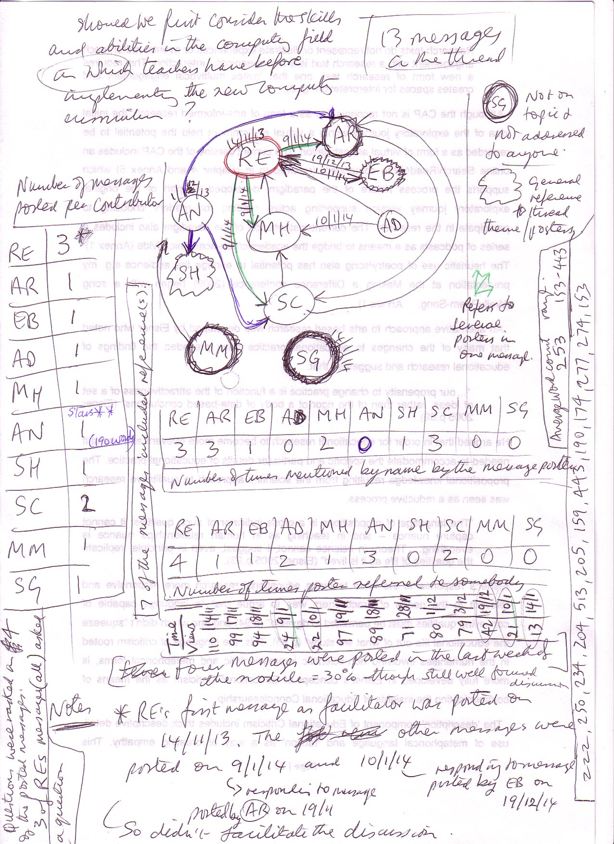
Passive facilitator

Slide 8
Passive facilitator

Slide 9
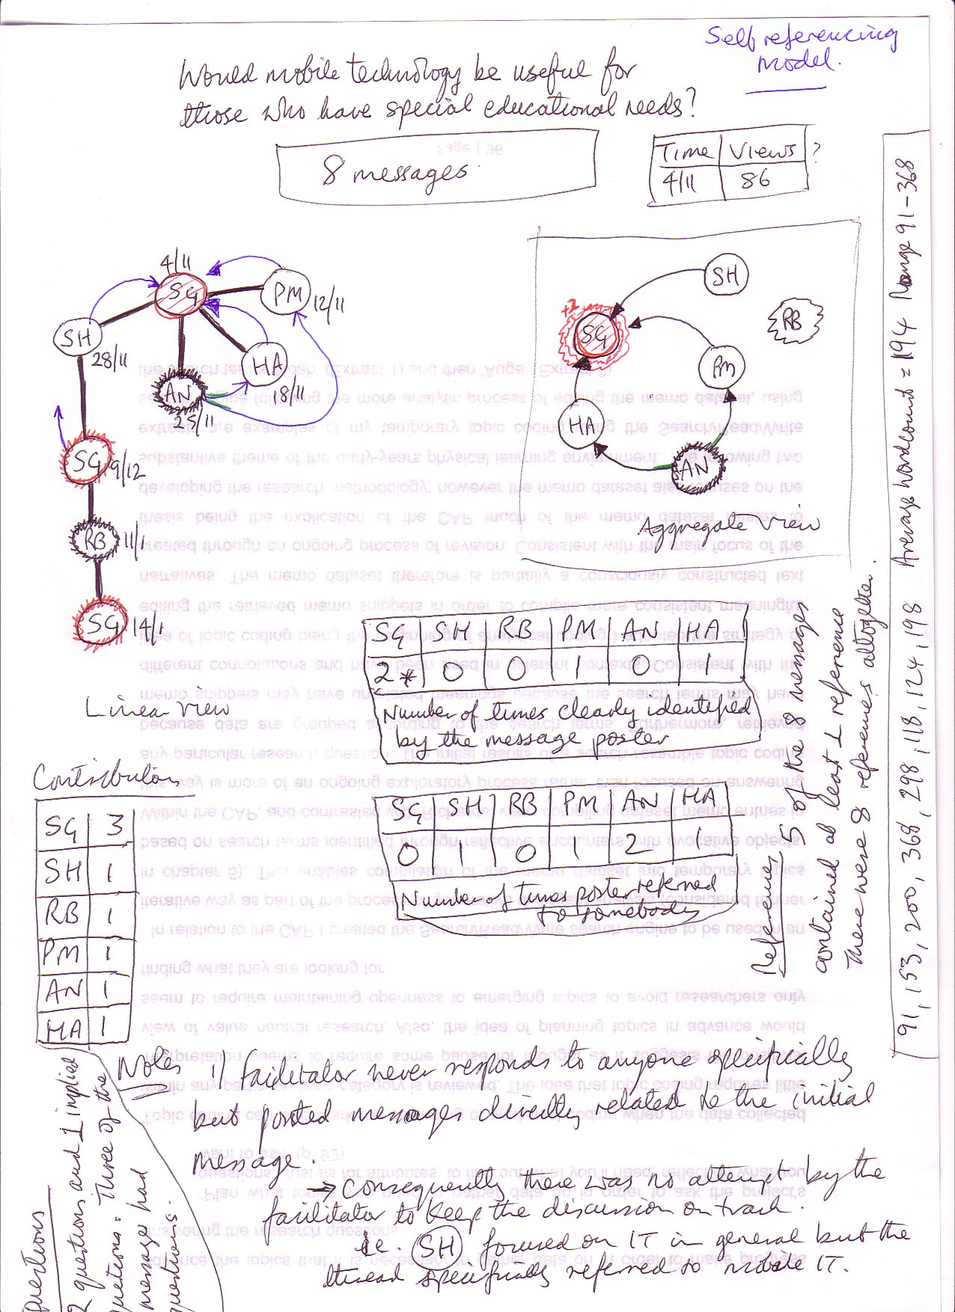
Self referencing facilitator

Slide 10
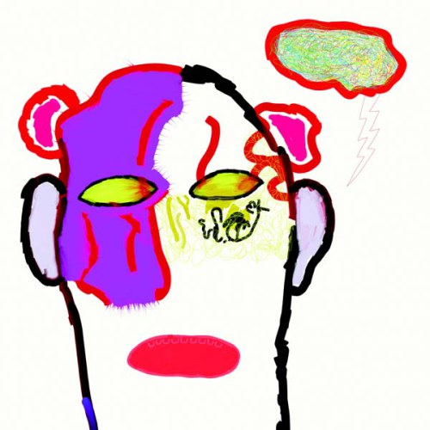
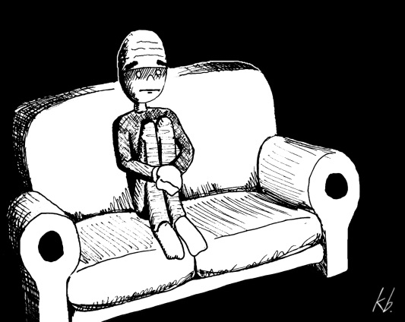
Self referencing

Slide 11
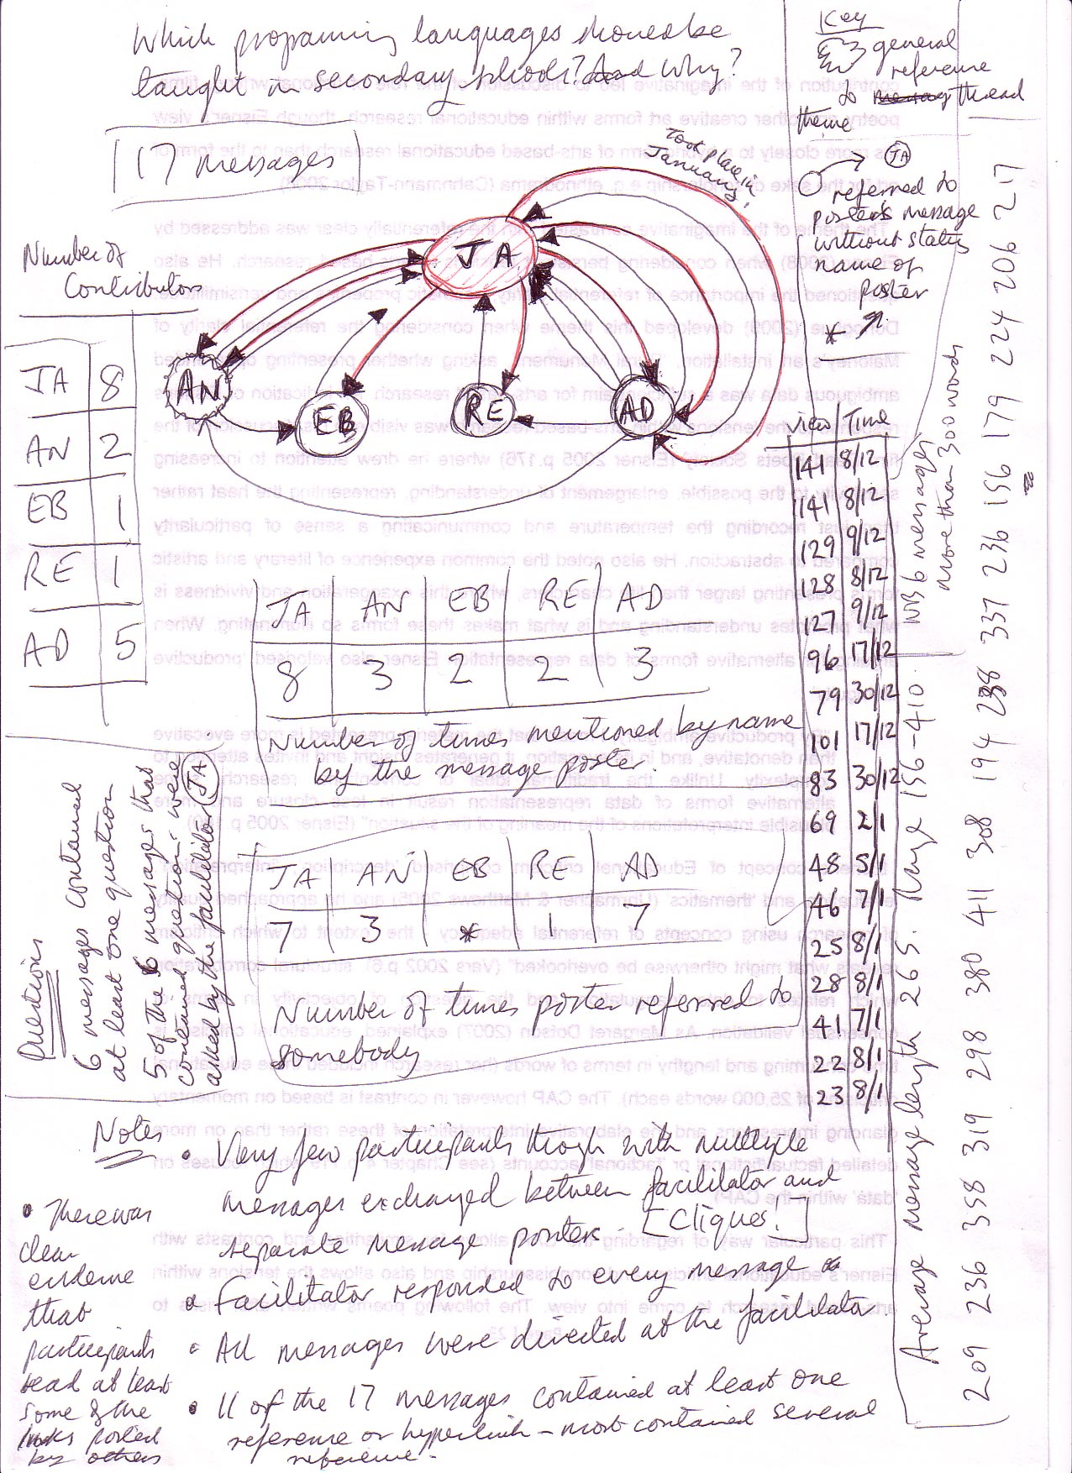
The dominant facilitator discussion

Slide 12
Dominant facilitator

Slide 13
Dominant facilitator – students’ views:
S1: “[As I posted the first message and therefore had the facilitator role], I believe it was my responsibility to respond to each post and assist with moving the discussion forward.”
S2: “On the whole for every participant commenting on this thread I made sure I replied back and tried to include a question for them to think about and research. This way I hoped they would return with their viewpoint to carry on the discussion.”

Slide 14
Categories:
The passive facilitator
The dominant facilitator
The self referencing facilitator
The multiple facilitators discussion
The balanced discussion
The cliqued discussion
The formulaic discussion
The uninvolved discussion
The multiple sub-threads discussion
The evolving discussion
Direct response discussion
Complex models
Time factor models

Slide 15
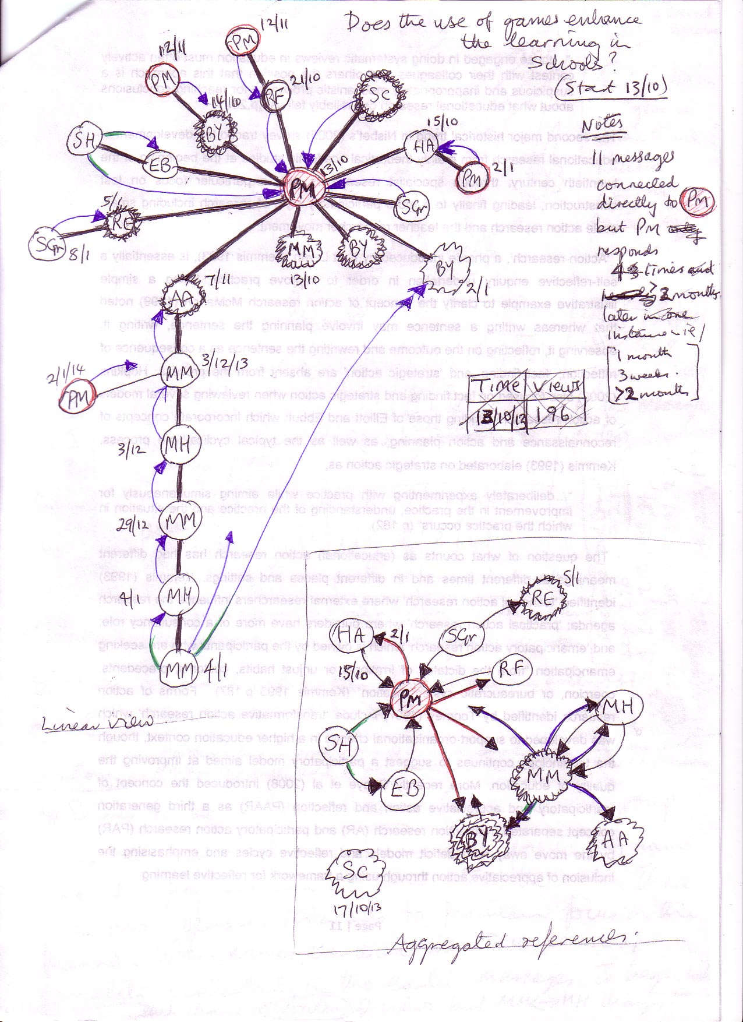
Complex model: multiple facilitators

Slide 16
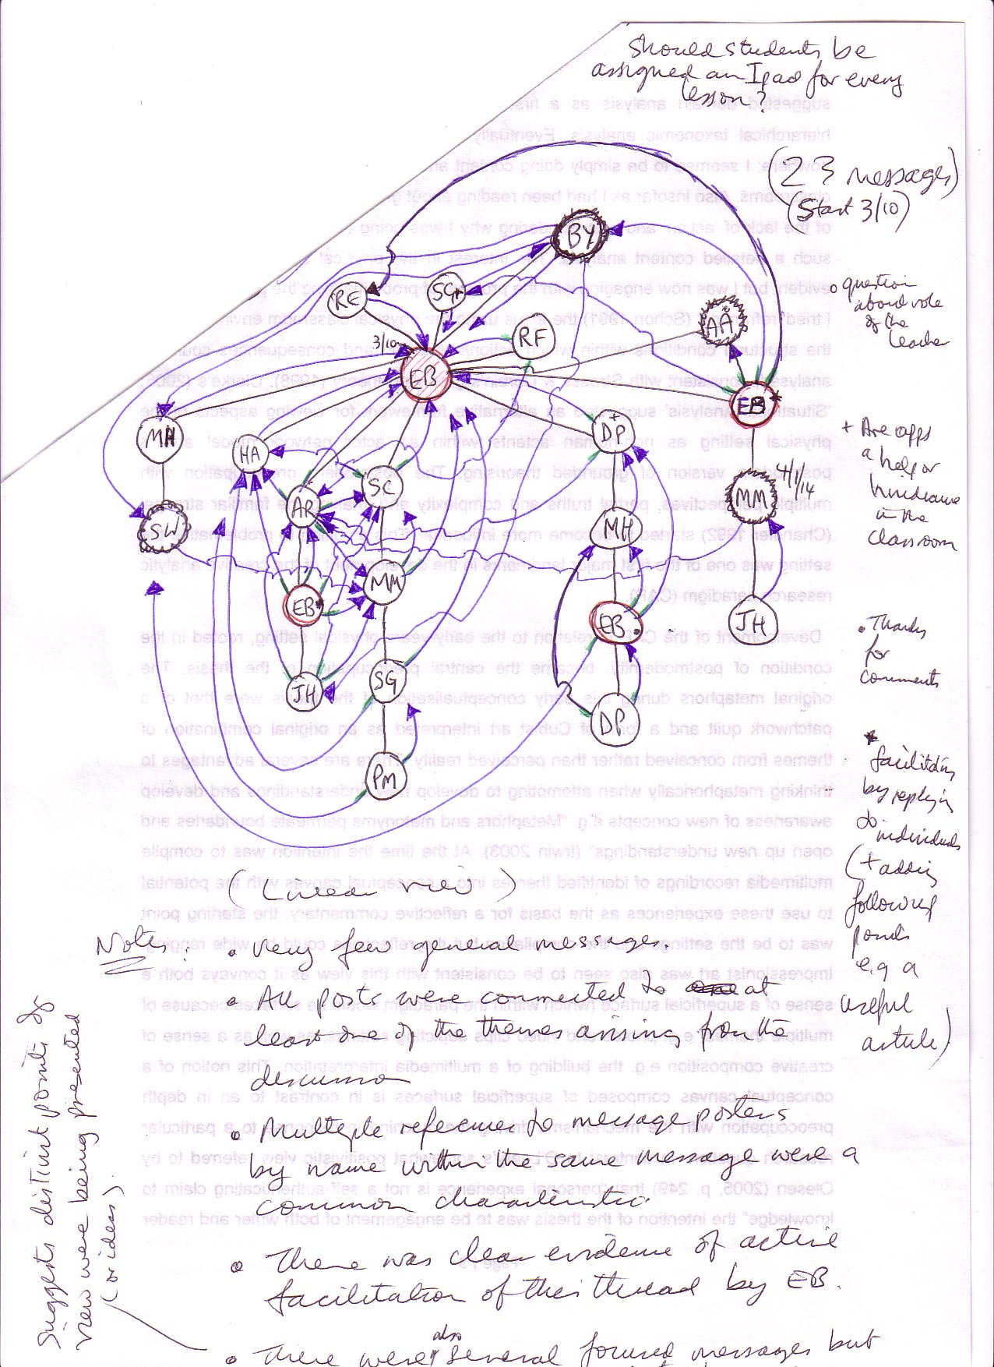
Complex model with multiple threads

Slide 17
Unresponsive star

Slide 18
Contact details:
Anthony Barnett – BYN1005
a.barnett@worc.ac.uk

