Slide 1
Context for the presentation
My thesis is focusing on developing a research paradigm
The paradigm involves generating lots of ideas…
My focus today is on one generated idea: the potential relation of Supermodernity to the early years learning environment

Slide 2
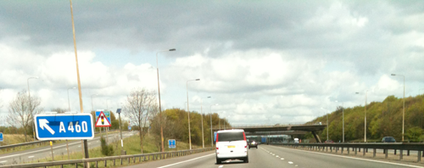
Supermodernity and the early-years learning environment

Slide 3
Supermodernity
The concept of Supermodernity, from Auge’s perspective, focuses on the social meanings related to transition spaces and contrasts anthropological place with non-place
Supermodernity from Relph’s perspective of place and placelessness can relates to the ideas of globalisation and the decline of place visible in the concepts of McDonaldisation and homogenisation
Supermodernity
arises through the proliferation of non-places
and placelessness

Slide 4
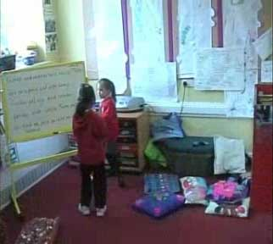
Auge: Non-place
Tuan: place as a pause in movement
Relph: incidental insideness
The intimate experience of place provides an occasion for genuine human exchange
Notes:
Tuan – occasion for genuine human exchange

Slide 5
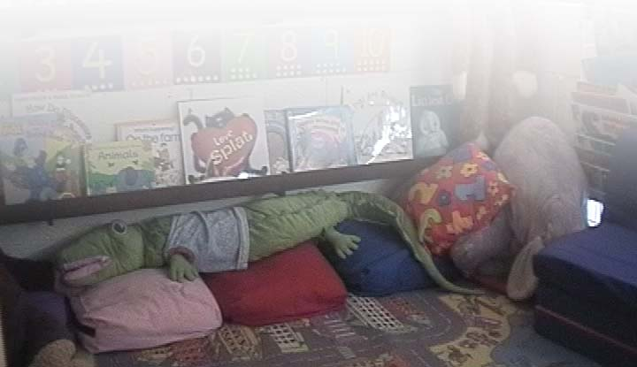
Visit to a Reception class
Functional, purposeful, colourful
Inside and out and calm
Standing in the doorway
Sleeves concealing hands
Looking out
Hands in pockets
Wandering about
And we’re not moving
Staying with the Blocks
Staying with the Towers
And now we’re just together
Sitting on a chair
On the seat and arm
No, wait… I’m crawling over there
- And back again
And to the winding train
Staying with the writing
Staying with sand
Egg timer held on head
And Action Man in hand
Waving sleeves and flapping sleeves fun
Hanging round the areas
Jumping up and skipping
Tidy up time… music - now the day is done
16/11/2010
transit-residence
‘floitering’
existential insideness

Slide 6
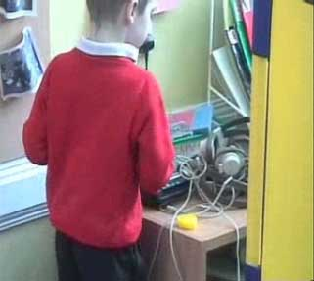

Slide 7
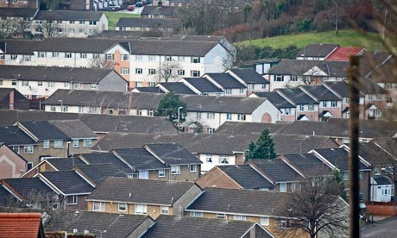
Housing estates
http://www.guardian.co.uk/politics/2011/feb/19/inequality-uk-growing-before-recession

Slide 8
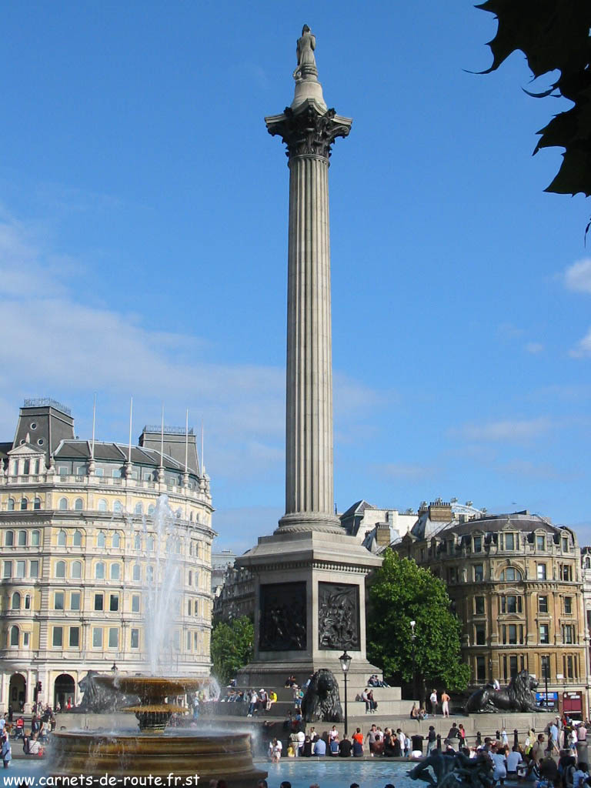
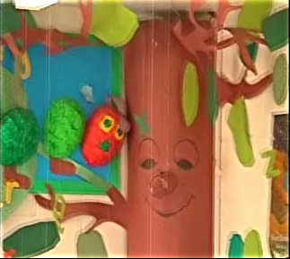
Monuments

Slide 9
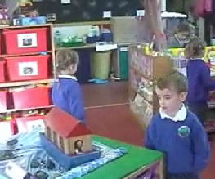
interchange-crossroads

Slide 10
passenger-traveller
Nursery/reception class children lining up and going to assembly in the school hall
One of the routes within the building – may pass signs that advertise other classrooms, the staffroom or the head teacher’s office

Slide 11
Signs of non-place and anthropological place
transit – residence, dwelling (e.g. railway station waiting rooms, car and bus); what are the transit and residential areas in the early-years setting?
passenger – traveller (passengers are transported as quickly as possible to the destination whereas travellers, like sightseers have time to stop and explore en route. What opportunities do children have for sight-seeing and experiencing the moment fully? How are transitions between activities and parts of the setting managed?
housing estate – monument (monuments are places for sharing and commemorating and can also be synecdochic; Are there enduring displays that add character and stability to the setting?
interchange – crossroads (social interaction occurs at crossroads and market square whereas interchanges reroute traffic in order to avoid congestion; where the routes and meeting places?
communication – language. How do signs and notices contribute to the individuality of the specific setting in the larger context of the school?

Slide 12
Associated ideas
Relph (1976) referred to places as ‘profound centres of human existence’ but noted the ‘inevitable spread of placelessness’
Auge (1995) commented that “… in the world of supermodernity people are always, and never, at home”
“Given the isolation and fragmentation that can be experienced in many modern places, and given the increased mobility and migration of globalisation, classrooms and schools have the potential to be important places in children’s lives” (Ellis, 2005, p.59).

Slide 13
The school reception area:
The TV screen presenting
events and achievements
of interest to parents and
visitors to the school
Various information posters and examples of children’s achievements

