Slide 1

The spread and modelling of Ambrosia plants and pollen: a tool to measure management success
C. Ambelas Skjoth¹, B. Sikoparija² and M. Smith³L. Cecchi⁵ & G. Karrer⁵
&
^{Many more from SMARTER}
1. National Pollen and Aerobiological Research Unit, University of Worcester, United Kingdom
2. Laboratory for Palynology, Department of Biology and Ecology, University of Novi Sad, Novi Sad, Serbia
3. Laboratory of Aeropalynology, Faculty of Biology, Adam Mickiewicz University, Poznań,Poland
4. Interdepartmental Centre of Bioclimatology, University of Florence, Italy
5. Institut für Botanik, Department für Integrative Biologie, Universität für Bodenkultur Wien, Austria

Slide 2
Background
Background
Sources
Phenology
Transport & Dispersion
Take home messages
Hayfever: a large impact on life
  Affects life quality ^{[1]}
  Is expensive ^{[2]}
  Interacts with asthma ^{[3]}
Exposure to ragweed pollen is important:
  Europe/USA - YES ^{[4]}
  All major continents – Maybe
Urban areas of high importance
  The majority of the population
  Co-exposure of pollen and air pollution^{[5]}
 | SSR - ragweed
Europe | 14.1
Austria | 8.5
Belgium | 3
Denmark | 17.1
Germany | 14.4
Greece* | 11.7
Finland | 2.3
France | 9
Hungary | 53.8
Italy | 3.5
Netherlands | 18.6
Poland | 10.8
Portugal | 12.4
Switzerland | 18.6
UK* | 7.9
Standard Sensitization Rates from allergy centres in different European Countries^{[4]}
[1] de Monchy et al, 2003; [2] Petersen et al, 2008; [3]; Molfino et al, 1991; [4] Burbach et al, 2009 [5] Mücke et al, 2014

Slide 3
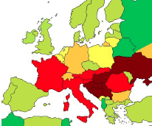
Empirical estimation: connecting models and data¹
Background
Sources
Phenology
Transport & Dispersion
Take home messages
Atmosphere
Pollen distribution
Health processes and behaviors
Location and amount of sources: Vegetation
Management effort
Plant Distribution
Pollen transport
Damages
Plant spread
Agricultural processes and behaviors
Costs
Accounting of management costs
[1] Jones, G., Champetier de Ribes, A., & Steinbach, S. Presetation at the COST SMARTER meeting, Brussels, 21/01/2015

Slide 4
The purpose with modelling
Background
Sources
Phenology
Transport & Dispersion
Take home messages
A set of basic questions:
  health impacts and impacts on the abundance and spread of pollen - exposure.
  research into the evaluation of management of Ambrosia in Europe - scenarios
Typical modeller questions on design (thus methods). What is the expected input/output and what is the purpose
  Temporal scale to be covered?
    Vegetation changes ~ decades or more
    Pests ~ years
    Atmospheric changes ~ days
    Health impacts ~ minutes
    Population impacts ~ decades
  Spatial scales to be covered?
    management of landscape typical on road or farm level
    Regulation of landscape typical at national level
    Pollen dispersion vary from <2 km to continental scale, typically 30 km
  Processes/species to be covered?
    Only ragweed plants or vegetation dynamics?
    Only ragweed pollen or co-exposure?
Four components needed in most basic ragweed models
  Source location (maps), plant growth (seasonal) pollen release (hourly), atmospheric transport (daily)
Connection of scales a major challenge in pollen dispersion modelling

Slide 5
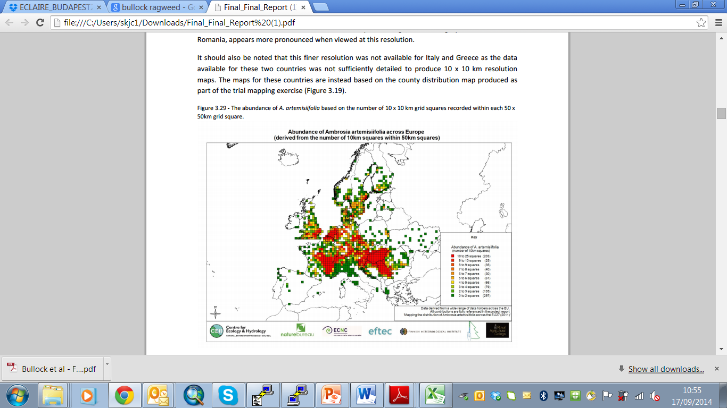
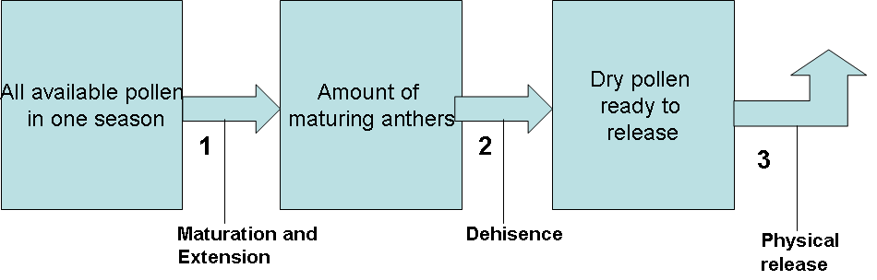
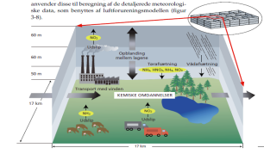
The modelling concept in its most simple form
Background
Sources
Phenology
Transport & Dispersion
Take home messages
[1] Skjoth et al, 2010; Zink et al (2012)

Slide 6
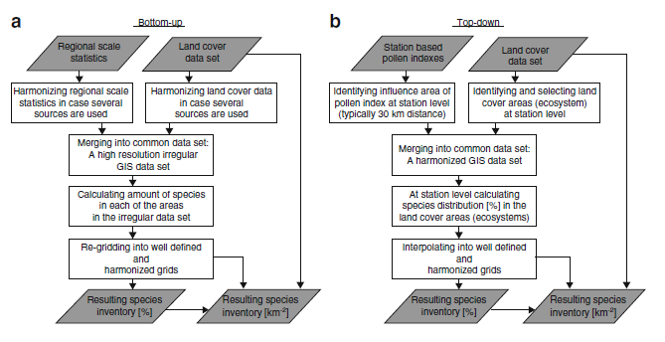
Methods for estimating sources^{[1]}
Background
Sources
Phenology
Transport & Dispersion
Take home messages
Can include process based modelling in the vegetation
Can include process based modelling in the atmosphere
[1] Skjoth et al, 2012

Slide 7
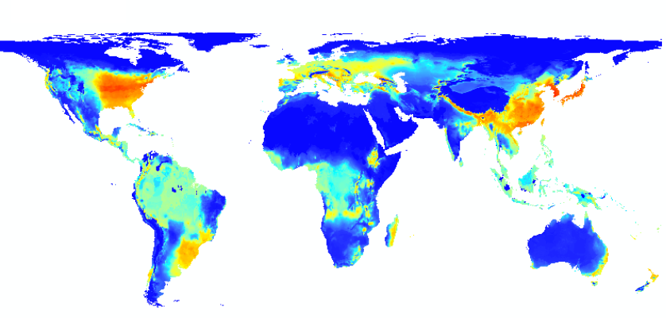
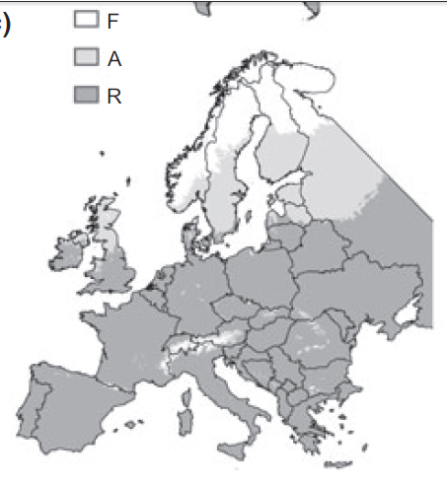
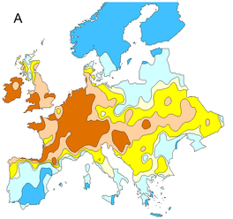
Sources – bottom up approaches
Background
Sources
Phenology
Transport & Dispersion
Take home messages
Considerable attention
  Global scale^{[1]}
  Europe^{[2,3]}
  Presence/absence, suitability etc.
  Focus on phenology^{[1,2,3,]}
  Driven by climate^{[1,2,3]}
  Climate change^{[1,2,3]}
  No dynamics
    (dispersal, competition,..)
  Bottom-up maps tested with COSMO-ART atmospheric transport model ^{[4]}
[1] Rasmussen, (2013), Chaptman et al (2014); Storkey et al (2014), Zink (2014)

Slide 8
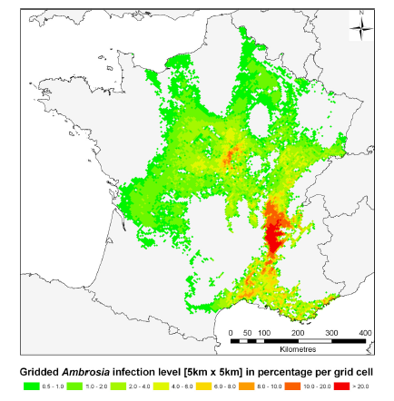
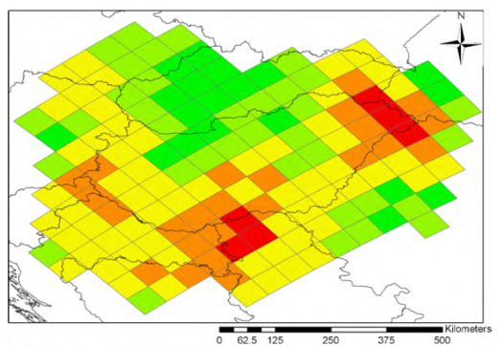
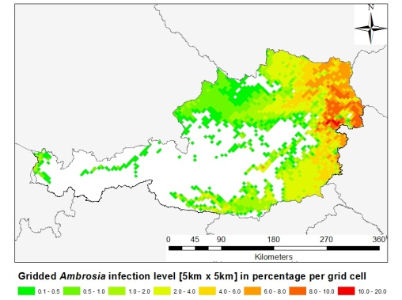
Sources – Top down approaches
Background
Sources
Phenology
Transport & Dispersion
Take home messages
Considerable attention
  National Scale^{[1]}
  Flexible but patchy approach^{[2,3]}
  Describes present state and abundance
  Works without ground observations but needs pollen sites and in on ragweed ecology
  Not for scenarios
  No dynamics
    (dispersal,..)
  Top-down maps tested with COSMO-ART^{[4]}
[1] Thibaudon et al, (2014); [2] Skjoth et al, (2010); [3]; Karrer et al, (2014); [4] Zink (2014)

Slide 9
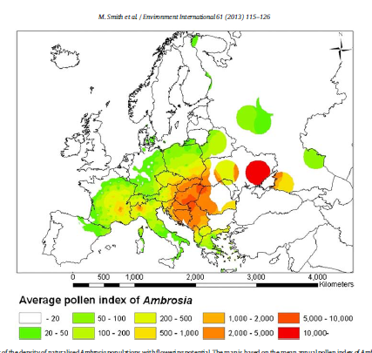
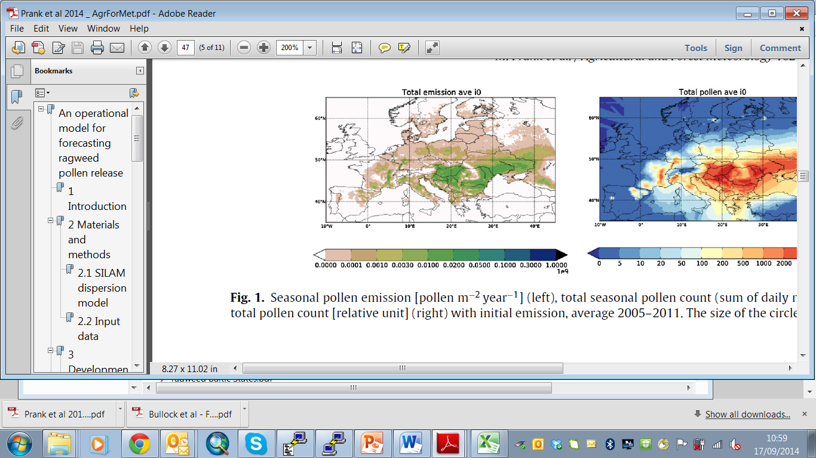
Source maps - disagreements
Background
Sources
Phenology
Transport & Dispersion
Take home messages
Ragweed ecology and mapping
  Native to North America^{[1]}
  Invasive in Europe, China, Australia^{[1]}
  Appear to have centres with large abundance^{[2,3,4]}
  Abundance vary locally^{[1]}
  Mapping disagrees outside main ragweed centres
(left) Ragweed density based on plant observationst^{[2]} . (right Ragweed density based on pollen index^{[3]}
Ragweed emission potential used by the SILAM model^{[4]}
[1] Smith et al, (2013); [2] Bullock et al, (2013); [3] Skjoth et al, (2013); [4] Prank et al, (2014)

Slide 10
Sources – current state of the art
Background
Sources
Phenology
Transport & Dispersion
Take home messages
Ragweed ecology:
  prefer lowlands, not present in mountains^{[1,2]}
  Occupy marginal terrain^{[1,2]}
  Small isolated populations outside main centres, mainly urban areas^{[2,3]}
  Invasive: Expands in coverage^{[1,4]}
  Affected by Urban climate and CO2 ^{[5,6]}
  Affected by “accidental mitigation”, e.g. pests^{[7]}
Current conclusion:
  Several bottom up suggestions – continental scale
  Patchy top-down suggestion – national scale
  Source maps only agree on continental scale
  Limited (no) mapping on microscale
  Dynamics hardly including in either atmosphere or vegetation
  Several map types have been testes in COSMO-ART. Hybrid approach appear to be best solution^{[8]}
[1]Smith et al (2013); [2] Skjoth et al (2010); [3] Sommer et al (2015) [4] Thibaudon et al, (2014); [5] Ziska et al (2002); [6] Rogers et al, (2006;) [7] Bonini et al., (2014) [8]; Zink (2014)

Slide 11
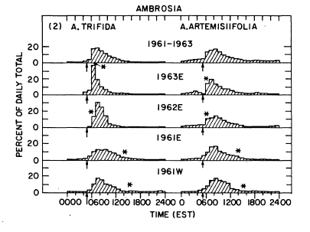
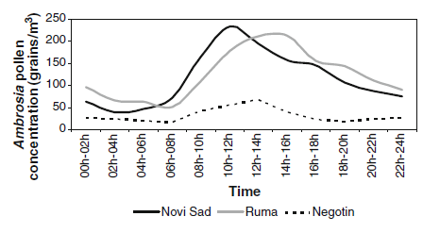
Phenology
Background
Sources
Phenology
Transport & Dispersion
Take home messages
Ragweed: Phenology
  Depends on photoperiod and temperature - > North-South gradient ^{[1,2,3,4]}
  Climate change effect^{[5]}
  Daily flowering depends on T and RH^{[3,4]} cause rooftop cyclic concentrations^{[6]}
  cyclic concentrations^{[6]}
Hourly ragweed concentrations, averaged annually, from a circular experimental plot of the surface^{[7]}
Averaged bi-hourly ragweed concentrations,, from three rooftops in Serbia in 2007 ^{[3]}
[1]Smith et al, (2013); [2] Ziska et al (2003); [3] Bianchi et al, (1959); [4] Allard et al, (1945); [5] Ziska et al, (2011);
[6] Sikoparija et al, (2009); [7] Ogden et al, (1969)

Slide 12
Modelling Phenology (seasonal & daily)
Background
Sources
Phenology
Transport & Dispersion
Take home messages
Ragweed: Simulation models of phenology
  Process based models implemented in atmospheric models DEHM^{[1]}, SILAM^{[2]} and COSMO-ART^{[3]}
  Methods underway for CHIMERE and WRF-Chem
  Vary in complexity from daily distributed releases^{[2]}, process based-biology^{[1]} and detailed surface layer meteorology^{[3]}
  Very few validation data sets for process models[1]
Simulation of dehisence of ragweed
[1]Skjoth (2009) [2] Prank et al, (2014); [3] Zink et al (2013)

Slide 13
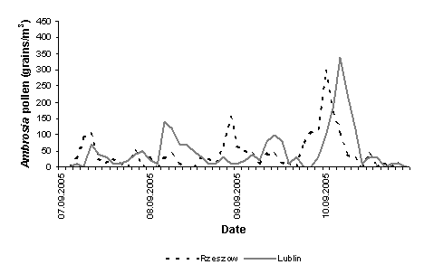
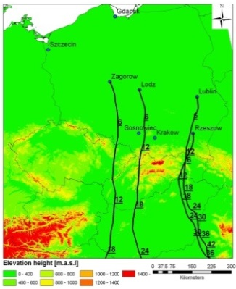
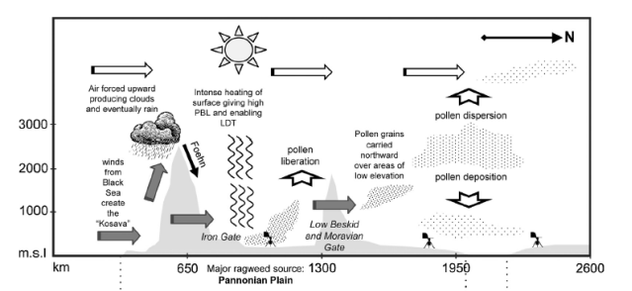
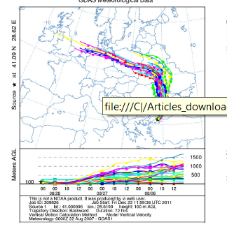
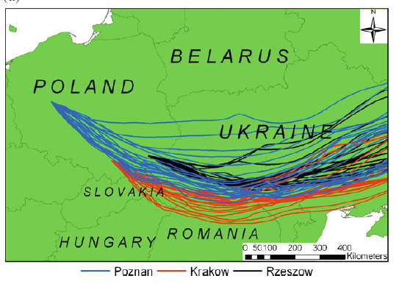
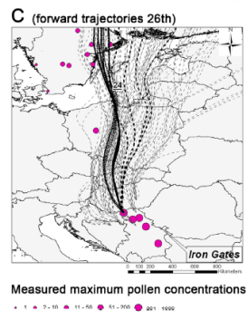
Transport & Dispersion
Background
Sources
Phenology
Transport & Dispersion
Take home messages
Ragweed
  LDT episodes are intermittent^{[1]}
  Related to atmospheric physics^{[2]}
  LDT episodes from Pannonian Plain and Ukraine repeatedly observed^{[3,4,5]}
Atmospheric transport shown by a atmospheric trajectory model^{[1]}
A physical mechanism providing LDT of ragweed pollen from the Pannonian Plain ^{[3]}
LDT transsport of ragweed pollen from Ukraine (left)^{[3]} middle ^{[3]} and PannonianPlain^{[5]}
[1]Smith et al, (2008); [2] Sikoparija, (2013); [3] Kasprzyk et al, (2013); [4] Zemmer et al, (2012); [5] Sikoparija et al , (2009)

Slide 14
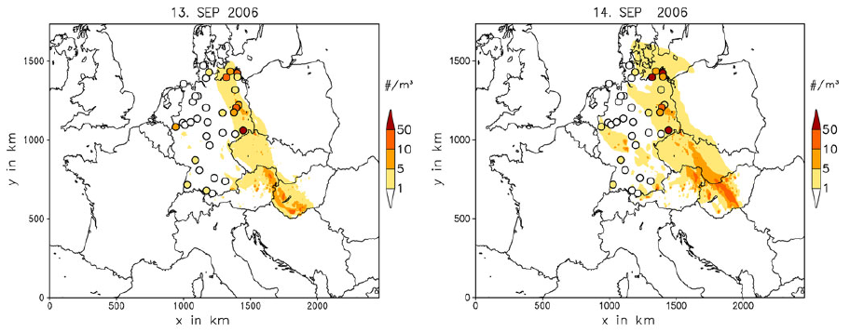
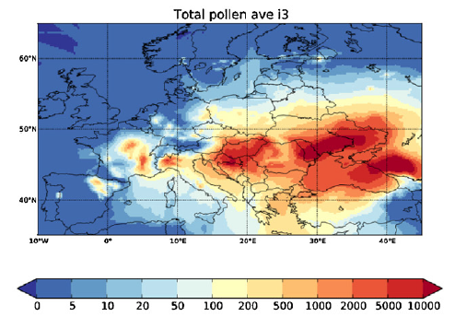
Transport & Dispersion –regional scale
Background
Sources
Phenology
Transport & Dispersion
Take home messages
Ragweed
  Dispersion and transport on meso-scale can be simulated with meso-scale atmospheric models^{[1,2,3]}
  Major uncertainty: source maps, biological release processes and hourly variations^{[4]}.
Simulation of ragweed concentrations with the regional scale atmospheric transport model COSMO-ART ^{[2]}
Simulation of seasonal pollen index with SILAM ^{[3]}
[1]Smith et al, (2008); [2] Zink et al, (2012); [3] Prank et al, (2014); [4] Zink (2014);

Slide 15
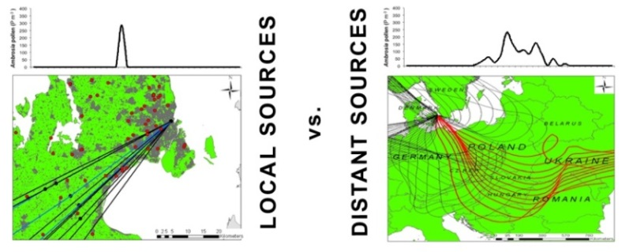
Transport & Dispersion –urban areas
Background
Sources
Phenology
Transport & Dispersion
Take home messages
Ragweed
  Dispersion and transport of pollen observed in (urban) areas^{[1,2]}
  Microscale scale simulations of ragweed pollen possible with Particle dispersion or gaussian models^{[2,3]}
  Combined local and regional scale approaches needed in some areas^{[1,3]}
Detecting ragweed concentrations from urban sources ^{[3]}
Simulation of ragweed concentrations with the local scale atmospheric transport model OML ^{[3]}
[1]Skjoth et al, (2013); [2] Sommer et al (2015); [3] Smith et al, (2013)

Slide 16
Transport and Dispersion – Conclusions
Background
Sources
Phenology
Transport & Dispersion
Take home messages
Ragweed:
  Atm. physics in regional scale transport well understood, e.g. LDT
  Micro-scale rarely addressed but possible to detect
  Existing monitoring network not designed for micro-scale studies (rely on being lucky)
  Urban scale models not available
Future research directions to improve on exposure modelling:
  Understanding both the regional scale and local (urban) scale
  Combining local scale & regional scale detection and modelling.
  Combining scales VERY challenging
  Atmospheric models can be improved by improving the emission flux

Slide 17
Take home messages
Background
Sources
Phenology
Transport & Dispersion
Take home messages
Regweed exposure modelling requires a number of model components (source maps, phenology, flowering, atmosphere)
Ragweed modelling with focus on population exposure needs to cover urban areas due to population densities with high detail
Ragweed modelling will most likely need both meso and micro-scale simulations in the vegetation and the atmosphere.
Both vegetation and atmospheric models (mapping) appear rough. Some components completely missing
Model usage without all scales covered is feasible, but reservations should in general be taken
No model studies on co-exposure

Slide 18
Thank you for your attention contact: Carsten Ambelas Skjøth email: c.skjoth@worc.ac.dk

