Slide 1
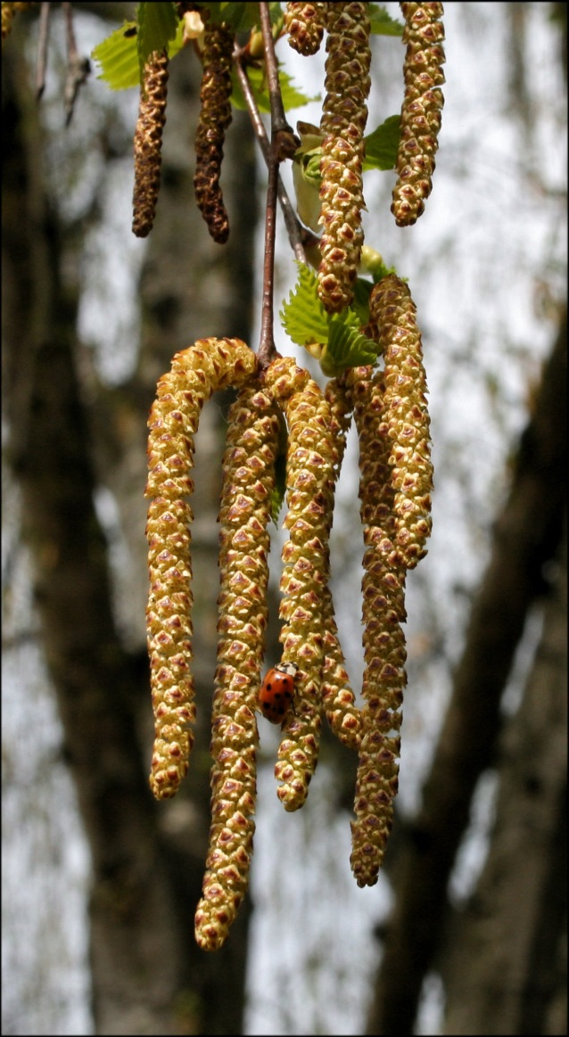
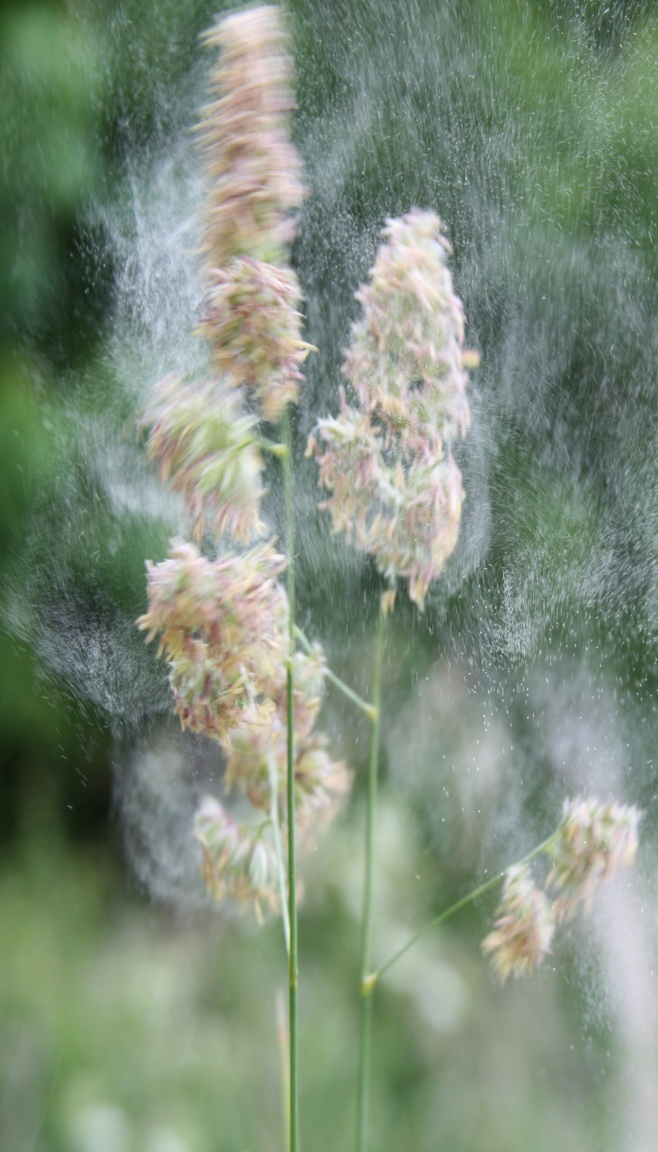
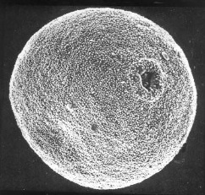
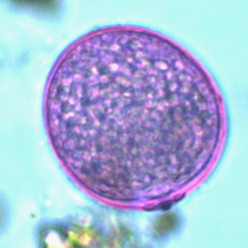
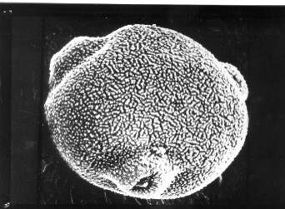
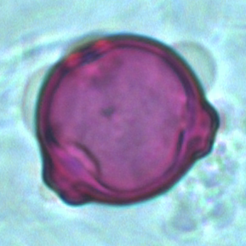
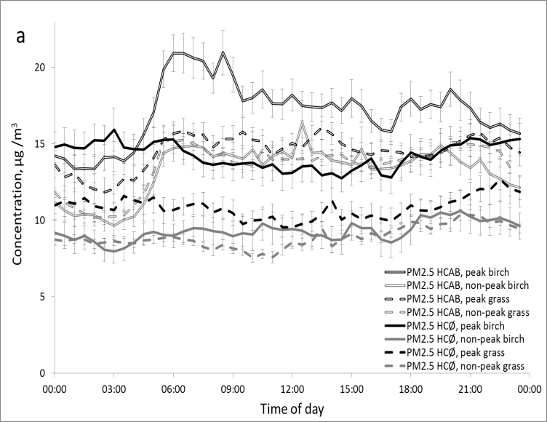
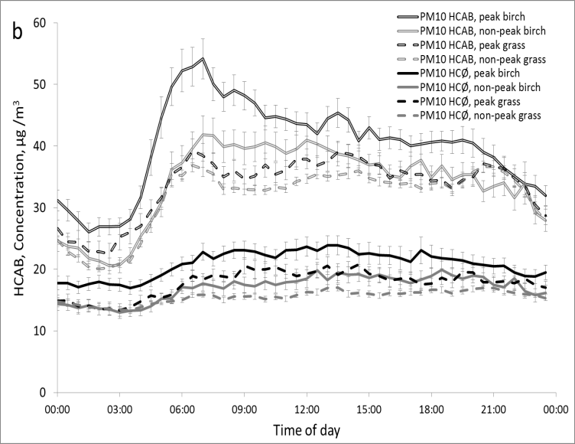
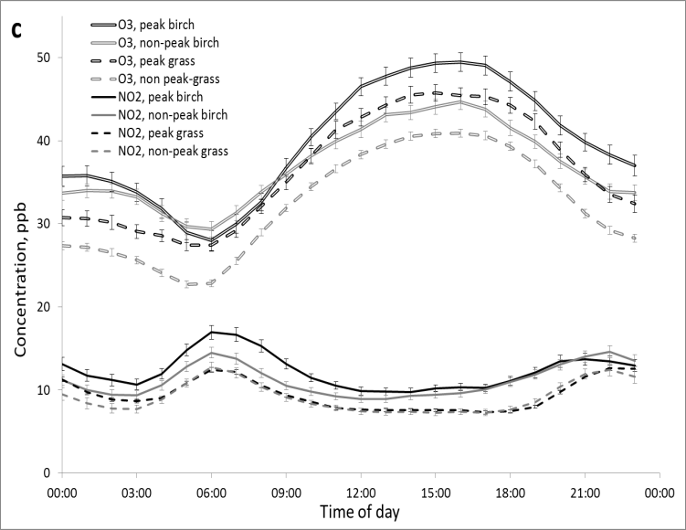
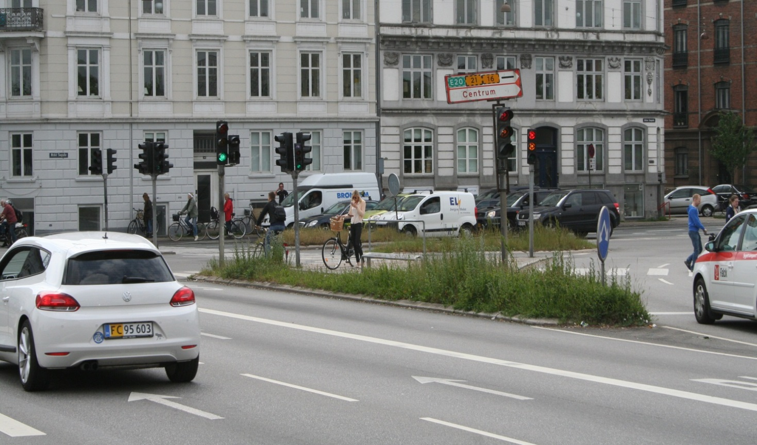
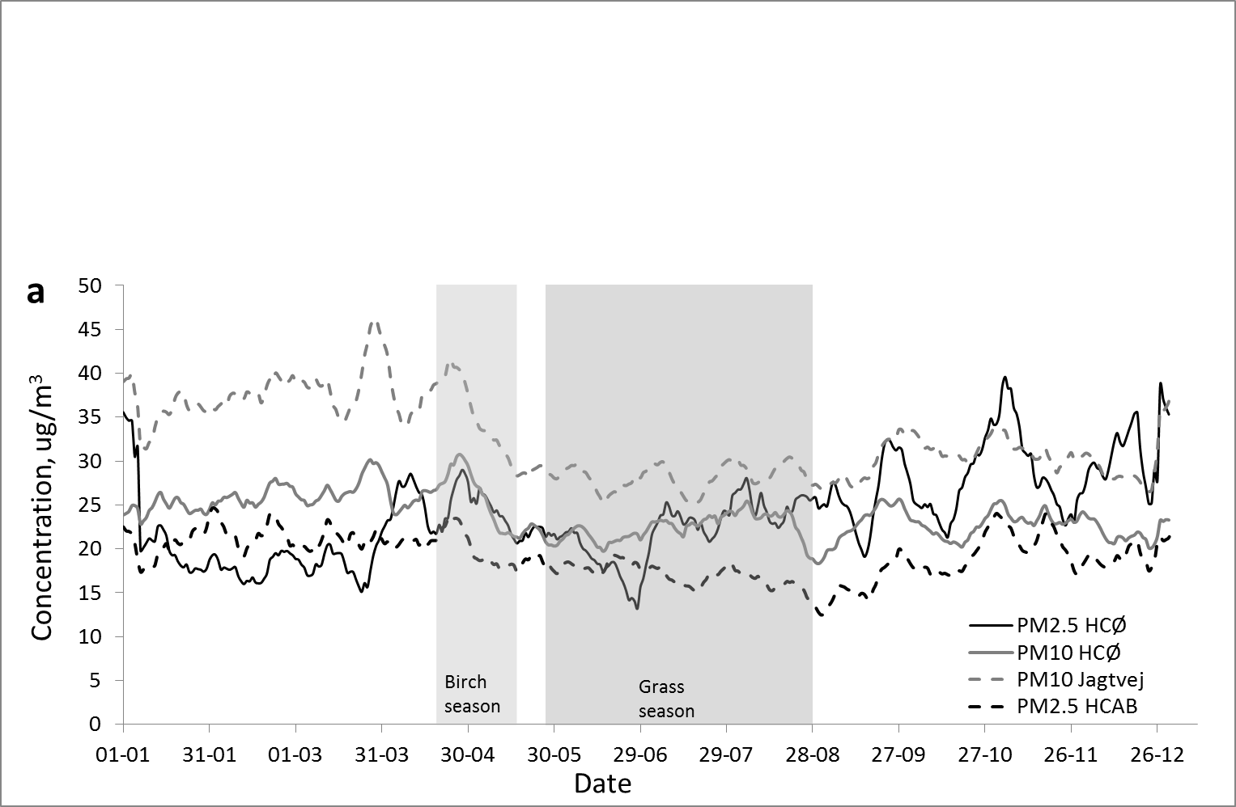
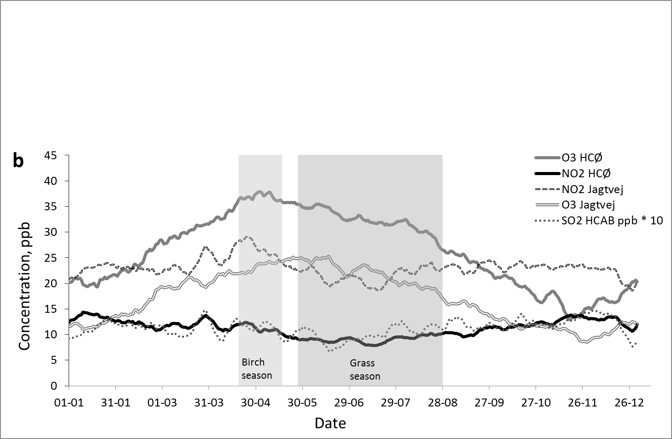
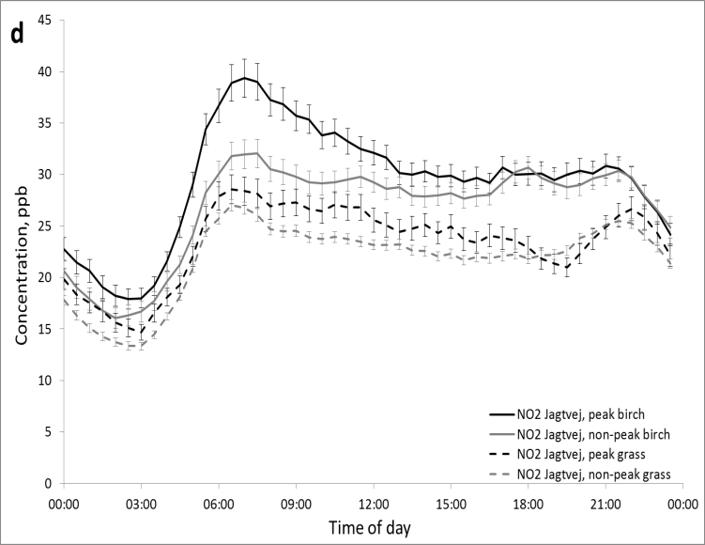
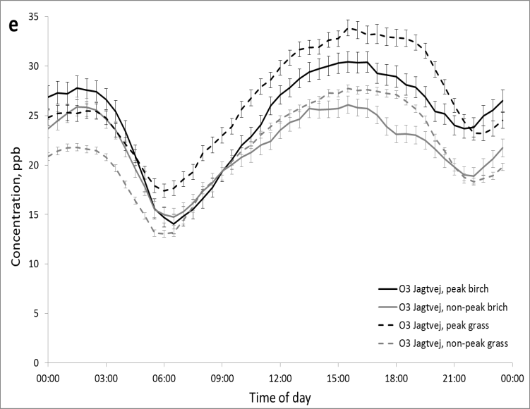
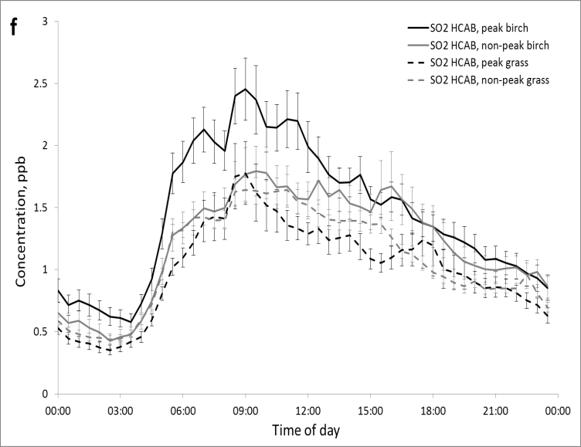
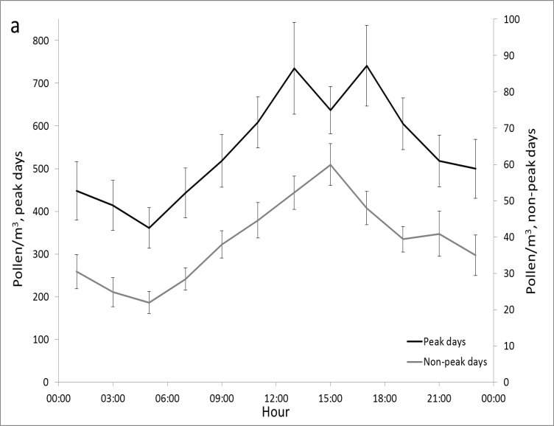
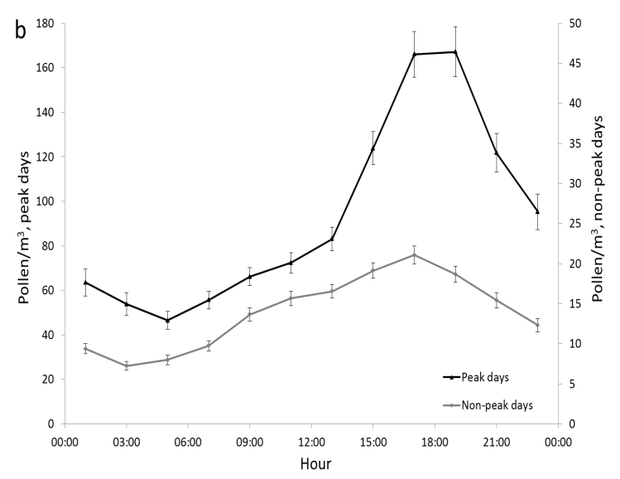
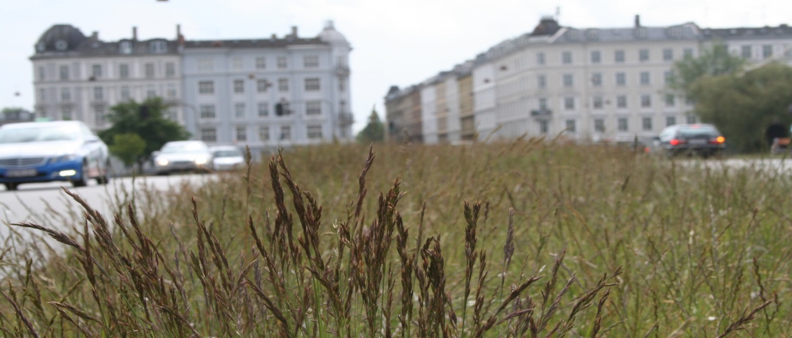



l
AN Assesment of The potential for co-exposure to Allergenic pollen and Air pollution in copenhagen, denmark
Pia Viuf Ørby¹, Robert Peel², Carsten Ambelas Skjøth³, Vivi Schlünssen¹, Jakob Bønløkke¹, Thomas Ellermann², Andreas Brændholt⁵, Torben Sigsgaard¹, Ole Hertel^{2,4}
¹Unit of Environmental and Occupational Medicine (DEOM), Department of Public Health, Aarhus University, ²Department for Environmental Science, Aarhus University, ³National Pollen and Aerobiology Research Unit, University of Worcester, ⁴Department for Environmental, Social and Spatial Change (ENSPAC), Roskilde University. ⁵Asthma-Allergy Association Denmark.
Background.
Co-exposure to air pollutants and allergenic pollen can exacerbate allergic airway diseases.
Results.
O₃ concentrations were increased on days with peak pollen concentrations. High O₃ concentrations coincide both seasonally and diurnally with high pollen counts, potentially leading to clinically relevant simultaneous co-exposure. NO₂ and SO₂ peaks did not coincide with peaks in pollen concentrations, and were well below potential thresholds for adjuvant effects to the allergic reaction. Neither diurnal nor seasonal peaks in PM coincide with pollen peaks, however daily average PM concentrations were higher on peak pollen days than on non-peak days.
Aim.
Patterns in pollutant and pollen concentrations at which co-exposure may be a particular risk with respect to adjuvant health effects were analysed by:
- Comparing the yearly pattern of the concentrations of pollutants with the timing of pollen seasons.
Comparing the average diurnal pattern of concentrations of pollen and pollutants on days with (a) high pollen concentrations and for (b) the remaining part of the pollen season.
This is pursued in order to establish if there are typical patterns of concurrently high concentrations, which could affect the guidance to the allergic and asthmatic public.
Grass pollen 35 um
Birch pollen 25 um
Co-exposure to ozone and allergen
After one hour of exposure to 120 ppb of O₃, Molfino et al. [1991] found that only half the allergen dose was needed to provoke a 20% drop in FEV1 compared to exposure to clean air. The O₃ concentrations observed in this study are lower than these, but their effect are expected to be of clinical relevance [Van Bree et al., 1995].
Methods.
We examined yearly variation and diurnal patterns of pollutants on days with high pollen levels, and also for the remaining part of the pollen season, for the following:
grass and birch pollen, sulphur dioxide (SO₂), ozone (O₃), nitrogen dioxide (NO₂) and particulate matter (PM) in the period 1997-2012.
Charts above.
Yearly plots of 11-day running mean for 1997-2012 for PM (a) and the gasses O₃, NO₂ and SO₂ (b) for both roadside (Jagtvej or HCAB) and urban background (HCØ). Typical birch and grass pollen seasons based on the period 1985-2009 are shaded grey.
Charts above.
Diurnal charts of the average patterns of pollutants with standard error of the means; (a) PM_{2.5} at roadside (HCAB) and rooftop (HCØ) , (b) PM₁₀ at roadside (HCAB) and rooftop (HCØ), (c) O₃ and NO₂ at HCØ rooftop station, (d) NO₂ at roadside (Jagtvej) roadside station, (e) O₃ at Jagtvej roadside station, (f) SO₂ at HCAB roadside station.
Charts, left.
Diurnal charts of the average patterns of (a) birch pollen and (b) grass pollen on peak and non-peak pollen days.
Peak pollen days are days with concentrations above 50 grains m⁻³ for grass pollen and 100 grains⁻³ for birch.
Conclusions.
This study indicates that when considering co-exposure effects from pollen and pollutants, O₃ appears to be the most relevant pollutant to further examine for clinical effects of simultaneous co-exposures.
l
Contact: Pia Viuf Ørby, piv@ph.au.dk
Results shown are under review for publication in the journal Urban Climate.
References. Molfino, N. A., Wright, S. C., Katz, I., Tarlo, S., Silverman, F., McClean, P. A., Slutsky, A. S., Zamel, N., Szalai, J. P., and Raizenne, M., Effect of low concentrations of ozone on inhaled allergen responses in asthmatic subjects, The Lancet 338 (1991) 199-203,
Van Bree, L., Marra, M., Van Scheindelen, H. J., Fischer, P. H., De Loos, S., Buringh, E., and Rombout, P. J. A., Dose-effect models for ozone, Toxicol. Lett. Volumes 82-83 (1995) 317-321

