Slide 1
What do Applied Performance Analyst employers really want?: Comparative analysis of job advertisements in the UK and Ireland (2021-2022)
John William Francisª, Jamie Kyte^{b} & Michael Batemanª
ªUniversity of Worcester; ^{b}University of Birmingham
A presentation from a member of the
BASES Special Interest Group Performance Analysis Steering Committee
Notes:
Good afternoon, within the next 10 minutes I will provide an insight into our project exploring performance analyst job adverts from 2021 to 2022 on behalf of Jamie and Mike.

Slide 2
Current Landscape and Problem
Sport Performance Analysis (SPA) is witnessing continued rapid growth and diversification regarding the role/responsibilities of Applied Performance Analysts (APA).
Coaching and Performance Analysis process models exist but no specific applied or theoretical framework existed before 2021 regarding the “Role of an Applied Performance Analyst”.
There remains no consensus on the definition, objective, critical relationships, or competencies to determine an APA and SPA success
Notes:
Within the discipline of sports performance analysis we are seeing a growing diversification of the role of the applied performance analyst and therefore confusion and ambiguity over what clubs are asking for, what applicants should highlight in their applications and issues for educators in helping to develop the next generation of practitioners.
Models of the coaching process and performance analysis processes exist, but minimal understanding of how the applied analyst fits into these models, their tasks and the skill sets they need is almost nonexistent. This leaves uncertainty for all parties.

Slide 3
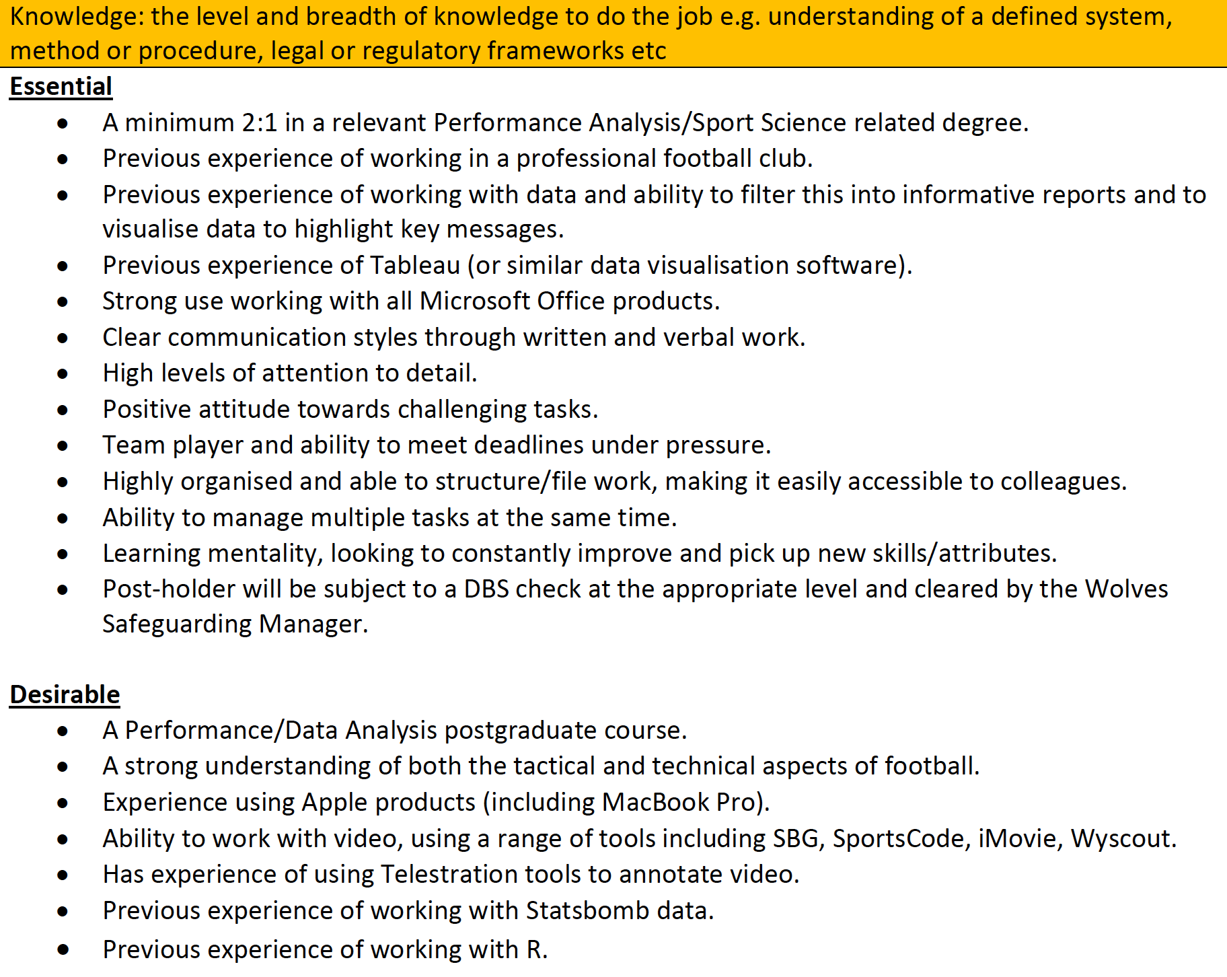
Advertisement examples
Notes:
When helping students throughout the development journey and reviewing our courses, we began to notice clear differences in adverts. Here is an advert on the left hand side for a first team assistant analyst that fits on one A4 piece of paper whilst an advert at a different club for an academy position is more extensive. The responsibilities have some overlap but the academy role is more detailed and requests extensive skills and experiences.

Slide 4
Seeking to Address the Gap in Knowledge
Research is beginning to explore the problem, BUT there is currently no understanding of whether sports settings align job descriptions and personal specifications with the recommendations made by researchers.
The study examined the key roles, responsibilities, and skills sought when advertising for the recruitment of APAs in UK and Irish professional sports settings from 2021 to 2022.
The insights have the potential to assist sports settings in tailoring their advertisements to align with specific needs across the entire APA spectrum.
Notes:
Subsequently, we sought to shed light on this problem and address the knowledge gap. The work of Martin et al. in 2021 from her PhD exploring the role of the analysts begins to provide clarity on what researchers and applied analysts think the role of the analyst is but do adverts actually align with these suggestions?

Slide 5
Methods
Text from 130 publicly available job advertisements was collected between 1st January 2021 to 31st December 2022.
Martin et al. (2021) framework:
Personal specification against the 4 out of 5 areas of expertise.
Tasks/responsibilities against the 9 components of APA practice.
Differences between Academy and First-team job advertisements were explored.
Notes:
As a result, we collected job adverts from a range of online websites over the two year period, leaving us with 130 adverts that were for full-time roles in the UK and Ireland.
We then extracted the text from these adverts and undertook manual content analysis linking to Martin et al’s framework. In particular, the personal specification section text were coded against the areas of expertise represented in blue on the lighthouse whilst the tasks and responsibility sections were coded against the components of practice, the red and white stripes.
We were particularly interested in the differences between academy and first-team. This left us with 65 academy adverts and 65 first-team adverts.

Slide 6
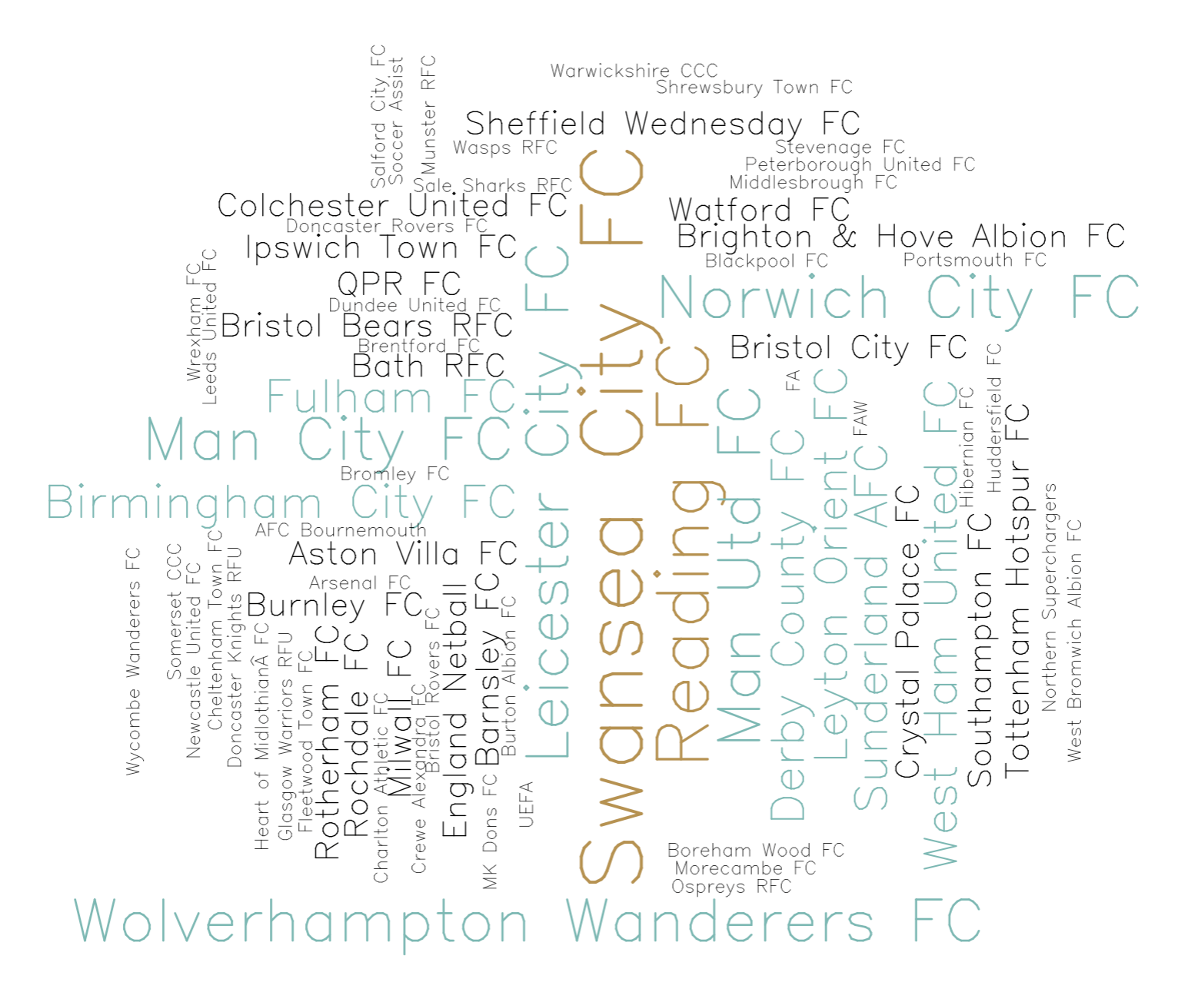
The shape of our data…
Specific Role Title Area | Academy | First-Team | Overall
Assistant | 1 | 15 | 16
Data |  | 3 | 3
FDP | 1 |  | 1
FDP & YDP | 11 |  | 11
General Academy | 1 |  | 1
Head | 5 | 7 | 12
Lead | 21 | 22 | 43
Opposition |  | 2 | 2
PDP | 7 |  | 7
Pre-Match |  | 2 | 2
Recruitment |  | 8 | 8
Research | 1 | 1 | 2
Set-Piece |  | 1 | 1
Technical |  | 1 | 1
Training |  | 1 | 1
U17-U21 | 1 |  | 1
U18 | 4 |  | 4
U23 | 6 |  | 6
Video & Data |  | 2 | 2
YDP | 5 |  | 5
YDP & PDP | 1 |  | 1
Overall | 65 | 65 | 130
Notes:
When looking at the specific job titles, 21 different roles emerged within Academy and First-team advertisements, demonstrating that this work was not focused on early-career analysts but represented a spectrum of role levels.
We also noticed some interesting trends with most recruiters advertising only once (n: 43) or twice (n:19) over the 24 months. Some sports settings are advertised more frequently, with Swansea City AFC (Academy: 4; First-team: 2) and Reading FC (Academy: 5) being notable examples. Obviously we don’t know the reasons for this but shows the continued growth of sport performance analysis over the two year period.

Slide 7
General observations within APA advertisements
Sport | Performance Level | Number of Roles | Tasks or Responsibilities | Essential Criteria | Desirable Criteria | Salary Mentioned
Cricket | Academy | 0 (0.00%) | 0.00 | 0.00 | 0.00 | 0
 | First Team | 3 (2.31%) | 13.00±2.65 | 13.00±5.20 | 1.67±1.53 | 0
Football | Academy | 59 (45.38%) | 11.05±4.96 | 10.17±4.71 | 3.28±2.44 | 10
 | First Team | 56 (43.08%) | 9.34±3.87 | 8.82±4.03 | 2.09±2.13 | 6
Netball | Academy | 1 (0.77%) | 13.00 | 16.00 | 7.00 | 1
 | First Team | 2 (1.54%) | 10.5±2.12 | 14.50±4.95 | 5.5±2.12 | 1
Rugby Union | Academy | 5 (3.85%) | 13.00±5.70 | 8.8±3.56 | 1.6±1.34 | 4
 | First Team | 4 (3.08%) | 10.25±2.99 | 10.00±6.32 | 1.5±3.00 | 1
Overall | Academy | 65 | 12.05±4.94 | 10.16±4.65 | 3.20±2.44 | 15
 | First Team | 65 | 9.60±3.77 | 9.26±4.33 | 2.14±2.21 | 8
Notes:
In particular, association Football APA positions dominated the data followed by smaller numbers in Cricket, Netball and Rugby Union. Assumingly due to finances available in football and the EPPP in academies.
The advertisements generally followed a default structure but as alluded to early the length and content of these sections differed greatly across our sample.
Academy APA roles typically had a larger number of tasks or responsibilities to cover compared to First-team. For example, Aston Villa FC, Swansea FC, and Munster RFC had over 20 job responsibilities or tasks in their Academy advertisements.
Furthermore, the personal specification section for Academy positions also tended to list a higher number of essential criteria that applicants must demonstrate
Only 23 of the 130 adverts displayed any financial details. Academy role salaries ranged from £15,000 to £29,000 whilst First-team roles salary information ranged from £18,000 to £30,000. There is continued backlash from applicants around the non-disclosure of finance details, particularly disparities between clubs for similar roles or how clubs financially view and value different support staff.

Slide 8
Personal Specs vs Areas of Expertise
Notes:
When looking at all text from the personal specifications within the 130 adverts, 'PA and Sport Expertise', 'Technical Expertise', and 'Professional Behaviours' were requested more frequently than ‘Building Relationships’, regardless of job level. Academy positions emphasised these to a greater extent than First-team roles. Potentially due to having more detailed adverts or wanting more from this level of analyst.

Slide 9
Personal Specs vs Areas of Expertise
Notes:
Academic and coaching qualifications were frequently requested, with Academy roles often requiring them significantly more often than First-team roles
We noticed that an undergraduate qualification was often an essential requirement (Academy: 48; First-team: 43), while only nine job advertisements listed it as desirable (Academy: 3; First-team: 6). Additionally, post-graduate qualifications, UEFA B licences or Level 2 coaching qualifications were more frequently requested for Academy roles compared to First-team roles

Slide 10
Personal Specs vs Areas of Expertise
Notes:
First-team advertisements typically requested general experience or skill-specific experience whilst, Academy advertisements typically sought role-specific experience working with specific age groups.
First-team roles requested ‘Data Reporting and Visualisation Skills’ more frequently (Academy: 25; First-team: 45), whereas Academy roles emphasised ‘IT Software Skills’ (Academy: 57; First-team: 36). ‘PA Software Skills’ were commonly requested, with advertisements often referring to industry-standard SPA software, in some cases by software programmes name.

Slide 11
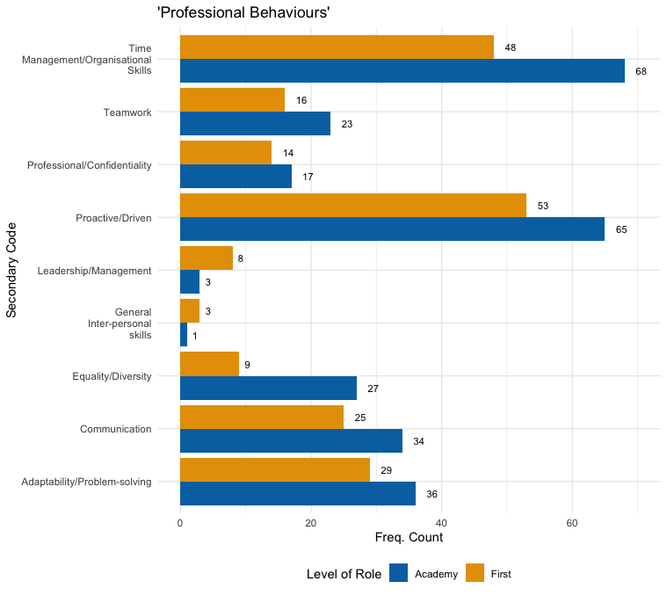
Personal Specs vs Areas of Expertise
Notes:
‘Professional Behaviours’ were frequently mentioned in job advertisements, with attributes such as being proactive, having good time-management skills, and effective communication being highly requested. Noticeably, Academy positions placed a stronger emphasis on ‘Professional Behaviours’, except leadership qualities which were sought more frequently in First-team advertisements. But still less leadership skill set requests in comparision to the number of Head or Lead positions which was 55.

Slide 12
Job Task/Responsibilities vs Components of APA Practice
Notes:
‘Data collection and reliability checking’ was the most frequently requested component, with Academy roles placing a higher emphasis (Academy: 175; First-team: 148). Academy positions requested ‘Facilitation of Feedback’ (Academy: 145; First-team: 64) and ‘Needs Analysis and Service Planning’ (Academy: 123; First-team: 77) more frequently than First-team roles. In contrast, ‘Analysis’ and ‘Reporting to Key Stakeholders’ were more frequently requested in First-team advertisements.
In the ‘Analysis’ category, there were minimal numerical differences in the task of creating ‘Profiles and Visualisations’ (Academy: 63; First-team: 65), while ‘Interrogation of Data’ more frequently in First-team roles.
The ‘Execution Phase’ was the most frequently requested task in the ‘Data Collection and Reliability’ category; particularly in Academy advertisements (Academy: 145; First-team: 120). Due to the accessibility of resources. It’s noteworthy, the ‘Reliability Phase’ only appeared in three advertisements despite researchers in performance analysis highlighting this as a core task.

Slide 13
Job Task/Responsibilities vs Components of APA Practice
Notes:
Academy advertisements emphasised tasks related to ‘Facilitation of Feedback’; planning of feedback was seen as more of a role for academy analysts. However, the planning to delivery ratio was less in both academy and first team roles suggesting that in certain settings, coaches would be delivering feedback with the analyst facilitating rather than delivering the sessions.

Slide 14
Job Task/Responsibilities vs Components of APA Practice
Notes:
Within the ‘Needs Analysis and Service Planning’ component, Academy advertisements more frequently requested tasks related to ‘Agree Service Plan’, ‘Audit Available Resources’ and ‘Capture Stakeholders Needs’. Maybe due to the EPPP requirements in academies to plan and audit and also having more stable staff structures.

Slide 15
Job Task/Responsibilities vs Components of APA Practice
Notes:
First-team job advertisements placed a greater emphasis on ‘Reporting to Key Stakeholders’. in particular, ‘Data Translation’ (Academy: 31; First-team: 48) tasks were requested at higher frequencies. Linked back to the exectution phase being requested less in first team environments, potentially due to having more automated processes.

Slide 16
Job Task/Responsibilities vs Components of APA Practice
Notes:
The ‘Service Review and Evaluation’ component was more prominent in Academy advertisements, particularly ‘Evaluate SPA Provisions’ (Academy: 64; First-team: 33). The tasks of ‘Review’ and ‘Share’ recorded lower frequency counts, indicating less focus on formally capturing feedback and sharing practice, and a greater focus on APA reflecting on delivery in both roles.

Slide 17
Job Task/Responsibilities vs Components of APA Practice
Notes:
Finally, the ‘System Design’ component revealed significant differences between Academy and First-team roles ($X^{2}$ (1, N = 45) = 6.412, p= .011, V = 0.377). First-team job advertisements emphasised ‘Explore System Requirements’ (Academy: 7; First-team: 15), whereas ‘System Design and Testing’ was mentioned more frequently in Academy advertisements (Academy: 16; First-team: 7).

Slide 18
Summary and Recommendations
Clear differences emerging regarding what employers are looking for across academy and first-team roles…
But the advertisements lack structure and key information.
Organizations should take time rather than adopting a copy-and-paste mindset regarding advertisements.
Advertisements should include:
Employer familiarity information
Description of job-related tasks and personal specification
Salary and remuneration
Opportunity for advancement
(Petry et al. 2021)
Findings aid applicants and SPA/APA developers.
Notes:
In summary we have started to identify clear differences in what tasks and expertise advertisements seek when looking to appoint applied analysts but further work is needed to begin to delve deeper into the specific job titles that are beginning to emerge.
Despite these patterns emerging in what clubs were looking for, the actual adverts differed significantly and we almost noted a copy and past mind set from similar roles being advertised at other clubs rather than taking time to really think what the role in that club entails.
When looking at recommendations from the world of business, we also noticed that there were no details in to what the performance analysis department, philosophy or culture entailed leaving applicants unsure of whether the environment would fit with their skill sets, experiences and philosophy. Whilst adverts included information around the tasks and specifications, it is worth BASES, ISPAS and other organisations beginning to develop standardized criteria that may help produce clear pay bands dependent on competencies and tasks.
Also, adverts did not mention details around role progression that has been found to be a key driver for job satisfaction and job performance.
These findings and recommendations uses Perty et al.’s work to help enhance the advertisement quality, aiding employers in actually getting what they are looking for, helping applicants highlight specific aspects that align to the club but also performance analyst developers with supporting the development journey of analyst and preparing them for the future.

Slide 19
References
Martin, D., O Donoghue, P. G., Bradley, J., & McGrath, D. (2021). Developing a framework for professional practice in applied performance analysis. International Journal of Performance Analysis in Sport, 21(6), 845–888. https://doi.org/10.1080/24748668.2021.1951490
Petry, T., Treisch, C., & Peters, M. (2021). Designing job ads to stimulate the decision to apply: a discrete choice experiment with business students. The International Journal of Human Resource Management, 1–37. https://doi.org/10.1080/09585192.2021.1891112

Slide 20
What do Applied Performance Analyst employers really want?: Comparative analysis of job advertisements in the UK and Ireland (2021-2022)
J.francis@worc.ac.uk
@drjwfrancis
A presentation from a member of the
BASES Special Interest Group Performance Analysis Steering Committee

