Slide 1

IT WAS GENUINELY QUITE UNPLEASANT:
TRANSGENDER MEN’S EXPERIENCES
IN PHYSICAL EDUCATION
IN THE MIDLANDS, ENGLAND
5th International Conference on Gender and Sexuality 2022
Chadwick G and Pepperell R
School of Sport and Exercise Science, University of Worcester, United Kingdom
This Photo by Unknown Author is licensed under CC BY-SA

Slide 2
Introduction
QR Code
Undergraduate degree Independent Research Project
Grand designs
Difficult ethical approval process
Recruitment
The recommendations – my personal experience as a PE teacher in this situation

Slide 3
The Background…
QR Code
“There is no other school subject in which the body is as exposed as in physical education.
Neither is there a subject where one is more dependent on the others’ reactions to the body”
To explore the similarities and differences of experiences of transgender individuals in PE and analyse the factors that contributed to these experiences.
To provide practical advice for teachers and schools for supporting transgender students.

Slide 4
The Method…
QR Code
Results were analysed through thematic, theoretical analysis based on Braun and Clarke’s 6 stages (as cited by Gratton & Jones 2010 p240 and Braun et al, 2016, Belotto, 2018, Coates et, al., 2021).
The analysis also fitted within critical paradigm and theory-based analysis (Markula and Silk, 2011).
The British Sociological Association, Statement of Ethical Practice (2017) and The British Psychological Society (BPS) guidelines were adhered to at all times.
Interpretivist, positivistic, qualitative design using a case study-based interview with two transgender male participants, who attended secondary education in the Midlands, England.
(Smith and Sparkes, 2016; Tracy, 2019).

Slide 5
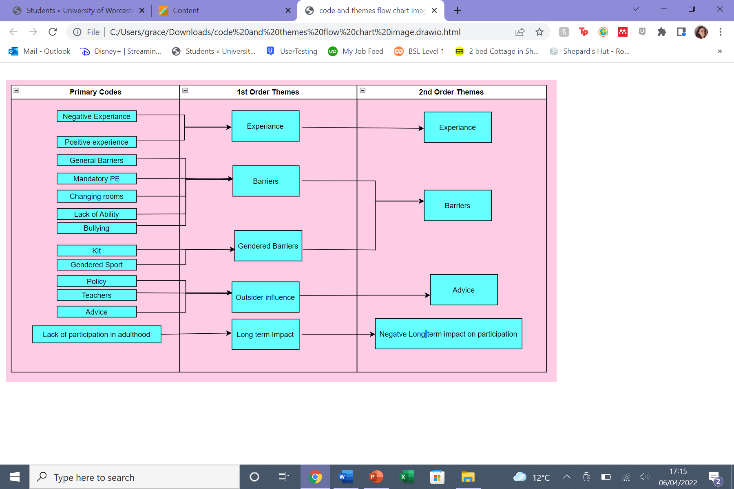
The Findings…
QR Code
Despite having many differences in their experiences, Oliver and Bertie’s experiences generally stemmed from the same barriers: changing room bullying and lack of ability.

Slide 6
The Findings…
QR Code
Oliver: genuinely an unpleasant atmosphere
Bertie: I'd spend all the time waiting for everyone else to get dressed …
facing the wall so that I could not see anyone and couldn't be accused of
looking and then get dressed once everyone was gone.
Oliver: I was not quite good enough.
Bertie: Even without, being trans and,, the being in the changing rooms.
I'm not good at sports, so PE was already a terrible subject for me anyway

Slide 7
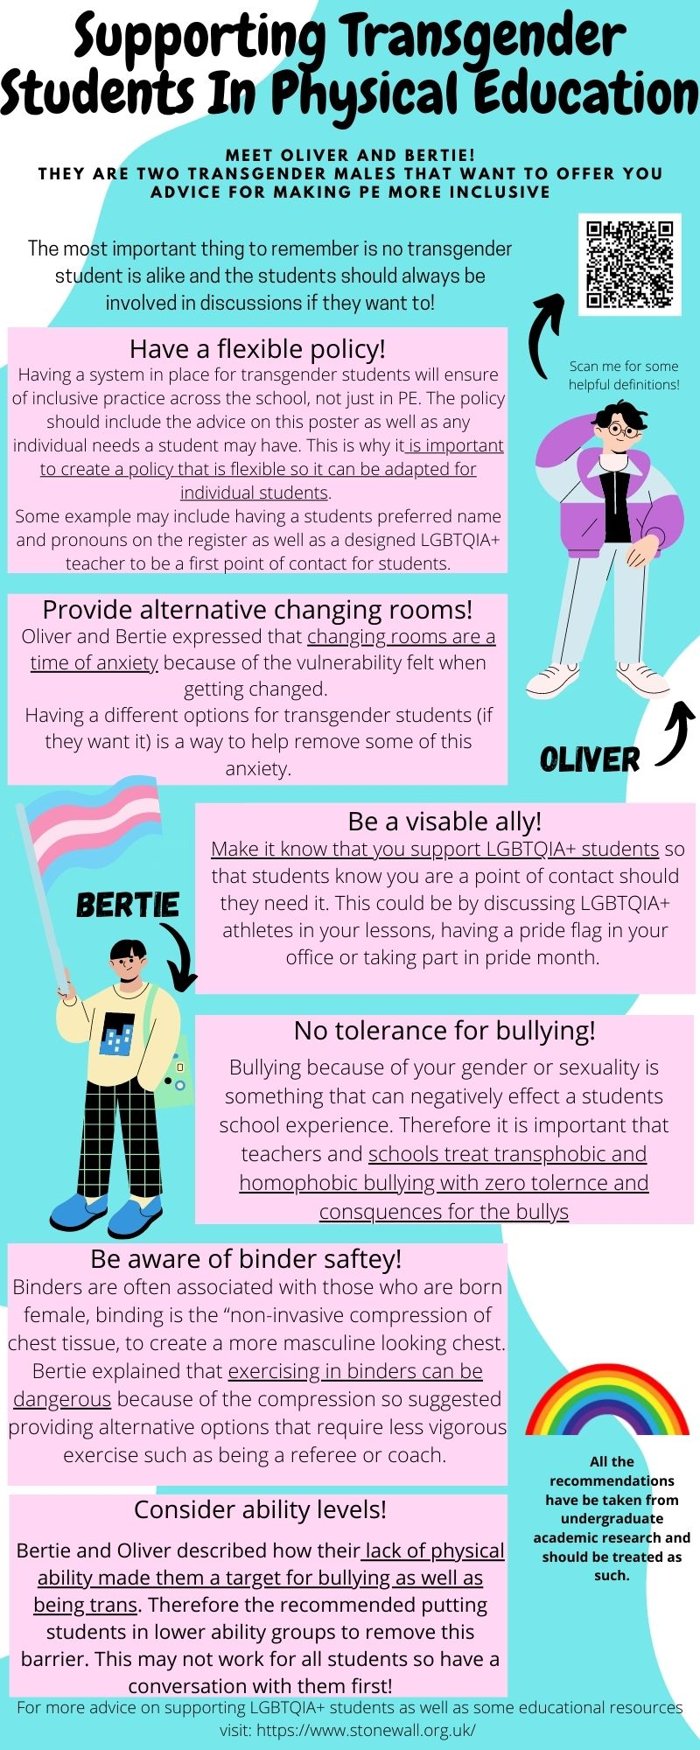
QR Code

Slide 8
The Limitations…
QR Code
The recruitment process concluded in a case study (Manson, 2010; Hennink, 2019).
Participants were both transgender men (Merriam and Tisdell, 2016; Lindqvist et, al., 2021).
Researcher Bias (Smith and Sparkes)

Slide 9

THANK YOU!
QR Code
Grace Chadwick and Richard Pepperell
School of Sport and Exercise Science, University of Worcester, United Kingdom
Email:
g.chadwick@worc.ac.uk r.repperell@worc.ac.uk
This Photo by Unknown Author is licensed under CC BY-SA

