Slide 1




Get practical with
the UN SDGs!
@ELengthorn

Slide 2

Notes:
END EXTREME POVERTY.
FIGHT INEQUALITY AND INJUSTICE.
TACKLE CLIMATE CHANGE

Slide 3
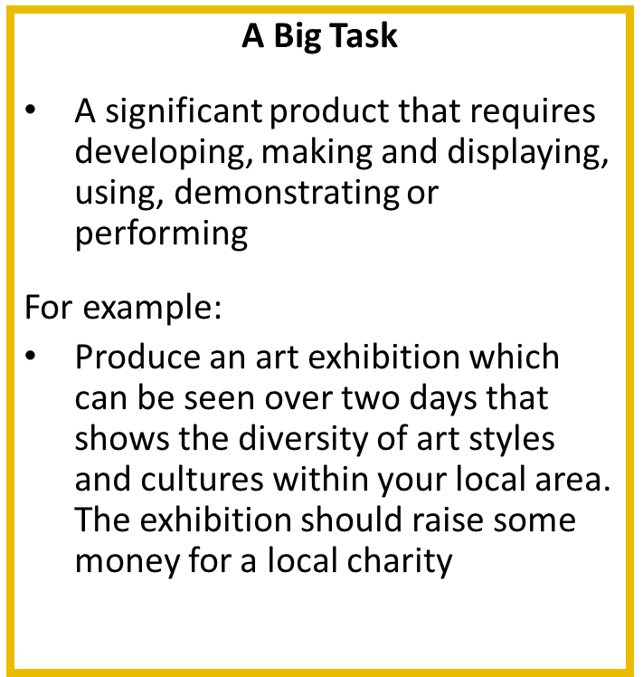
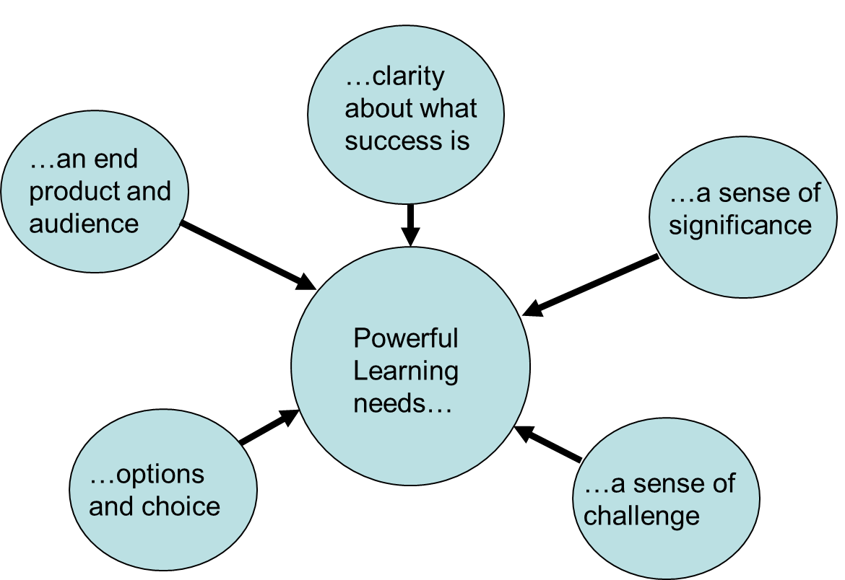
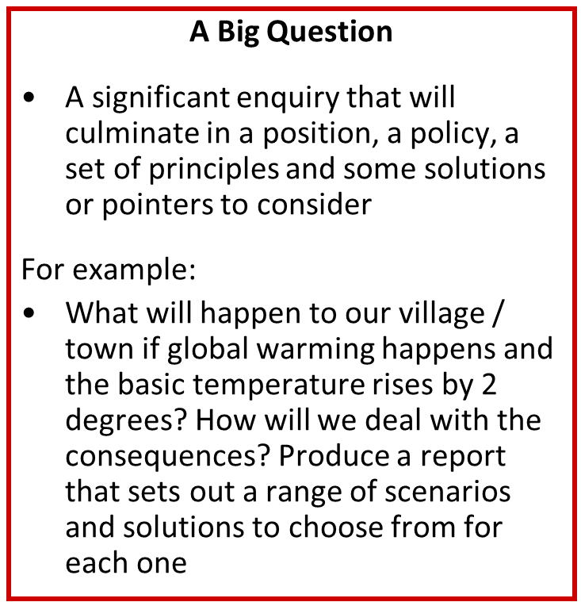

Five Elements Needed for Powerful Learning

Slide 4
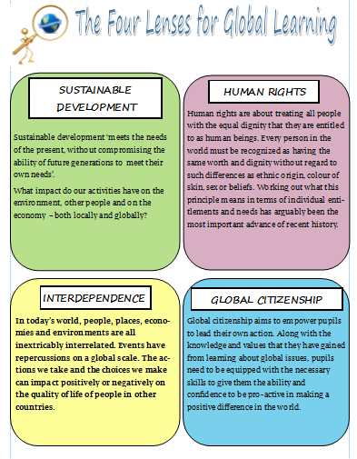

Slide 5

Notes:
Our first BIG task is to consider Household Air Pollution

Slide 6
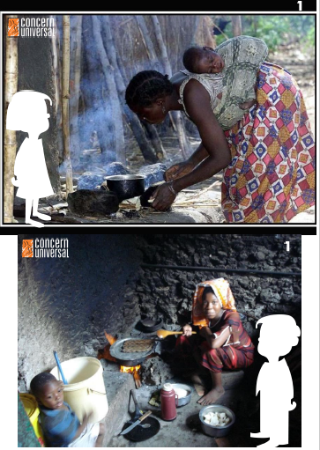


Slide 7



Slide 8

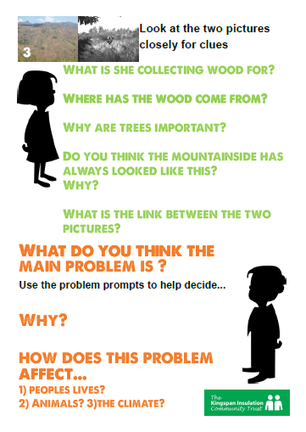

Slide 9




Slide 10
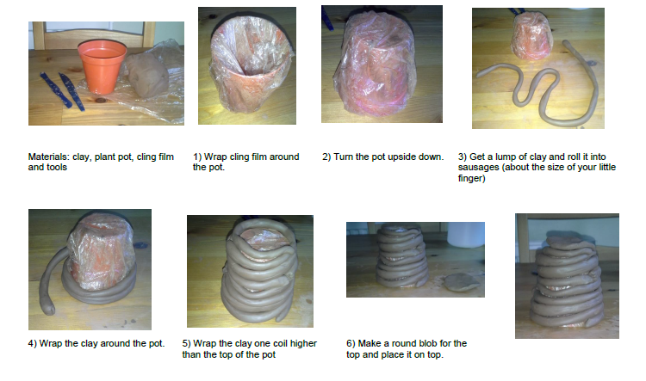

Slide 11
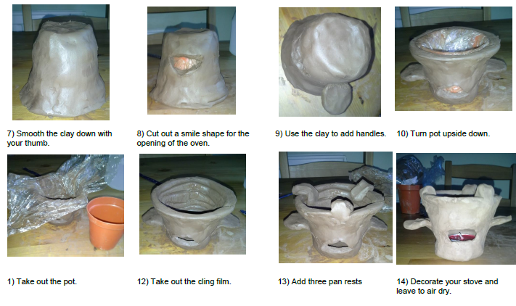

Slide 12


Slide 14

Notes:
Our second Big Task is to provide ecologically and economically sustainable sources of light to underprivileged communities around the world. Slum darkness can prevent productivity, lead to accidents, cause depression, alcoholism and prevent socialising.

Slide 15
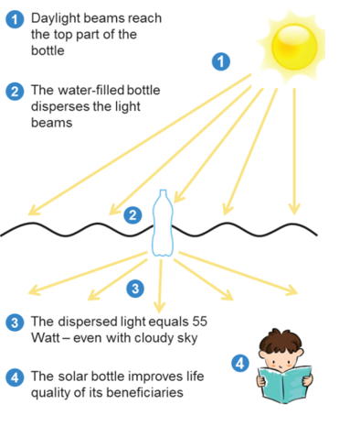
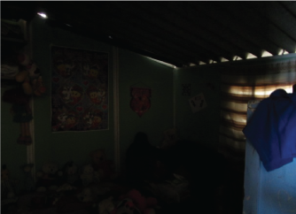
Litre of light
Video clip
Make water bottle lights
Consider their impact

Slide 16
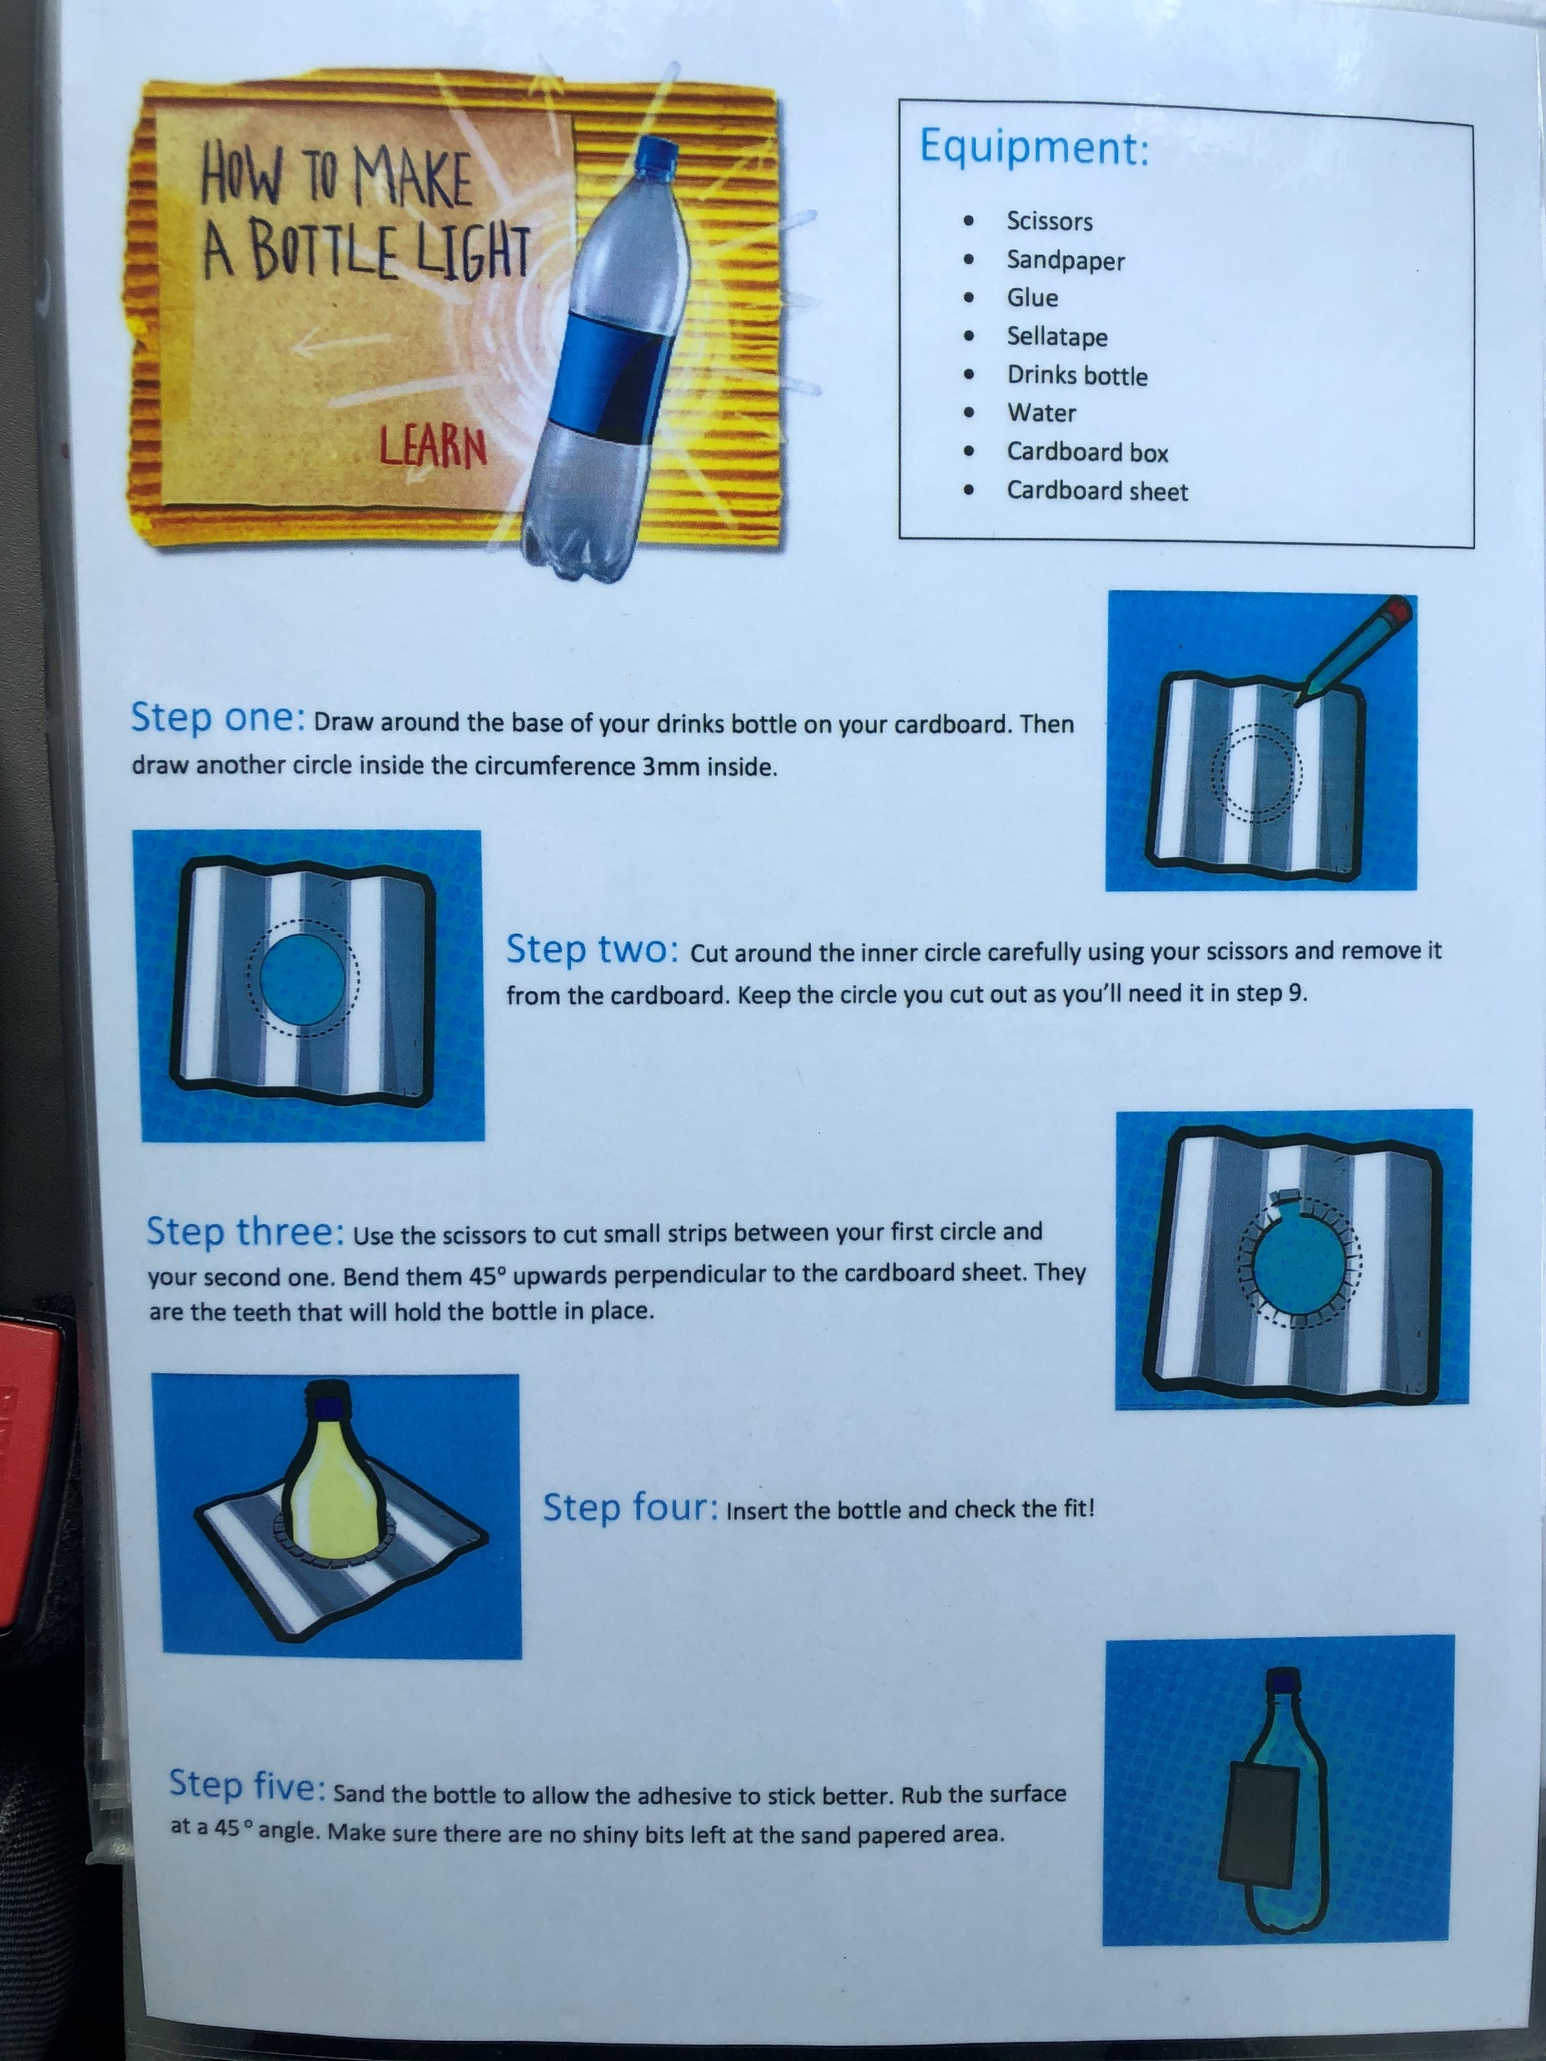
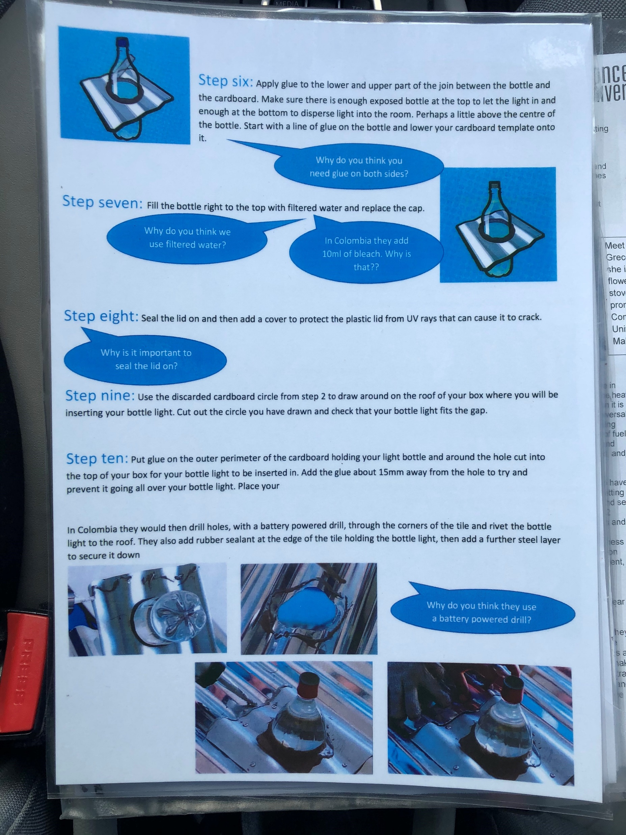

Slide 17
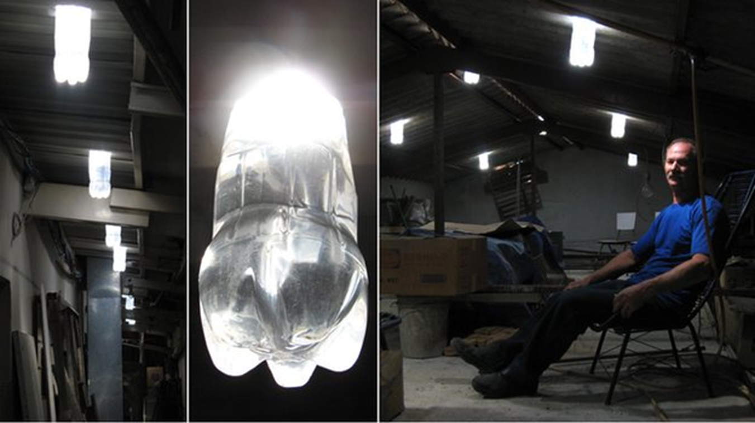

Slide 18
Notes:
3 – health and wellbeing
5 empowering women and girls
7 affordable and clean energy
8 decent work and economic growth
10 reduced inequalities
13 – combating climate change

Slide 19
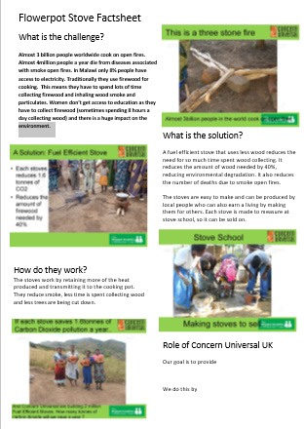
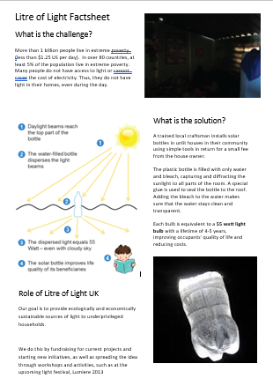

Slide 20
Three Top Tips
Try to make your SDG learning active and powerful by having an end product and an audience, as well as a sense of significance and challenge.
Build links with local development organisations and charities so you can share work that is being supported by your local community and provide opportunities to get involved.
Use the International UN observances as a hooks e.g. https://www.un.org/en/observances/clean-air-day 7th September

Slide 21


Further reading
Rosenthal et al (2018). Clean cooking and the SDGs. Energy for Sustainable Development, Volume 42, February 2018, Pages 152-159
Available at: www.sciencedirect.com/science/article/pii/S0973082617309857
UNESCO (2017). Education for Sustainable Development Goals:
Learning objectives. Available here: https://unesdoc.unesco.org/ark:/48223/pf0000247444
UNESCO (2021). Reimagining our Futures Together: A new social contract for education. Available here: https://unesdoc.unesco.org/ark:/48223/pf0000379707.locale=en
World’s Largest Lesson: https://worldslargestlesson.globalgoals.org/

Slide 22

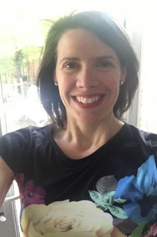

Elena Lengthorn
Senior Lecturer Teacher Education e.lengthorn@worc.ac.uk

Slide 23
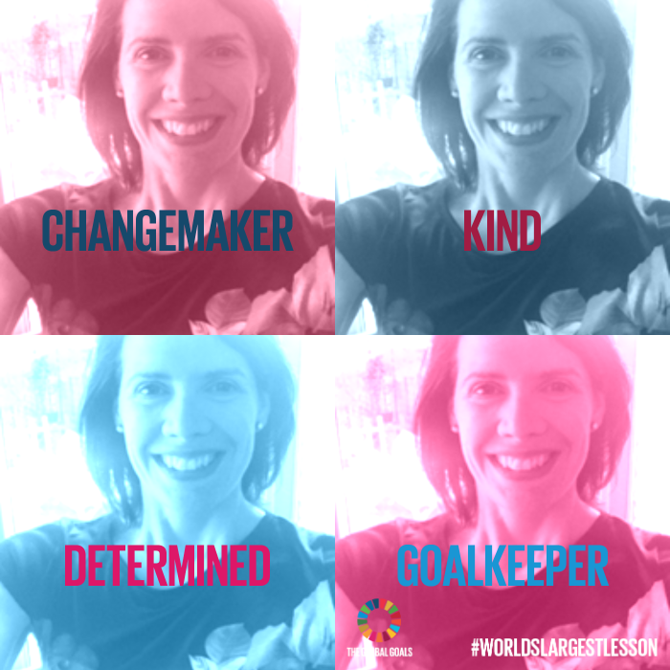




Notes:
https://think-global.org.uk/global-educator-year-2016/
Add Uni logo

