Slide 1
Move the World
with the SDGs
Movement and case studies, to build knowledge and change behaviour
@ELengthorn

Slide 2
Notes:
Project number 1 – workshop on this tomorrow afternoon

Slide 3
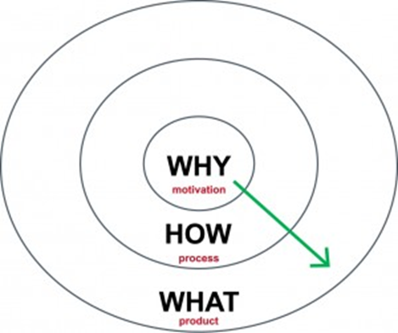
Why should we build in 15 minutes of movement?
How can we build in 15 minutes of movement?
What movement will we do and what will it achieve?
Notes:
Obesity, depression, anxiety, low mood, CV disease, bone health problems, loneliness
Essential for child development and lay the foundation for a healthy, active, lifestyle.
The World Health Organization stated an average of 60 min of Moderate to Vigorous Physical Activity (MVPA) that children should accumulate every day.
These findings outline the need for strategies to promote PA and reduce sedentary behaviours in children to prevent COVID-19 restriction long-term effects.
https://bmcpublichealth.biomedcentral.com/articles/10.1186/s12889-021-12483-0: The impact of COVID-19 on physical activity behaviour in Italian primary school children: a comparison before and during pandemic considering gender differences
Dallolio et al, 2022
https://www.sportengland.org/news/coronavirus-challenges-highlight-importance-physical-activity-and-sport-children
Overall, children and young people are doing fewer activities than they were before the pandemic. Another concerning piece of evidence from the report is that children and young people reported fewer positive attitudes towards sport and physical activity over the 2020-21 academic year, with enjoyment and confidence in taking part seeing significant drops – two of the five components defining physical literacy (competence, understanding and knowledge being the others). If positive attitudes and physical literacy levels don't increase, there's a likelihood the next generation will be less active, leading to poorer health and wellbeing outcomes.
Build pupil ownership
Even better if we take it outside!

Slide 4
Notes:
Conservation and household pro-environmental behaviours
Eudamonic wellbeing (sense of purpose) – evaluative wellbeing (life satisfaction) – overall well being – general health
http://publications.naturalengland.org.uk/publication/6005041314136064

Slide 5
Congratulations!
You have promised to Move the World

Slide 6
Move the World

Slide 7
Move the World
This project has been created to help you to learn about sustainability, geography and to encourage you to exercise.
If you are active for 15 minutes every day, you will make your way around the world, learning interesting things about different countries.
You will learn about the global Sustainability Development Goals (SDGs) which are a set of targets for the world to aim for by 2030 in order to make the world a better and healthier place for us all to live in.
^{Did you know...?}
‘Sustainability’ means being able to meet our needs without stopping future generations from being able to do the same. e.g. not using up all natural resources, keeping the climate at the right level, and making things equal for all people.

Slide 8
Good Health and Wellbeing
What does this mean?
Good health and wellbeing is when people are free from illness and disease, and feel happy.
We need to make sure that everyone in the world has access to doctors and medicine when they need it.
There are lots of diseases that can be prevented with vaccinations, or with a good lifestyle, which includes eating well and getting lots of exercise.
We need to let people know what they can do to live healthily and happily.

Slide 9
Good Health and Wellbeing
How does Move the
World help?
Exercise keeps your body and mind fit and healthy so you are less likely to be ill. The Move the World project is therefore encouraging children like yourselves to be active for 15 minutes each day. This should help you to feel happier and more awake.
We also need to keep our world healthy, so it is important to learn about sustainability too. Sustainability means using natural resources in a way that we could keep doing for a long time. Living more sustainably can also make you feel better about yourself.

Slide 10
?
Health and Wellbeing
QUICK QUIZ
1. How many portions of fruit and
vegetables should you eat each day?
a.) 0-2 b.) 5-10 c.) 20-30
2. If you want to improve your mood, which of
these should you NOT do?
a.) Talk about it with someone
b.) Do some exercise
c.) Think about your problems alone
3. How much water should you drink each day?
a.) None b.) At least 5 glasses c.) 20 pints

Slide 11
?
Health and Wellbeing
QUIZ ANSWERS
b. You should eat 5-10 portions of fruit and
vegetables each day. Eat more
vegetables than fruit, and try to eat a
variety of colours too, to get a variety
of good nutrients.
2. c. If you are feeling sad, don’t think about your problems alone. It always helps to talk to someone - a teacher, a friend, or your family. Exercise can also help your mood.
3. b. You need to drink at least 5 glasses of water a day to keep your body and brain hydrated and able to work properly. A lack of water is called ‘dehydration’.
^{Did you know...?}
Around 60% of a human body is water, and the brain is about 80% water.

Slide 12
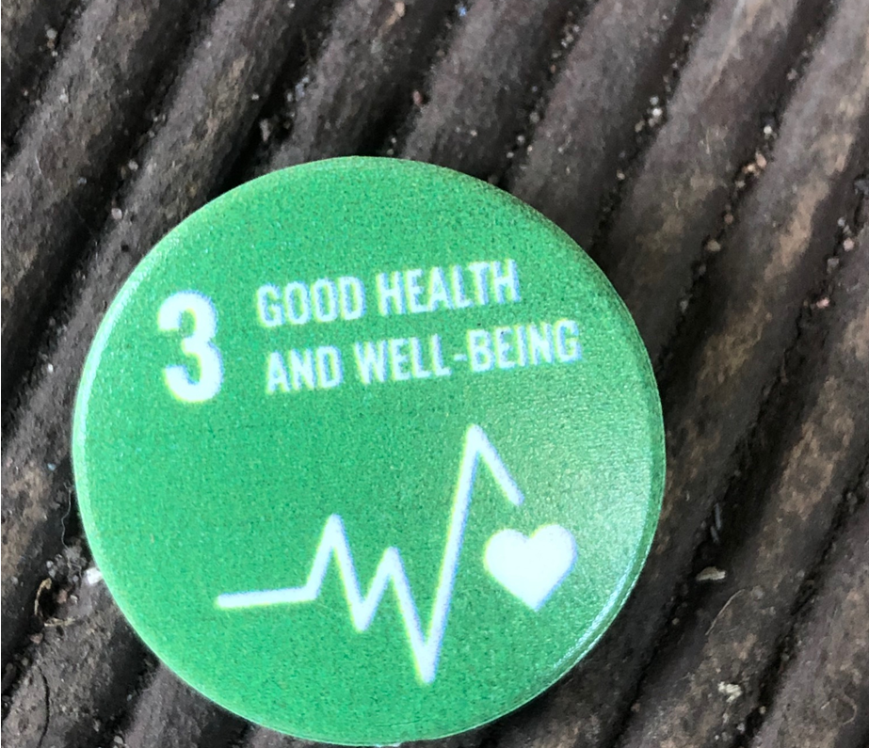
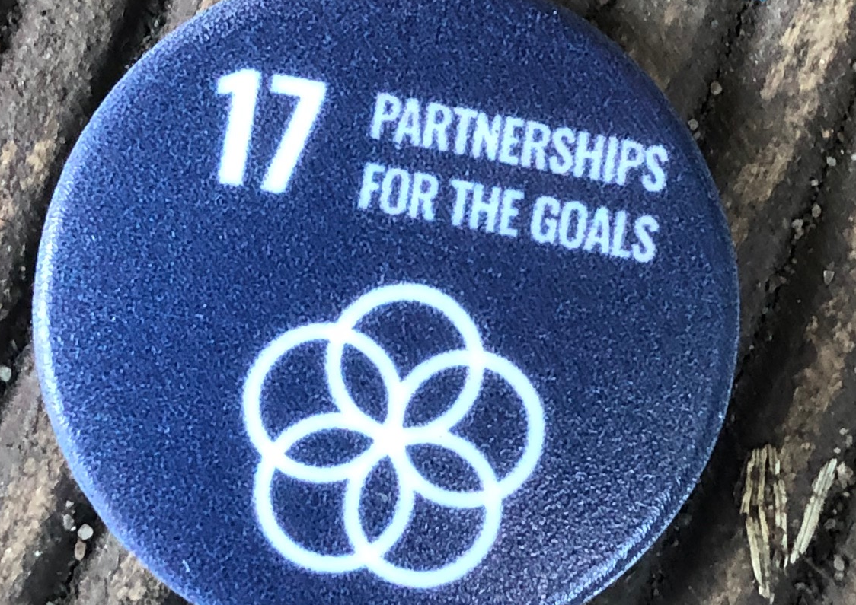
How can you ‘Move the World’?
Notes:
A starting point for combining exercise and case studies to learn about the SDGs – intrinsic and extrinsic motivation and sending messages home

Slide 13
Congratulations!
You have reached India!

Slide 14
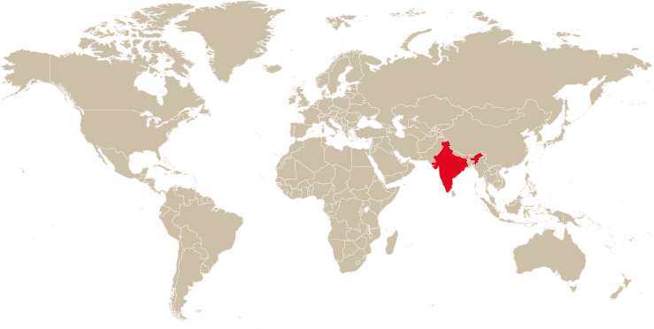
Where in the world?

Slide 15
India
Almost 1.4 billion people live in India - it has the second
largest population of any country in the world.
India is a country on the continent of Asia.
There are 22 official languages in India, the most commonly spoken being Hindi.
Cows are sacred in India - they are highly respected and honoured animals.
India is home to the 3rd highest mountain on Earth – Kanchenjunga (8586m tall).

Slide 16
No Poverty
What does this mean?
Half of the population of the world is thought to live in poverty, which means they are poor. These people might not having enough money, food, fuel, clothing or shelter.
The poorest children are less likely to be in school and are more likely to die than those who are richer.
Everybody deserves the chance to thrive in life, so we need to make sure that things like housing, basic services (e.g. water and electricity), technology, jobs, medicine and schooling are available to everybody.

Slide 17
No Poverty
What has India been doing?
Around one quarter of the population of India is classed as ‘poor’.
The Indian government has created schemes including the Mahatma Gandhi National Rural Employment Guarantee Act 2005. This act makes sure people in the countryside have at least 100 days paid work per year.
India now has a National Social Assistance Programme which helps those who are out of work, old, sick or disabled.
These programmes, and others, have made sure that there are now fewer people living in poverty in India.

Slide 18
?
QUICK QUIZ
India
1. What is the capital of India?
Here is an anagram of the answer:
‘HEEL WIND’
2. What is the name of this famous Indian
monument?
a.) Taj Mahal b.) Tal Majar c.) Tam Jahal
3. There is a temple in the area of Rajasthan that is dedicated to which animal?
a.) Elephant b.) Rat c.) Goat

Slide 19
?
QUIZ ANSWERS
India
The capital of India is NEW DELHI, which has a
population of over 31 million.
2. a. This monument is called the Taj Mahal. It attracts 7-8 million visitors each year.
3. b. The Karni Mata Temple is
dedicated to rats!!
Would you like to visit a
temple full of rats?
^{Did you know...?}
The Taj Mahal was built from 1631 to 1648.
It is a tomb for the wife of an Emperor.
?

Slide 20
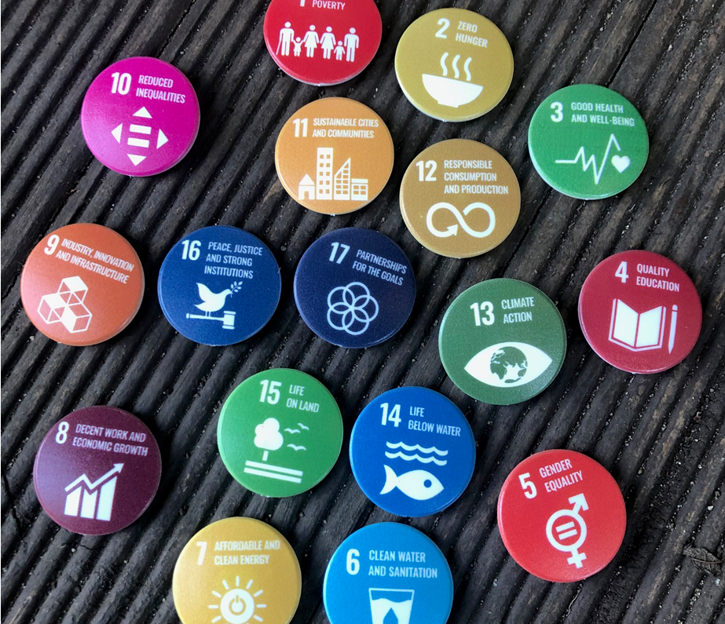
Associated resources
SDG teaching resource and suggested activity
A3 ‘Classroom’ posters
Pin badges
Notes:
The badge supplier is Silk Group https://silk-group.com/services/branded-merchandise/ they have an Eco range which where we purchased the badges from https://www.gogreenpromotions.co.uk/recycled-badges-gg0156b.html
They are 100% recycled plastic made in the UK

Slide 21
Participatory Action Research (PAR) opportunity

Slide 22
DCT: Reflective diary

Slide 23
DCT: Semi-structured interview

Slide 24
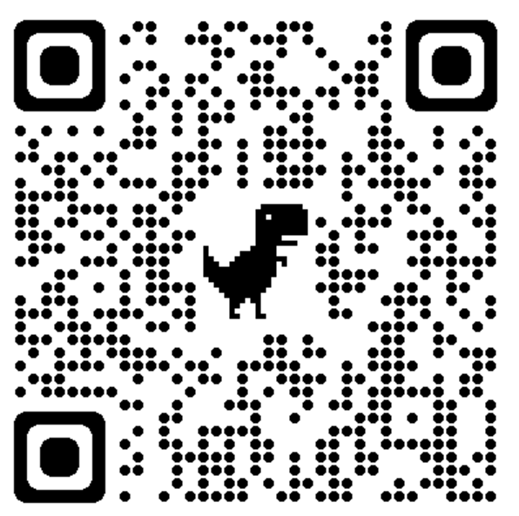
Padlet
What do you think of ‘Move the World’?
Would you like to use ‘Move the World’?
Would you like to be part of the ‘Move the World’ pilot?

Slide 25
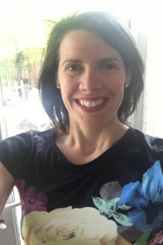
Elena Lengthorn Senior Lecturer Teacher Education e.lengthorn@worc.ac.uk
@Elengthorn
#TiE2022

