Slide 1
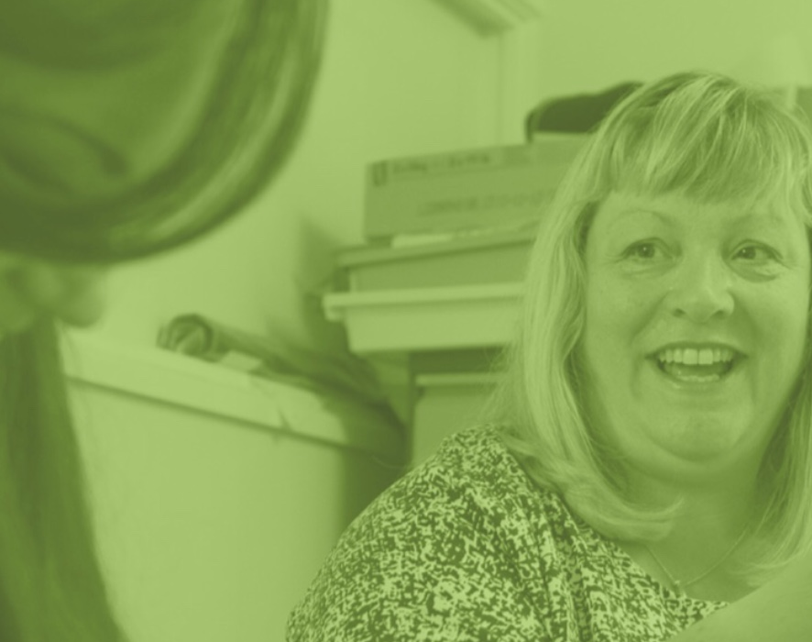
Exploring the experiences of domestic abuse survivors working in the field of domestic abuse support: assisting recovery or re-victimisation revisited?
Beverley Gilbert
University of Worcester
4th ECDV
Notes:
This presentation considers the experience of women who act as domestic abuse support workers and the impact on them, both positive and negative, of undertaking such demanding work with lived experience of domestic abuse themselves. This study considers the voice of women survivors working in the field of domestic abuse support work, affording them the opportunity to explore the benefits and the costs to them personally.

Slide 2
The Data
Interview data from 12 respondents was collected from 5 different organisations
Including women from both statutory provision and third sector, charitable organisations.
Organisations were located in England: one in the North West, two from the Midlands, one from the South East and one based in the South West region.
Women’s roles varied from volunteer support worker, peer mentor, paid support worker, to the top level of some organisations.
Notes:
Following a literature review of this area, women ‘survivor support workers,’ or ‘peer support/mentors,’ have rarely been given the opportunity to articulate what it is that they are gaining personally and the impact in undertaking this emotionally challenging work. In-depth, semi structured interviews were used with each participant to consider the depth of the respondents’ accounts and experiences.
Twelve women survivor support workers from five distinct organisations in England took part in this research. Semi structured, qualitative interviews were undertaken then analysed thematically within a feminist paradigm. Findings indicate that there are both highly positive aspects for survivors of abuse working in the domestic abuse sector, and equally, that there are areas of risk where re-victimisation and vicarious trauma could occur. This research comes from a feminist paradigm, as the researcher affirms the identity of a feminist writer for the purposes of research undertaken. As such, there is an acknowledgement that the researcher acts as a ‘central active ingredient of the research process’

Slide 3
Key Themes: Benefits
Self actualization
Esteem
Belonging
@username
Notes:
Findings: -The benefits to both survivor support worker and to the women clients can be powerful within the domestic violence support sector. -Survivor support workers can gain a sense of self- actualisation, esteem and belonging when working in the domestic abuse support sector. This can serve to empower women and reinforce their personal sense of survival. Once participants’ views were divided into clearly articulated themes, it became apparent that they correlated closely with the upper range of Maslow’s Hierarchy of Human Need: self-actualisation, esteem, and belonging. Whilst the universality of Maslow’s model is not without critique regarding issues of intersectionality (Bouzenita and Boulanouar, 2016; Gamberel and Cianci, 2003), it is not the first time Maslow’s model has been used when writing about domestic abuse. Abrahams does so when considering the overall effects of domestic violence on victims (Abrahams, 2007: 22). Whilst the Maslow model is not from a feminist paradigm, it fitted well in terms of the themes women participants articulated as the key areas of benefit for them in undertaking support work in the domestic violence sector.

Slide 4
Statements indicative of self actualization
“In some ways you can look back on the abuse and think, well actually, I’ve used that experience to the good of others and that can sometimes make you at peace with yourself.”
“I suppose it’s a silver thread that can be pulled from the trauma of what I went through. I can pull one positive aspect from the experience of abuse and use it for something good, something honourable – helping other women to move from victim to survivor, like I was able to, with the help of other women survivors.”
Notes:
Self-Actualisation is interpreted within this study as women being able to use their own lived experience for the benefit of other women, to develop self-identity, a sense of purpose and to become fully functioning as an individual. Thereby creating something that they consider to be positive after the pain of their own lived personal experiences of domestic abuse. This in turn allows women to make some sense of their past experience, to increase their sense of actualisation and to enable themselves as survivors to develop a sense of ongoing purpose.
All 12 women interview participants indicated that within their role they were able to create something positive from a past traumatic episode in life, gaining some sense of closure on the period where abuse was experienced and being able to create a meaningful distinction

Slide 5
Esteem
“When you’ve gone through domestic abuse, everything’s kind of taken away from you. You become kind of like, I call it a shell of myself, or what I used to be. Actually, you know, you can get back to that person, to who you were and to be helped to be moved along that way, not only to that person, become someone better as well. To show to other women and be able to help them along that route was really good. I mean the kind of thing is that when you’re going through DV I see it that you, you just accept crumbs, so why have the crumbs when you can have the whole loaf?”
“I had very low self-esteem, very low confidence, you know, just looked at the floor, didn’t look up. One of my friends said that I was like a little mouse and every time, I cried. I still haven’t got loads of confidence, but I can actually stand up in front of people I never thought I’d be able to do that and actually talk to people, you know, and I love talking anyway.”
Notes:
In terms of this study, esteem is understood as women being able to develop a sense of confidence, self-worth and feeling of empowerment. This is arguably more important for
Interviewee 3
10
women surviving domestic abuse since the complex and repeated nature of abuse diminishes all of these areas of being, decimating esteem whereby recovery can be lengthy and nonlinear

Slide 6
Statements indicative of belonging
“The advantages of being an ex-victim of domestic abuse gave me a deeper understanding or the women that I was talking to, the women would see me on the same level as one of them, not that I talked about my own experience because I didn’t, but they saw me as somebody they could actually talk to and they would tell me a lot more than they’d tell support workers. I knew the women that were talking to me; I knew what they’d been through themselves, you know, and having that understanding, it gave me, it gives you a lot of patience with victims as well.”
“Women are very intuitive, they can tell when somebody really gets it and I think by going through domestic abuse and being able to really know what they’ve gone through, see their, like their internal battles they’re having with themselves, they can tell. Within my experience of working here, where we’ve had younger women coming through who haven’t experienced domestic abuse, it all, isn’t always a good fit with all the women, it’s like they can tell, you know.”
Notes:
Belonging is understood as women being able to enjoy an environment of feeling comfortable, at ease, of both understanding and of knowledge. One way of achieving a sense of belonging may be for women survivors to become peer supporters to other women.

Slide 7
The Negatives or the disadvantages
Expressed by interview participants
1
Triggering, Vicarious Trauma and Burnout
“I know when I first started this role; I found it really difficult to separate my life and their lives. I’ve related so much to it all, I was taking it home with me and then going through pictures and remembering a lot of stuff and I had to very quickly, I managed to actually learn to go, okay, that’s work, this is home.”
2
Self-blame, frustration and failure to help women
“I think that’s where at the beginning when I first started was probably a drawback because you wanted so much to prevent them going back. I think of my first failure… you blame yourself.”
3
Too close to own experience of victimisation
“Sometimes I just have enough of domestic abuse, I don’t want to hear about it, read about it, or meet another person going through it. Sometimes I wish I worked with animals or nice things rather than with distress, horror and pain.”
Notes:
There are issues connected with the negative aspects of survivors working in women support organisations (Slattery and Goodman, 2009). As with the positive aspects, the responses of the interview participant were coded into themes and are shown here.
1. Vicarious trauma is a potential risk for all support workers of victims of domestic abuse, so too burnout or countertransference (Iliffe and Steed, 2000), and is the direct result of support workers hearing the emotionally shocking lived experiences of their service users (Shauben and Frazier, 1995). Feelings can include intense helplessness, despair, over identification, vulnerability and fear. These emotional responses can impact negatively on the core beliefs of support workers, on their own relationships and on their worldview in general. This can then lead to disruptions to levels of trust, safety and personal agency. he lack of supervisory support to maintain emotional safety. This lack of clinical or supervisory support for most interviewees was a significant critique of the organisations they worked for.
2. This theme may well occur for support workers who had not experienced domestic abuse within their lives. However, given the issues of loss of power and of perceptions of failure associated with domestic abuse victimisation, it may resonate more strongly, or have more significance when considering the experiences of survivor support workers. Survivor support workers may over connect with their clients and struggle to maintain a boundary in terms of responsibility.
3. The time between victimization and support work varied enormously within the cohort of this research study, from 2 years to 20 years, but it was generally recognised to be a disadvantage to come into support work too near to a woman’s own experience of abuse. It is widely recognised that a period of recovery is essential to sufficiently prevent survivor support workers from actually impairing the efficacy of the support offered (Gelso and Hayes, 2007).

Slide 8
The experience of working as survivor support workers impacts on women survivors in both positive and negative ways.
The responses revealed distinctly personal views, yet there was a significant consensus in terms of key themes.
The benefits to both women survivor support workers and women survivors when working together to reinforce recovery can be powerful.
However, as a survivor of domestic abuse, individual lived experiences often stay with a woman irrespective of time passing between the experience and the professional role undertaken.
There can be a risk of re-victimisation as service users’ own traumatic stories and circumstances have an impact on the support worker, particularly where appropriate clinical supervisory support is not provided
in being able to use their own lived experience positively, a survivor can reinforce her own sense of worth, bringing meaning to the abuse previous experienced and in effect, adding to the process of recovery and self-actualisation.
Notes:
There can be a risk of re-victimisation to the support worker, particularly where appropriate clinical supervisory support is not provided.

Slide 9
Key Messages
The benefits to both survivor support work and to the women client can be powerful within the domestic violence support sector. Survivor support workers can gain a sense of self actualisation, esteem and belonging when in working in the domestic abuse support sector.
There can be a risk of re-victimisation to the support worker, particularly where appropriate clinical supervisory support is not provided. However, in using their own lived experience as a source of knowledge, a survivor support worker can enhance her own sense of self-worth, using her past experience positively to add to her own process of recovery and self-actualisation.
Notes:
This research has implications for practice and for further research beyond this study. In using their own lived experience as a source of knowledge, a survivor support worker can enhance her own sense of self-worth, using her past experience positively to add to her own process of recovery and self-actualisation. The implications for practice include the need for an open recognition of lived experience and appropriate supportive supervision to negate the inherent risks connected when considering lived experience of abuse and working as a practitioner with other individuals surviving domestic violence.
The number of women interviewed is relatively small in quantitative terms, so cannot be said to be representative of all women survivor support workers
Larger scale research is required to understand more about the diversity of experience in this area and to ensure the recognition and the well-being of survivors who work in this sector.

