Slide 1
Value Creation in Coach Developer Learning
Don Vinson
University of Worcester
@donaldvinson
@CoachingandPer1

Slide 2
The plan for today…
Explain how we are using particular tools and concepts to help better understand Coach Developer learning
Key learning concepts
Situatedness
Identity
Engagement, alignment and imagination
(Wenger, 1998)
Value Creation Framework
(Wenger-Trayner and Wenger-Trayner, 2015)

Slide 3
Definitions…
ICCE (2014)
Encompasses all those with a responsibility for the development of coaches including (depending on organisational rhetoric) tutors, coach educators, and mentors
CIMSPA (2021: 1)
“Coach developers are skilled support practitioners who plan for, implement, and sustain strategies and interventions in support of expert performance in sport coaching…
…The coach developer’s work is educational, developmental, caring and support-oriented…
…long-term behavioural changes”

Slide 4
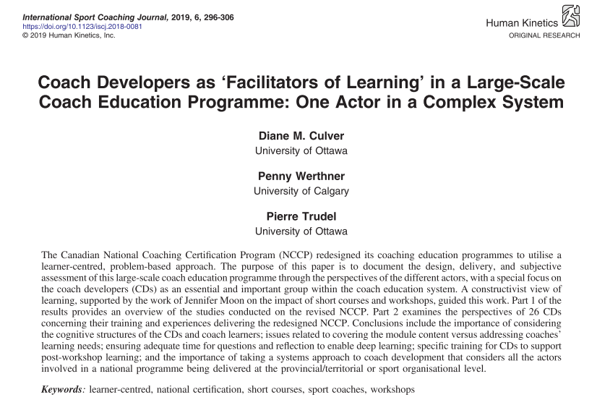
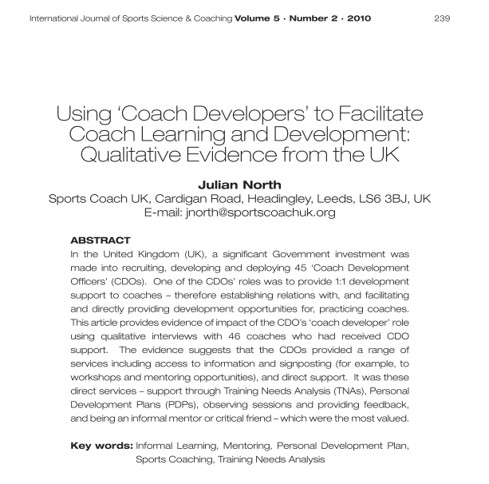
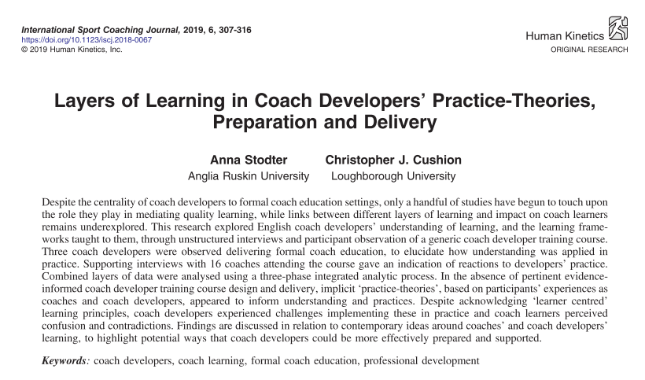
Research into Coach Developer learning

Slide 5
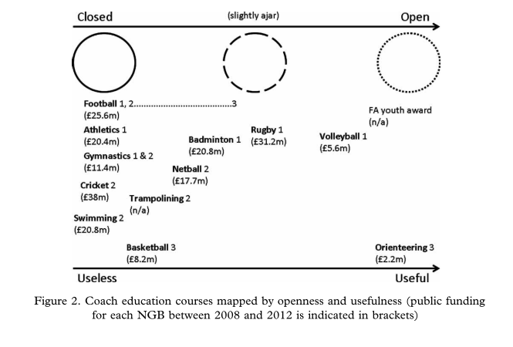
Piggott (2012: 545)

Slide 6
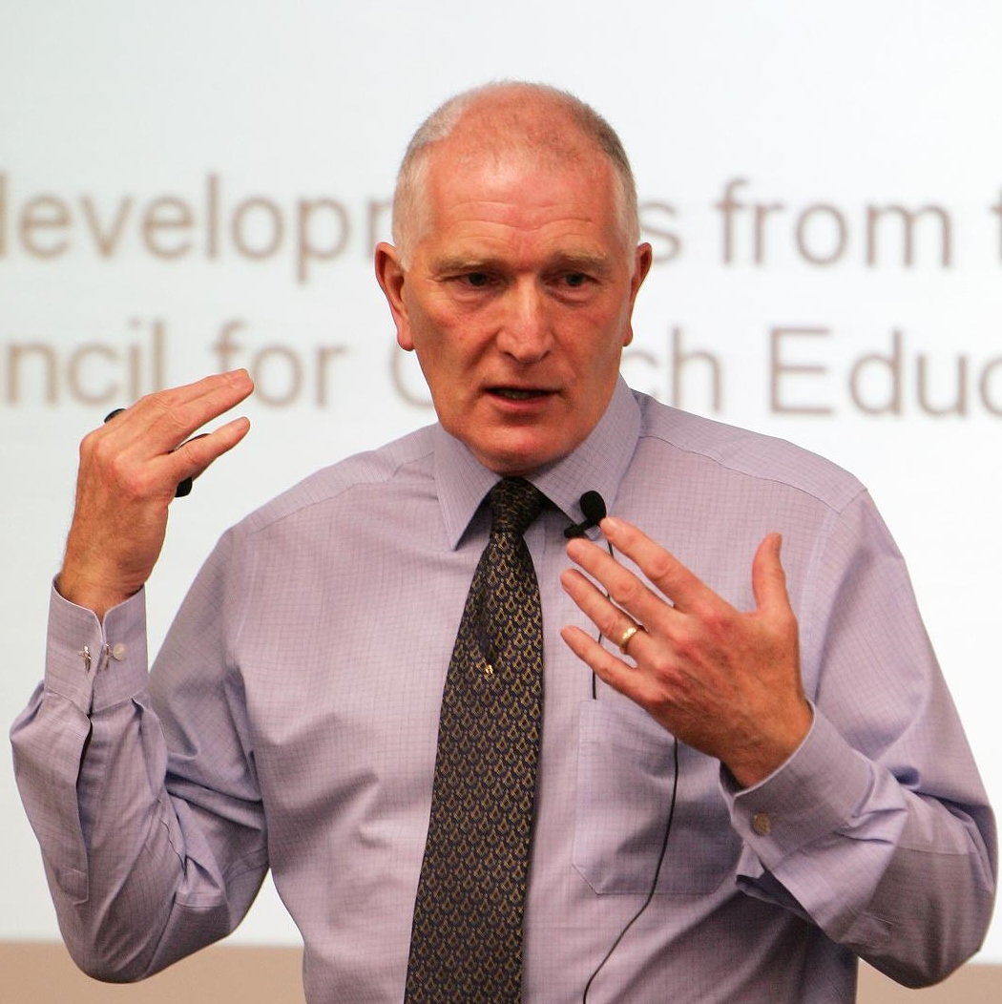
John Lyle (2019) Cluster for Research into Coaching (CRiC) keynote (from 5 hours 15 minutes): https://www.youtube.com/watch?v=ZMYaR9kav9M&t=18885s)
Is it [coaching research] related directly to sport performance and performance outcomes?
In general, coaching research does not feature athlete performance as an outcome
So what?
Does our facilitation/mediation actually help Coach Developers to learn?

Slide 7
Four phases of ‘Wenger-ian’ theory

Slide 8
A social theory of learning: Some key concepts
Community
Where do we belong?
Identity
Who are we becoming?
Meaning
What is our experience?
Practice
What are we doing?
Learning

Slide 9
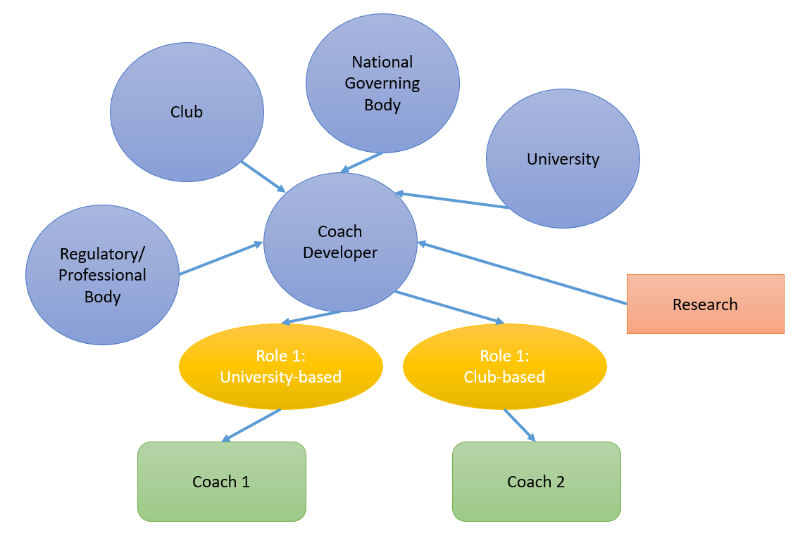
2
A illustration of a Landscape of Practice for a Coach Developer

Slide 10
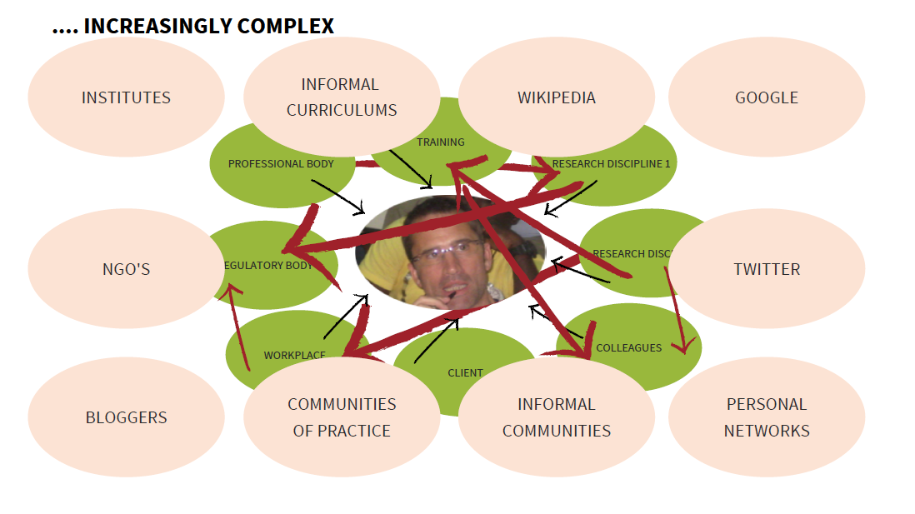

Slide 11
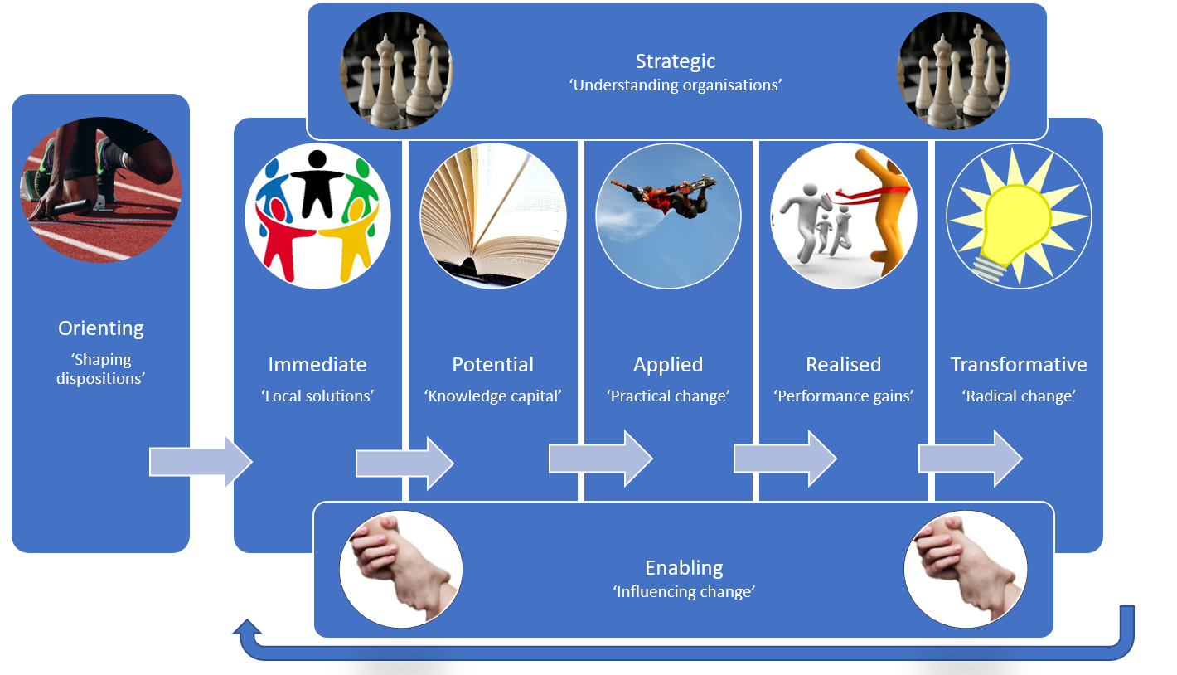

Slide 12
The plan for today…
Explain how we are using particular tools and concepts to help better understand Coach Developer learning
Key learning concepts
Situatedness
Identity
Engagement, alignment and imagination
(Wenger, 1998)
Value Creation Framework
(Wenger-Trayner and Wenger-Trayner, 2015)

Slide 14
Thank you!
Any questions?

Slide 15
Our research
Published
Bradshaw, A., Vinson, D., & Cale, A. (2020). Value creation in the coach developer landscape. Applied Coaching Research Journal, 5, 14-17.
Vinson, D., & Cale, A. (2019). Exploring the nature of the value created through learning support provided to Coach Developers undertaking the Strive programme 2018-19. UK Coaching.
Vinson, D., Cale, A., Christian, P., Huckle, V., Faulkner, C., & Jones, G. (2019). Investigating the value created through a selective talent and performance coach development programme. In C. Corsby & C. Edwards (Eds.), Context and Contingency: Exploring research in sports coaching pedagogy (pp. 73-84). Cambridge Scholars Publishing.
Vinson, D., Huckle, V., & Cale, A. (2020). “I’ve had a magical journey”: Understanding how international sports coaches learn through cross-sport boundary encounters. Sports Coaching Review. https://doi.org/10.1080/21640629.2020.1851934
Current
Identity in Coach Developer learning
Exploring the value created through a coaching and leadership development programme
Understanding learning loops and flows through a non-formal Coach Developer programme
Future (ethics pending)
Investigating the use of the VCF as a planning tool for a multi-sport coach Social Learning Space
Investigating leadership roles and functions in Social Learning Spaces
The role of the facilitator in a decision-making focussed Social Learning Space
Please see: https://eprints.worc.ac.uk/view/author/Vinson=3ADon=3A=3A.html

Slide 16
References
Culver, D. M., Werthner, P., & Trudel, P. (2019). Coach Developers as ‘Facilitators of Learning’ in a large-scale coach education programme: One actor in a complex system. International Sport Coaching Journal, 6(3), 296-306. https://doi.org/10.1123/iscj.2018-0081
North, J. (2010). Using ‘coach developers’ to facilitate coach learning and development: qualitative evidence from the UK. International Journal of Sports Science and Coaching, 5(2), 239-256. https://10.1260/1747-9541.5.2.239
Piggott, D. (2012). Coaches' experiences of formal coach education: A critical sociological investigation. Sport, Education and Society, 17(4), 535-554. https://doi.org/10.1080/13573322.2011.608949
Stodter, A., & Cushion, C. J. (2019). Layers of learning in Coach Developers’ practice -theories, preparation and delivery. International Sport Coaching Journal, 6(3), 307-316. https://doi.org/10.1123/iscj.2018-0067
Wenger, E. (1998). Communities of Practice: Learning, meaning, and identity. Cambridge University Press.
Wenger-Trayner, E., & Wenger-Trayner, B. (2015). Learning in a Landscape of Practice: A framework. In E. Wenger-Trayner, M. Fenton-O'Creevy, S. Hutchinson, C. Kubiak, & B. Wenger-Trayner (Eds.), Learning in Landscapes of Practice (pp. 13-29). Routledge.

