Slide 1
The Football Association and game-based approaches to coaching
Dr Don Vinson, Dr Andy Cale, Michelle Morgan, Harley-Jean Simpson, Sam Richardson and Stephen Harvey
TGfU Virtual Pre-Conference Symposium - 7th June 2021

Slide 2
Context
Football Association (FA) coaching awards = 30,000 coaches each (normal) year
Majority focused on ‘grassroots’ football (i.e., outside of the 92 professional clubs)
Level 1, Level 2, UEFA ‘B’ Licence etc.,
Advanced Youth Award and Primary/Secondary Teachers’ Awards.
Playmaker (https://thebootroom.thefa.com/learning/qualifications/the-fa-playmaker)
Football Association launched ‘DNA’ in 2014
Revised coaching and playing philosophy
DNA necessitated revision of all formal coach education curricula (Football Association, 2015)
DNA - call to adopt games-based approaches as the predominant method of coaching practice
Substantial revision of the FA’s coach education courses
FA’s tutor workforce also required substantial (re)training (Football Association, 2015).
Research has frequently reported a lack of understanding of theoretical underpinnings, pedagogical principles and practical implications
(e.g., Evans, 2012; Kinnerk et al. 2019).
No investigation has explored coach educators’ (i.e. the FA’s tutor workforce) knowledge of games-based practice

Slide 3
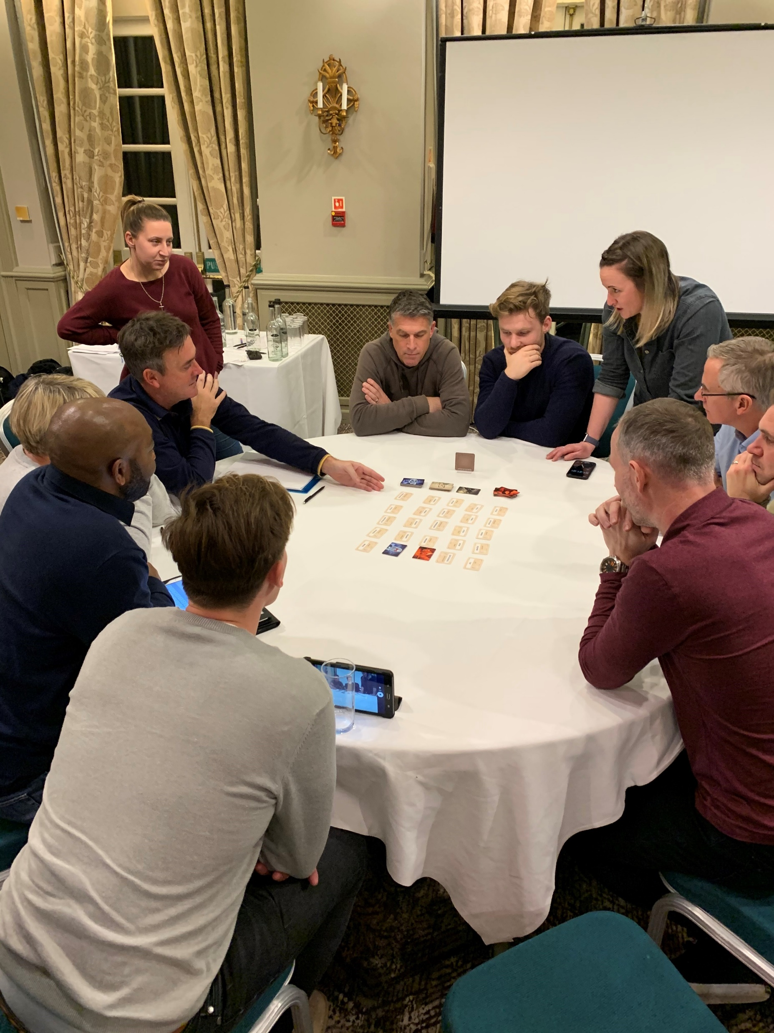
Research Questions and Methods
Research questions
What are FA grassroots tutors’ beliefs and practices concerning game-based approaches to coaching?
To what extent are FA grassroots tutors’ beliefs and practices about game-based practice congruent across the workforce?
Methods
Two-day ‘CPD’ event
Pre-day online survey
38/72 responses; 32 males, 6 female
Mean age = 42.13 ± 9.13 years
Mean years as FA tutor = 10.84 ± 8.01 years
Professional discussions
6 groups = 36 discussions (consensus)
+1 ‘support’-focussed discussion

Slide 4
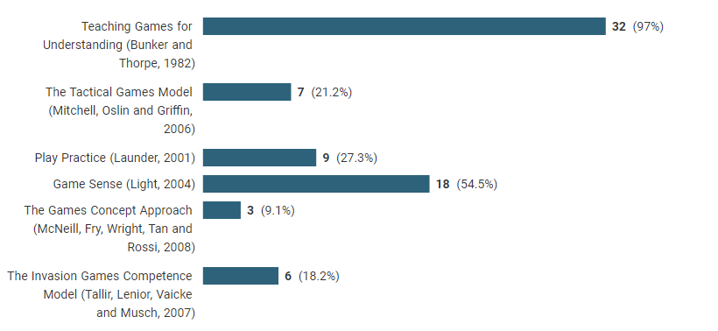
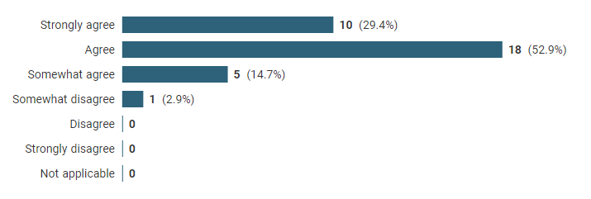
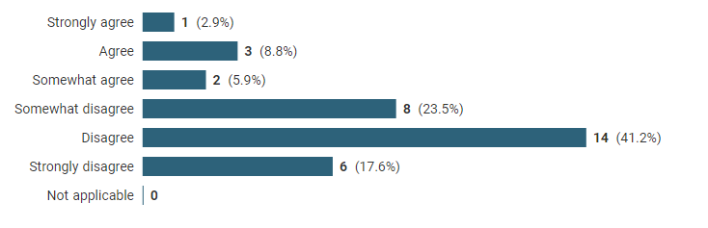
Figure 1: Familiarity with the term ‘game-based approach’
Figure 2: Recognition of named approaches
Figure 3: Provides opportunities of players to discuss and debate their own strategies
Figure 4: Agreement with ‘I primarily use drills to allow players to refine their skills’

Slide 5
Consensus
We need greater consistency of language and understanding of game-based approaches across courses and workforce. Grey areas are okay, as long as we understand them.
We need the leadership of FA Education to show our direction of travel in terms of game-based approaches
We want the best for each individual learner. The focus on the end-user (players) should be retained.
Game-based approaches are a valuable and essential part of the ‘offer’
We should be ‘brave and bold’ about our beliefs surrounding game-based approaches
Learner ownership and empowerment are important concepts

Slide 6
Support
We need clarity on what game-based approach means to the FA and guidance on common terminology
Greater direction in the future of FA coach education and bravery to say ‘this is what we believe in’.
Alignment in course design, delivery and assessment
Utilize internal expertise within grassroots department concerning game-based approaches
We need to better understand Active Learning
Better understanding of working with adult learners
FA Education ‘steering group’ – all teams and levels represented

Slide 7
References
Evans, J. R. (2012). Elite rugby union coaches; Interpretation and use of Game Sense in New Zealand. Asian Journal of Exercise and Sports Science, 9(1), 85-97.
Kinnerk, P., Harvey, S., Kearney, P., MacDonncha, C., & Lyons, M. (2019). An investigation of the self-reported practice activities and session sequencing of inter-county Gaelic football coaches. International Sport Coaching Journal, 6(2), 211-219. https://doi.org/10.1123/iscj.2018-0090
The Football Association. (2015). Developing the developers. The Football Association.

