Slide 1
The UN SDGs: A cause for courageous hope?

Slide 3
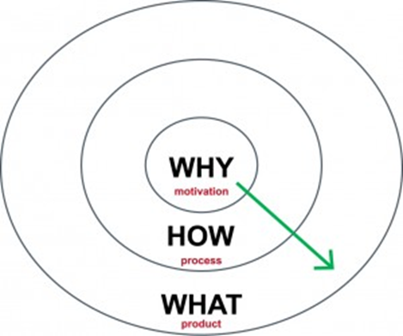

Slide 5
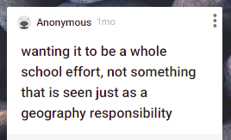
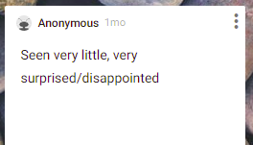
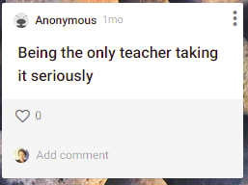
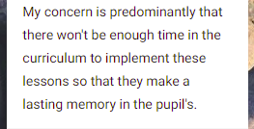
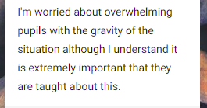
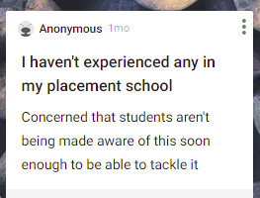
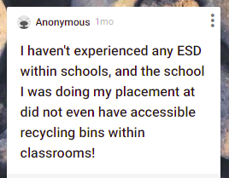
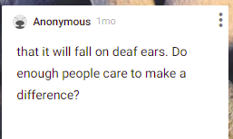
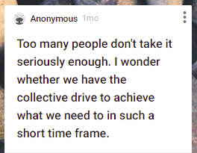
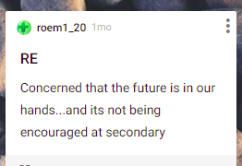
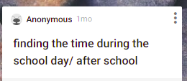

Slide 6
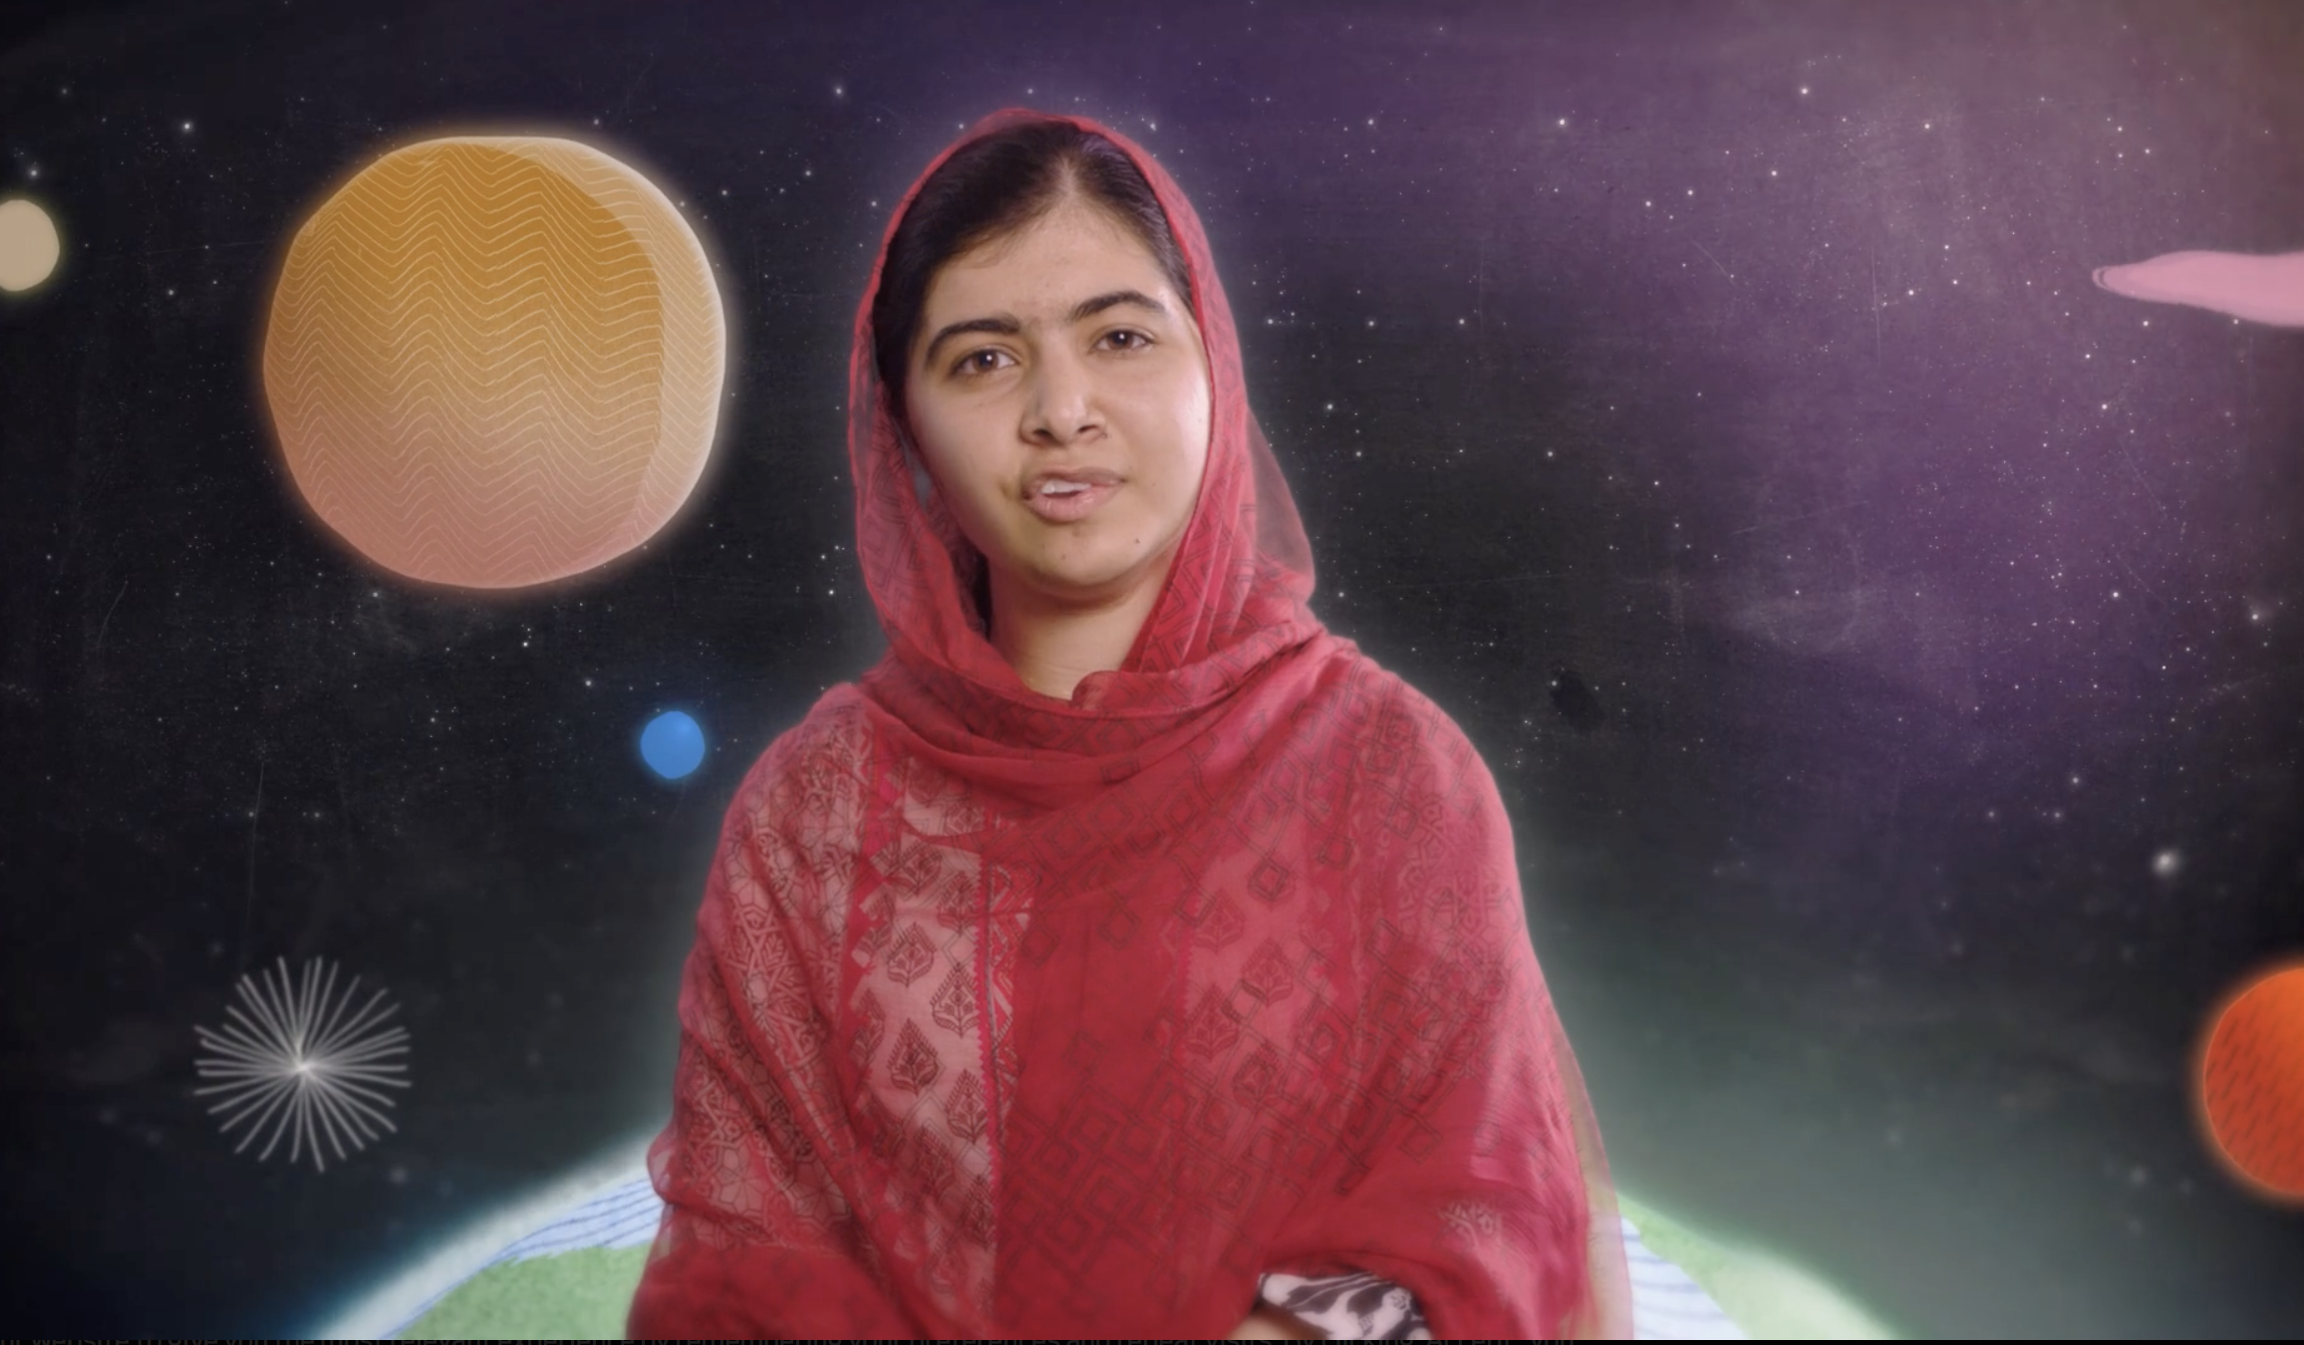
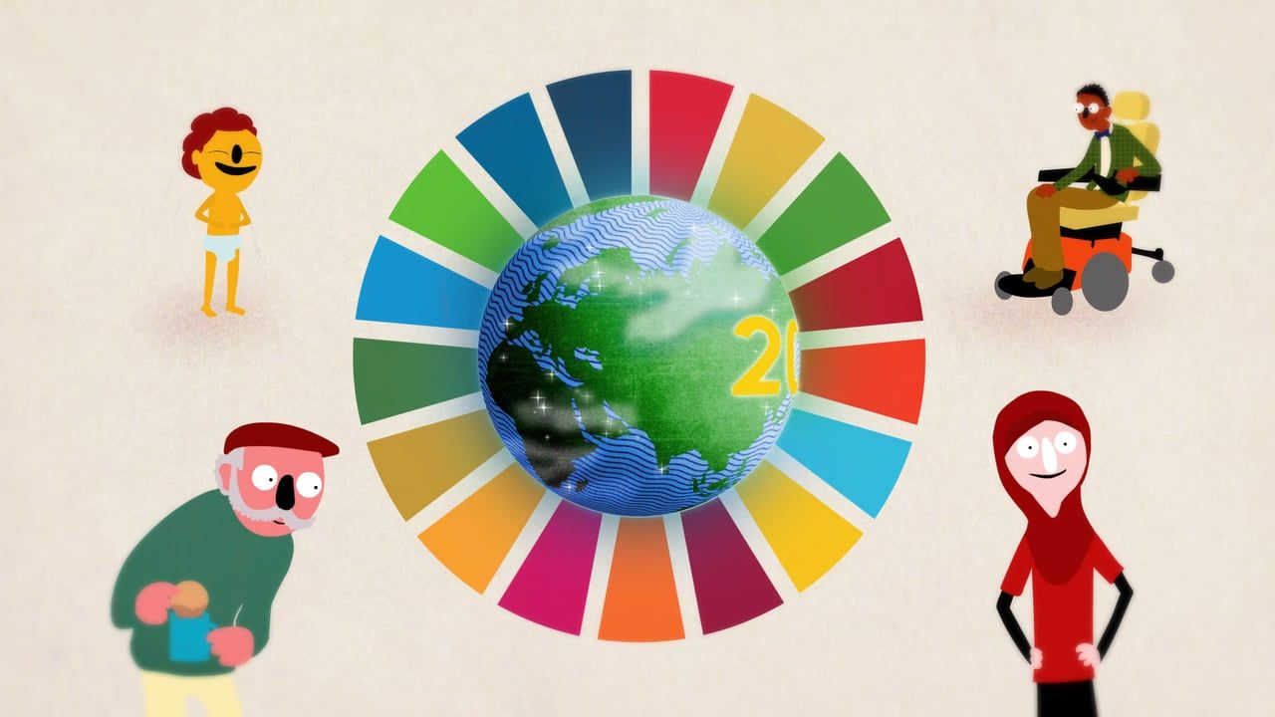

Slide 7
4.7 by 2030 ensure all learners acquire knowledge and skills needed to promote sustainable development, including among others through education for sustainable development and sustainable lifestyles, human rights, gender equality, promotion of a culture of peace and non-violence, global citizenship, and appreciation of cultural diversity and of culture’s contribution to sustainable development

Slide 10
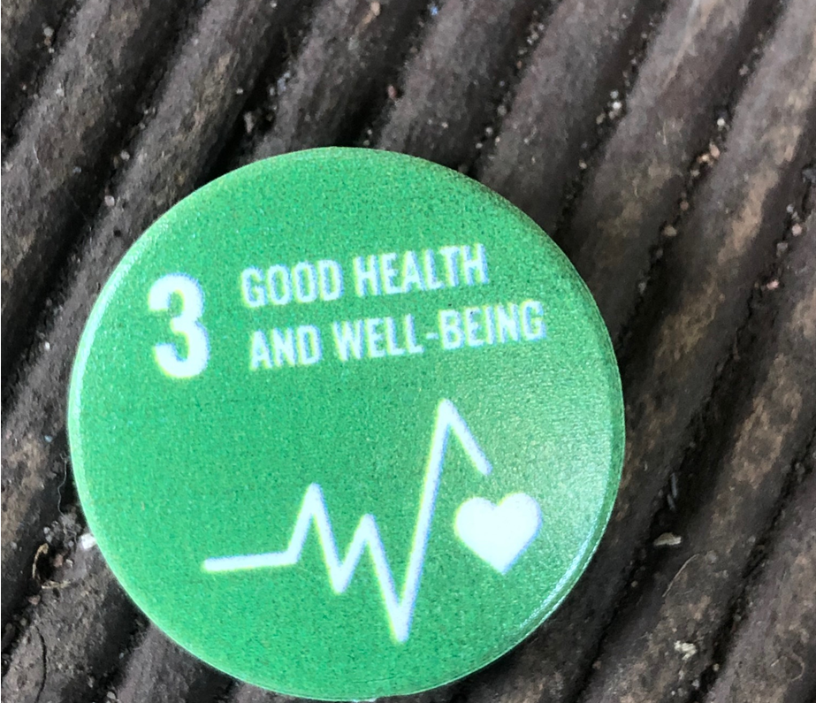
How can you ‘Move the World’?

Slide 11
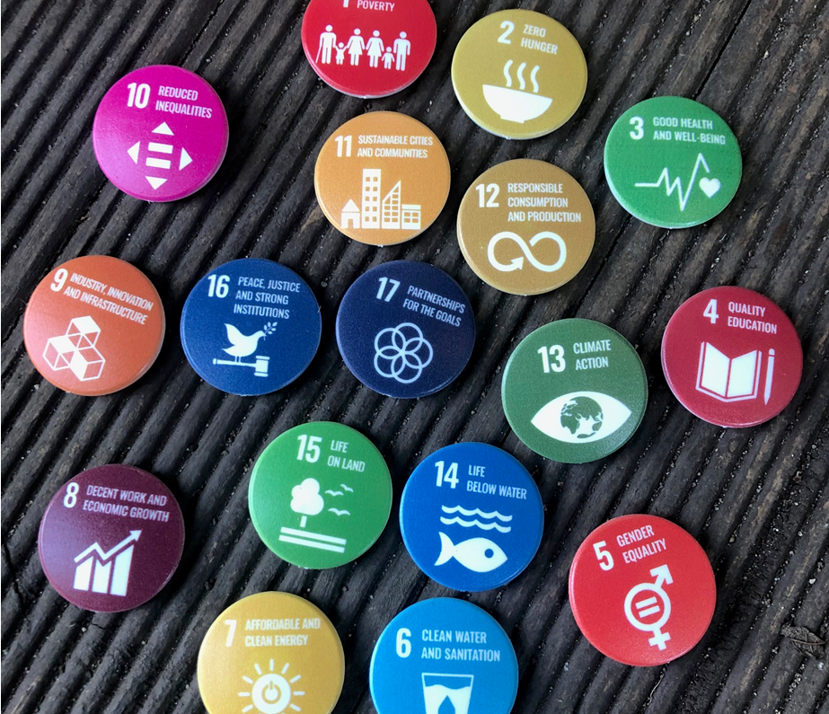
Associated resources
SDG teaching resource and suggested activity
A2 Wall ‘Year group/Key stage’ Posters
A3 ‘Classroom’ posters
Pin badges
A5 goal certificates with related SDG case study facts
Notes:
The badge supplier is Silk Group https://silk-group.com/services/branded-merchandise/ they have an Eco range which where we purchased the badges from https://www.gogreenpromotions.co.uk/recycled-badges-gg0156b.html
They are 100% recycled plastic made in the UK

Slide 12
Democracy in the development of a climate emergency curriculum for initial teacher education
Advance HE – Sustainability Symposium:
Facing forward with sustainability – principles, progress and partnership
@Elengthorn
@UW_Sustain
@sosukcharity

Slide 13
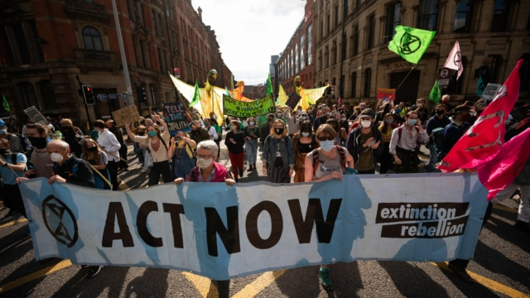
Teachers left without climate change training
92% teachers are concerned about climate change
7 in 10 say they have not received adequate training
5% identifying it as integral to many different aspects of the curriculum and teaching in their school
41% said it was ‘rarely’ or ‘never’ taught in their schools.
17% said climate change is mentioned in subjects outside of science and geography.” (Hazell, 2021)

Slide 14
Politics and climate change:
State level responses to climate change are inherently political.
It is possible & essential that we find democratic solutions

Slide 15
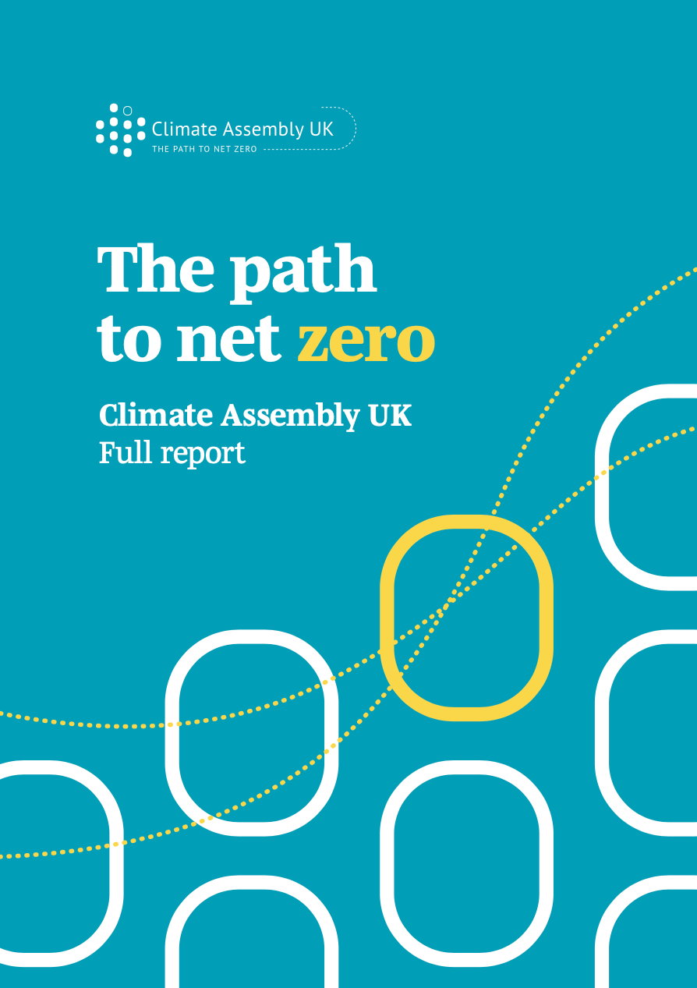
Principle 1 (to underpin the path to net zero):
‘Informing and educating everyone’
“There is a need for information and education for everyone – individuals, businesses, government and others – about climate change and the steps needed to tackle it. It is essential for buy-in to the changes that are needed.”
(UK Government, 2020, p6)

Slide 16
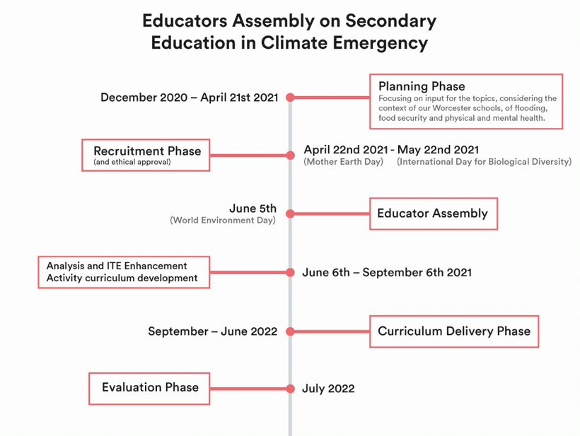

Slide 17
Top tips for embedding ESD: The Super Six!
Pester Power – perseverance is key!
Don’t be disheartened
Use the resources out there to help you
Collaborate with other schools
Keep it contemporary
Record and share it all!

Slide 18
Participation
Commitment
Change
Notes:
Don’t wait to be told
This goes beyond the classroom
Beyond the job
Beyond the pay

Slide 19
“…unparalleled levels of global cooperation”
(Attenborough, 2021)

Slide 20
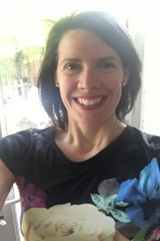
Elena Lengthorn Senior Lecturer Teacher Education e.lengthorn@worc.ac.uk

