Slide 1
International Collaboratory for Leadership in Universally Designed Education
CAST Presentation April 14th, 2021
Notes:
Speaker 1: Richard

Slide 2
Implementing UDL on a Global Scale with INCLUDE
International Collaboratory for Leadership in Universally Designed Education
Richard Jackson (Boston College and CAST) jacksonr@bc.edu
Luigia Nichols (Student Voice Leader) lmnicholas4@gmail.com
Mustapha Aabi (Ibn Zohr University, Agadir, Morocco) m.aabi@uiz.ac.ma
Ashiya Abdool Satar (University of South Africa -- Unisa) satara@unisa.ac.za
Betsy Dalton (First UDL Fellow and Senior Consultant for Dalton Education Services International (DESI) elizabethmdalton@gmail.com
Aashna Khurana (Assessment Associate at ASER Centre) aashna.212@gmail.com
Sean Bracken (University of Worcester (UK)s.bracken.bracken@worc.ac.uk
Notes:
Speaker 1: Richard

Slide 3
Notes:
Speaker 1: Richard

Slide 4
Genesis of INCLUDE
2006-UDL Task Force
2006-UDL Task Force 2007-National UDL Summit in Washington, DC
2009-CAST and Boston College awarded a grant nation’s first postdoctoral UDL Fellows program
September 2019-Dissemination of INCLUDE’s initial concept paper by Jackson & Bracken
October 2019-Official launch of INCLUDE at Royal Roads University
November 2019-acceptance of concept paper establishing INCLUDE within the University of Worcester
December 2019-Establishment of the Steering Committee for INCLUDE Collaboratory
Notes:
Speaker 1: Richard

Slide 5
Notes:
Speaker 3: Mustapha

Slide 6
Notes:
Speaker 3: Mustapha

Slide 7
Notes:
Speaker 3: Mustapha

Slide 8
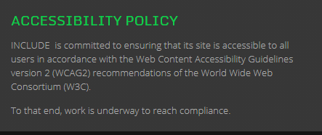
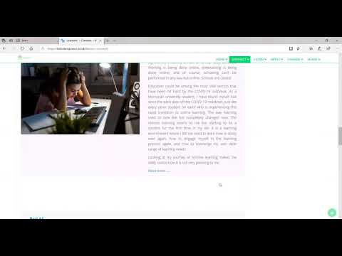
Website (Re)Development
INCLUDE WEBSITE
Ashiya Abdool Satar
University of South Africa (Unisa)
satara@unisa.ac.za
Notes:
Speaker 4: Ashiya
The INCLUDE Website showcases the magnificent work of the transnational collaboratory and its incredible reach through multiple resources from UDL and inclusion experts across the globe. Although the website is committed to ensuring accessible content, it is still a work in progress that is under constant development and redevelopment to promote greater accessibility and inclusion. For instance, we have been working towards creating resources in various formats, such as videos, images with alt text, PDF and Word documents with sections/bookmarks, avoiding tables in the website, using different languages (such as English, French, Swedish, Arabic, etc.). However, despite the immense work towards ensuring accessibility, we still have more work to do to achieve greater compliance to the website content accessibility guidelines. This can be achieved with the collaboration of CAST, which we are looking forward to. In this way, not only will our website showcase content related to context-specific UDL practices in Education across the world, but it will also be an accessible website with content that is accessible to a wider audience.

Slide 9
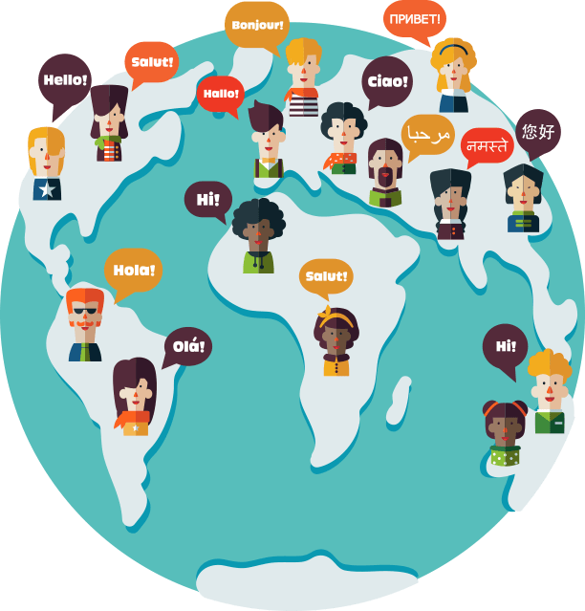
Growth of UDL Interest Around the World
1990: UNESCO World Conference on Education for All - “Every person - child, youth and adult - shall be able to benefit from educational opportunities designed to meet their basic learning needs.”
2020: UNESCO GEM Report on progress toward 2030 Sustainable Development Goals (SDGs) has sixteen specific references to UDL.
“What is UDL?” “How to implement UDL?”
Notes:
Speaker 5: Betsy

Slide 10
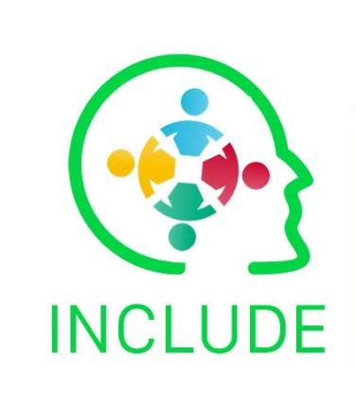
Developing INCLUDE
Key Steps – Year 1
Steering Committee
Website
Network
Webinars
Accessibility training
Collaborative projects
Key Steps – Year 2
Strategic planning
Reorganization of work
Student Voice
Professional Development
Research
Communications
Notes:
Speaker 5: Betsy

Slide 11
Professional Development and Training
International planning team
Monthly blog and webinar series
Organizational collaborations
Courses & training
Masters in UDL
Notes:
Speaker 5: Betsy

Slide 12
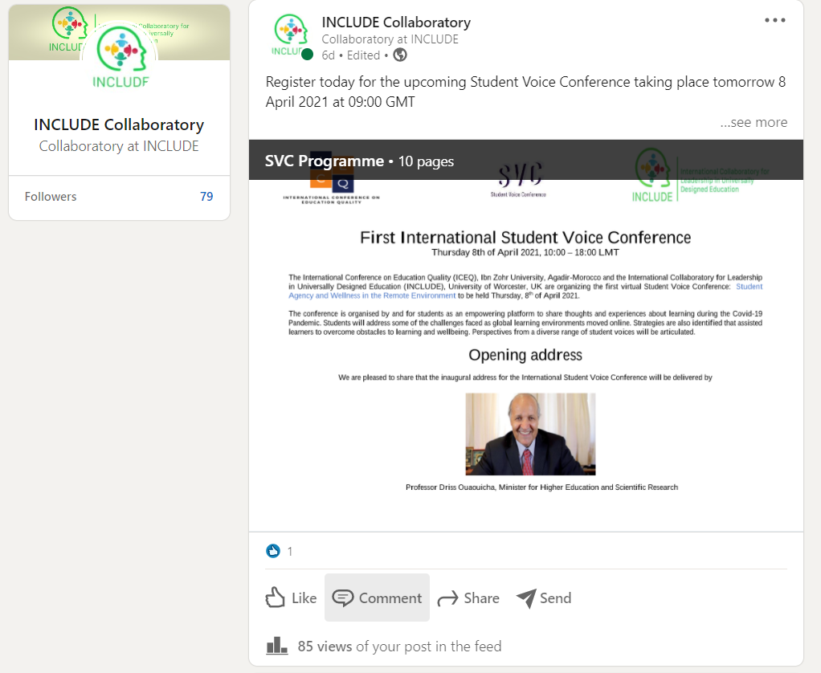
Social Media
Helps us to reach, nurture and engage with our target audience - no matter where they are.
Mainly involves sharing content and information in multiple formats such as videos, tweets for quick read, images on instagram and facebook, etc
Post about upcoming events such as webinars, conferences; blogs; other resources that are posted on website
Announcement of Student’s Voice Conference on LinkedIn
Notes:
Speaker 6: Aashna

Slide 13
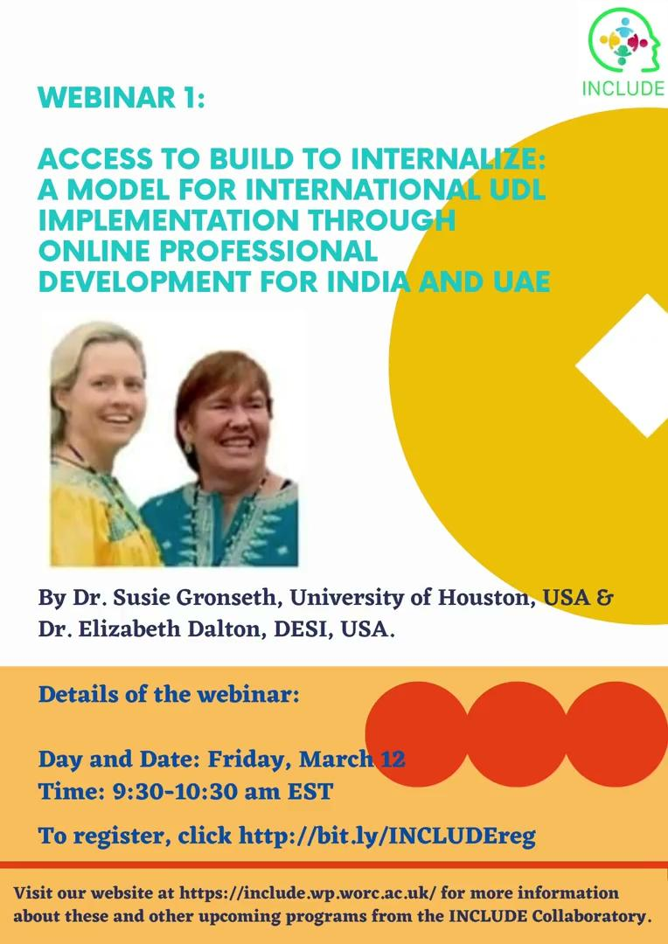
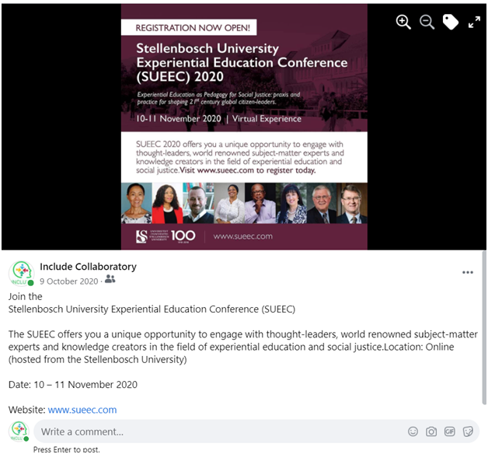
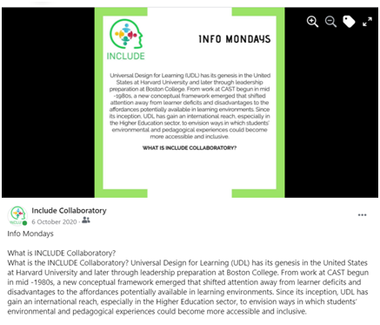
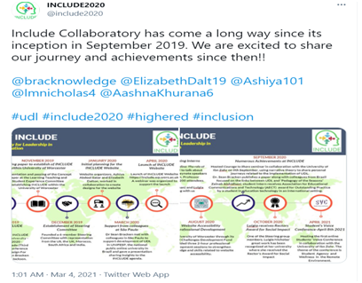
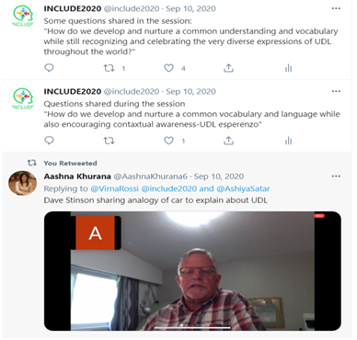
Announcements of Upcoming Webinar and Conferences shared by our members
Weekly facts and general information on UDL
Tweets to share our work, and live tweets during webinars

Slide 14
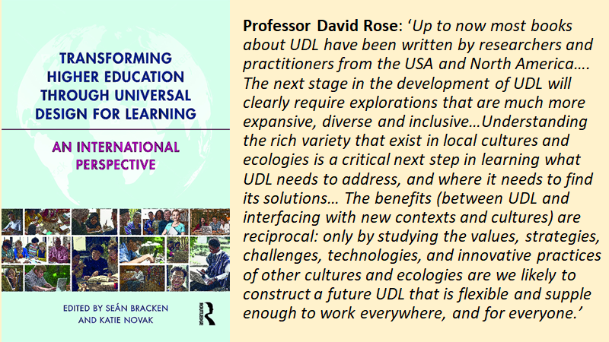

Slide 15
Synthesizing learning within the INCLUDE initiative
We are guided by our action oriented values
Our work is informed by the United Nations Sustainable Development Goals, so we are committed to social justice, as well as to linguistic, social and cultural sustainability
The network has begun to inform policy within and across nations, for example with Learner Voice being brought to the attention of the Minister of Higher Education at our recent Conference in Morocco
Capacity building through collegiate professional development is core
We are developing a transnational clearing house for UDL focused research, for example focused on blended learning and gamification as inclusive learning approaches across disciplines in Higher Education
We are keen to foster facilitative transnational links with organisations such as CAST.
Notes:
Speaker 7: Sean

