Slide 1
Move the World
24th Charney Manor, Primary Geography Conference
‘Opening onto a world of geography’
www.menti.com
73 13 67 1
@ELengthorn
@UW_Sustain
#TeachSDGs

Slide 2
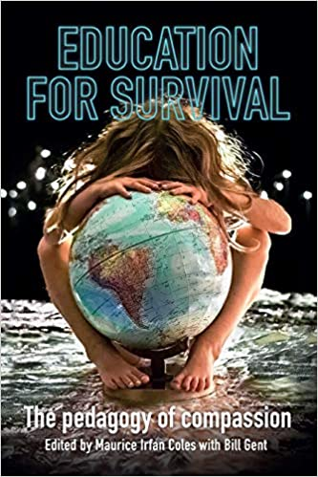
Education for Survival
Section 5: Compassion for Planet
Educational responses
Compassion’s ecological roadmap: Our ‘starter for 10’
Some tips for schools and colleges and their staff
Notes:
Science has spoken again & again. Doing nothing is a death sentence. p139

Slide 3
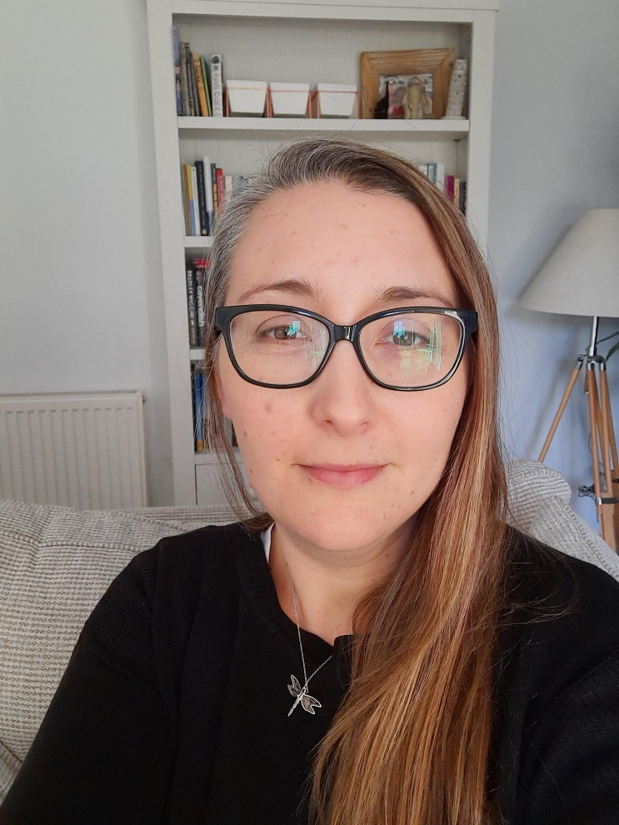
Green Impact 2021
Green Impact is a United Nations award-winning programme designed to support environmentally and socially sustainable practice in your organisation.
“I am nearing the end of a Masters by Research in Biology, looking into dietary fatty acids and biomarkers of cardiovascular health. I did my undergraduate degree in Human Biology at Worcester too, having decided to change my career after the birth of my first son. I had previously worked in graphic design and marketing, and these skills have come in useful in a number of different student job roles, including being a GIPA. If I could combine design AND biology once I leave University, I would be very happy, but I am not sure how to do that!”
GIPA – George Sherrard
@sosukcharity
Notes:
Who has heard of it? Possible to do a poll? – Quick ‘Y’ in the chat poll
Collaboration between staff and students
Green Impact has been delivering change and supporting volunteers to become sustainability innovators across campuses for over 10 years. They recognise that the example that our academic institutions set to our students is fundamental to creating a sustainable future. There are over 60 institutions who have used the model, we have gained experience in tailoring the approach to fit almost any kind of university.
Universities and Colleges
A bespoke programme for universities and a national programme for colleges to support staff and students to take impactful actions towards sustainability. This goes far beyond the narrow, purely environmental definition of sustainability, helping embed sustainability into the curriculum, enhance the social fabric of institutions and improve the wellbeing of staff. To date they have reached over 60 UK universities, and are developing partnership programmes across Australasia and Europe. From campus grounds, to green procurement, green cleaning.
In the UK, Green Impact was developed by the National Union of Students (NUS) in 2006 and delivered by the sustainability team within NUS. Since 1st October 2019, NUS’ sustainability team became Students Organising for Sustainability (SOS-UK) (Students Organising for Sustainability is a registered charity operating across the UK) in response to the ecological and climate crises to go further and faster with our sustainability work. SOS-UK now deliver Green Impact within the UK, with SOS-International and ACTS delivering our international work.
Hedgehog Friendly Campus
A national biodiversity programme for universities, offering free support to staff and students to make impactful changes for hedgehogs. This programme allows universities to progress through Bronze, Silver and Gold levels, supporting this native species which is currently in severe decline. With a choice of actions including communicating the issues, completing hedgehog surveys and improving green spaces for hedgehogs, there are actions to suit every university. This is a great programme for any urban or rural university and particularly for those who are or have considered declaring a climate and nature emergency.
In 2019, the programme reached 36 universities across the UK and is a partnership between the British Hedgehog Preservation Society and SOS-UK. Contact info@hedgehogfriendlycampus.co.uk for more information and to get involved.

Slide 4
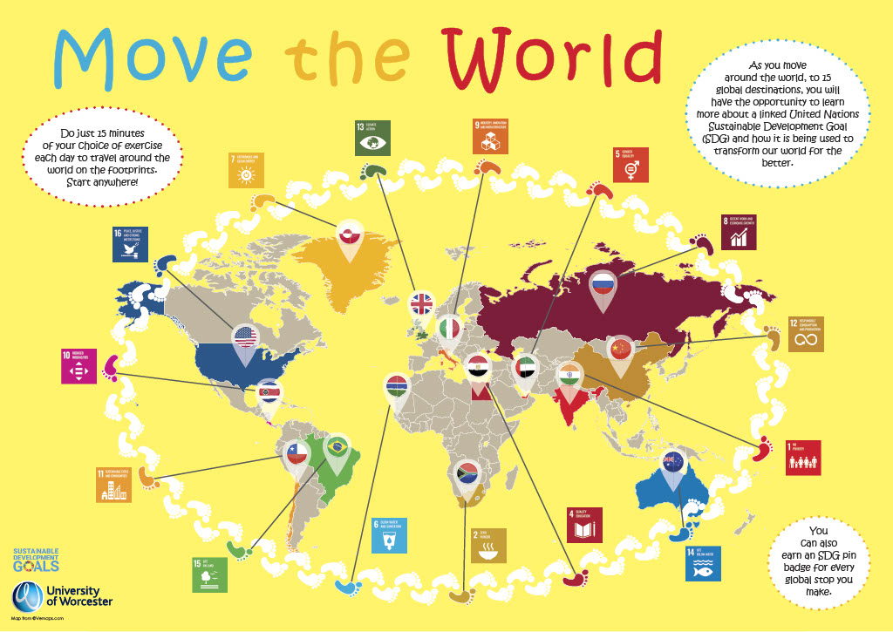

Slide 5
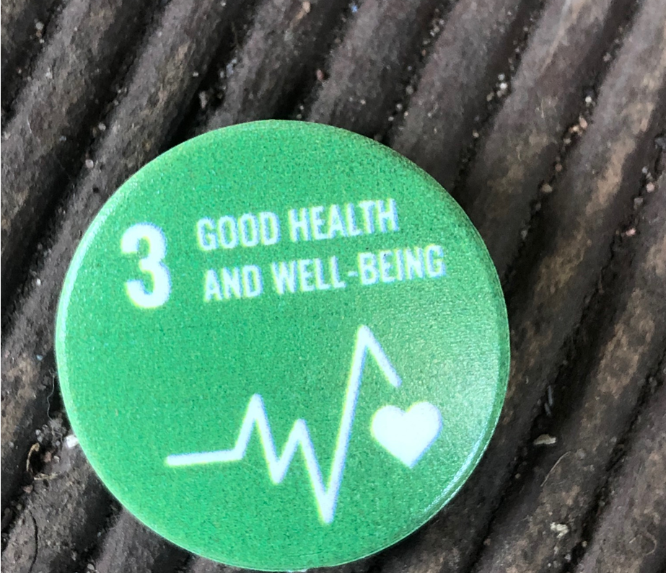
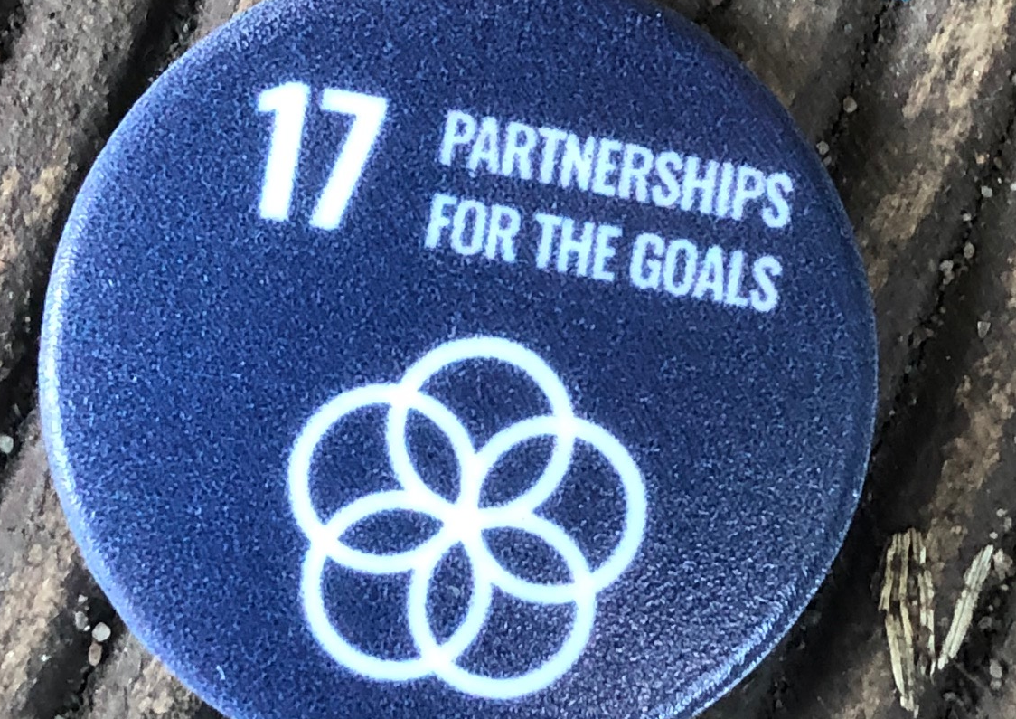
Move the World process

Slide 6
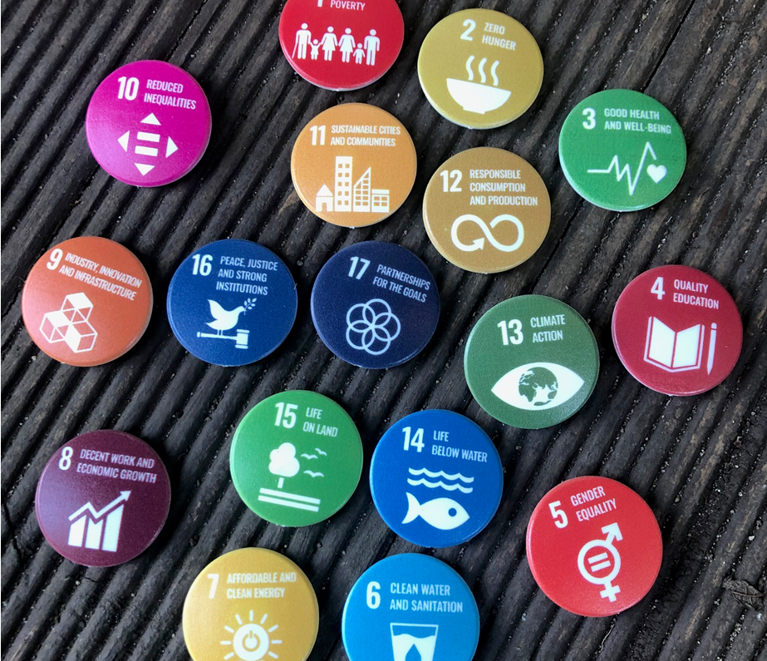
Associated resources
SDG teaching resource and suggested activity
A2 Wall ‘Year group/Key stage’ Posters
A3 ‘Classroom’ posters
Pin badges
A5 goal certificates with related SDG case study facts
Notes:
The badge supplier is Silk Group https://silk-group.com/services/branded-merchandise/ they have an Eco range which where we purchased the badges from https://www.gogreenpromotions.co.uk/recycled-badges-gg0156b.html
They are 100% recycled plastic made in the UK

Slide 7
MENE 2020 report findings
Notes:
Nature connectedness has relatively recently been defined as a measurable psychological construct that describes a person’s relationship with the natural world. It includes aspects related to a person’s affective (emotional) and cognitive relationship to nature and their sense of place in nature (4). So, nature connectedness is very different to simply describing a person’s exposure to or contact with nature. Contact with nature is typically reported through measures like visit frequency, length of visit and visit location. A person’s nature connectedness can change over time and in response to different experiences (rather like a person’s wellbeing can change.) Five pathways to nature connectedness have been described (5) and are already being used to design activities that are effective in increasing people’s nature connection.
With crises in both human and environmental health, there is an increasingly urgent need to better understand people’s connectedness to nature as well as their contact with nature if we are to be able to respond effectively to government ambitions to ‘reconnect people with the natural environment’, including the commitments set out in Government’s 25 Year Environment Plan (10).
Reported pro-environmental behaviours and wellbeing were highest among people who also reported both high visit frequency to natural environments and high nature connectedness. The implication of this is that optimising pro-environmental and wellbeing outcomes is likely to rely on increasing both contact and connection with nature.
Super findings from the MENE report on nature connectedness in adults and children = increased euadaimonic (feeling life is worthwhile) well being/increased pro-environmental behaviours – household and conservation/ drop off with age
Is outdoors in an urban setting enough? A Portuguese study by Loureiro, A. and Veloso, T.J in 2014 ‘Outdoor Exercise, Well-Being and Connectedness to Nature.’ suggested that the outdoor location was beneficial regardless, suggesting that even looking at images of nature during exercise was beneficial!

Slide 8
A call out to our critical geography friends!
Thoughts on ‘outdoor’ exercise?
What problems do you foresee?
Could this work for KS1?
Any recommendations to help keep our primary education colleagues on board?
How would you measure the outcomes?
How about a leader board?
www.menti.com
73 13 67 1
Notes:
Reported pro-environmental behaviours and wellbeing were highest among people who also reported both high visit frequency to natural environments and high nature connectedness. The implication of this is that optimising pro-environmental and wellbeing outcomes is likely to rely on increasing both contact and connection with nature.
Super findings from the MENE report on nature connectedness in adults and children = increased euadaimonic (feeling life is worthwhile) well being/increased pro-environmental behaviours – household and conservation/ drop off with age

Slide 9
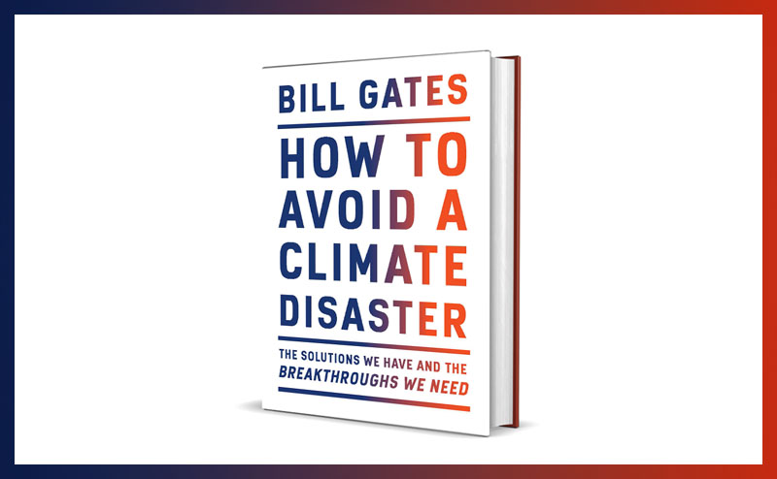
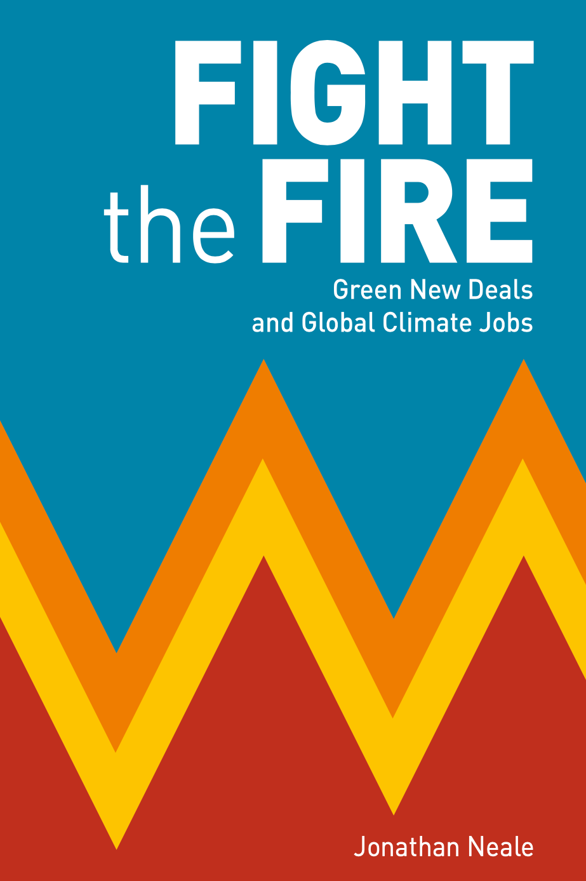
Notes:
https://theecologist.org/fight-the-fire
https://drive.google.com/file/d/1amdmpgll2wGatuwnqt0BK5VCZjXAkjiK/view
The primary audience for this Global
Guidance document is the higher
education community. However, other
educators, NGOs, governments,
employers and youth organizations
will find this document useful for
strategic planning and collaborative
efforts with higher education and each
other.
Climate change is one of their biggest challenges right now.
Low prices for their crops mean that they are struggling to fight back.
Only with more money will they feel equipped to meet their everyday needs and deal with the challenges they face from climate change.
The climate crisis is an immediate and ever-increasing threat and those in climate vulnerable countries are already seeing its impacts from droughts and crop disease to floods, heatwaves and shrinking harvests.

Slide 10
References
Coles, M.I (2020) ‘Education for Survival: Compassion for Planet’ in Coles, M.I and Gent, B. (eds) Education for Survival. The pedagogy of Compassion. Trentham Books, UCL IOE Press.
Loureiro, A. and Veloso, T.J. (2014) Outdoor Exercise, Well-Being and Connectedness to Nature. Psico, 45(3), pp.299-304.Available at: https://www.researchgate.net/publication/268217011_Outdoor_Exercise_Well-Being_and_Connectedness_to_Nature/stats Accessed 25th Feb 2021
MENE, 2020. Nature Connectedness among adults and children in England. Available at: http://publications.naturalengland.org.uk/publication/6005041314136064 Accessed 25th February 2021
NUS, 2021. Green Impact. SOS. Available at: http://greenimpact.nus.org.uk/ Accessed 25th February 2021
Notes:
https://www.childresearch.net/papers/playing/2013_01.html

Slide 11
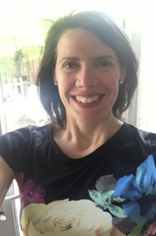
Elena Lengthorn Senior Lecturer Teacher Education e.lengthorn@worc.ac.uk

